Slide 1

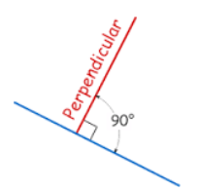

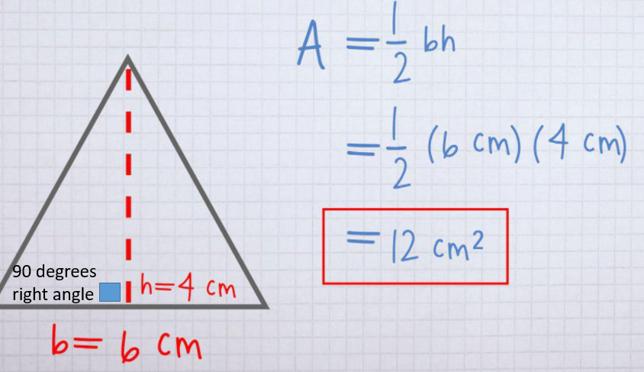

Mathematics
Date: 08.02.21
Area of a Triangle

Slide 2
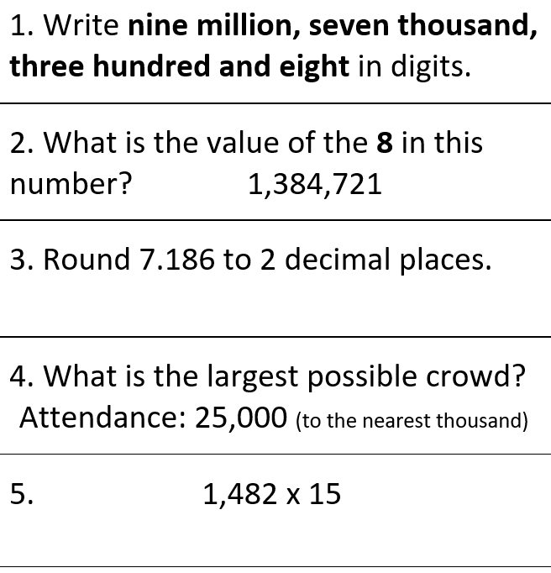
Starter Activity

Slide 3

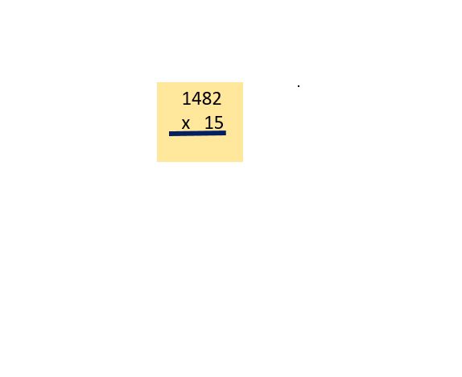
Long Multiplication
Please click on the audio to get some help to solve this if needed

Slide 4

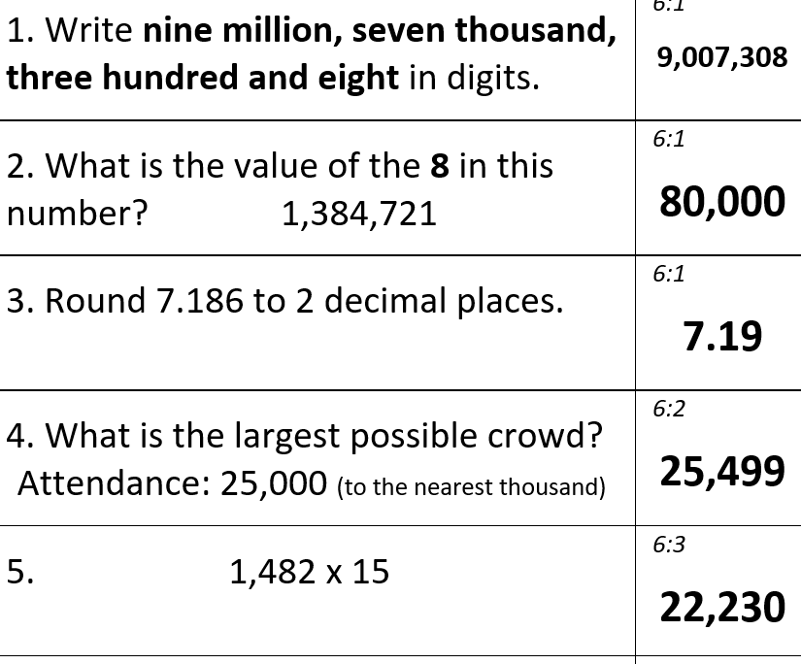
Starter Activity

Slide 5

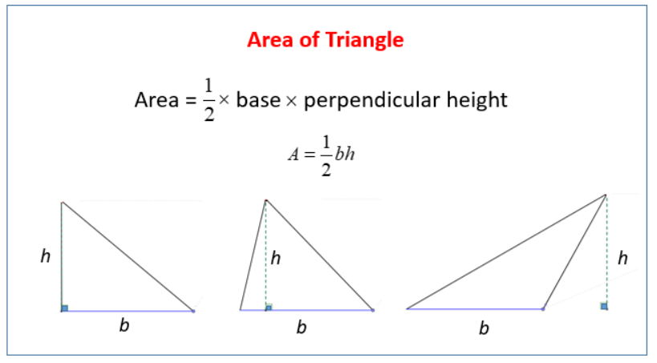

Slide 6
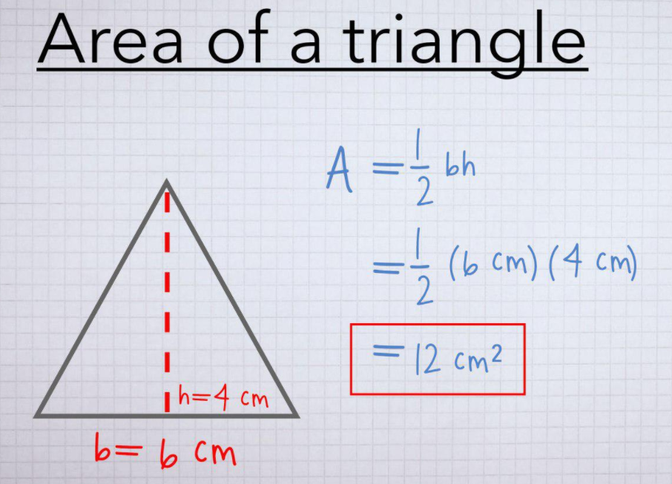
Step 1. (Base x height)
Step 2. divided by 2
90 degrees
right angle

Slide 7
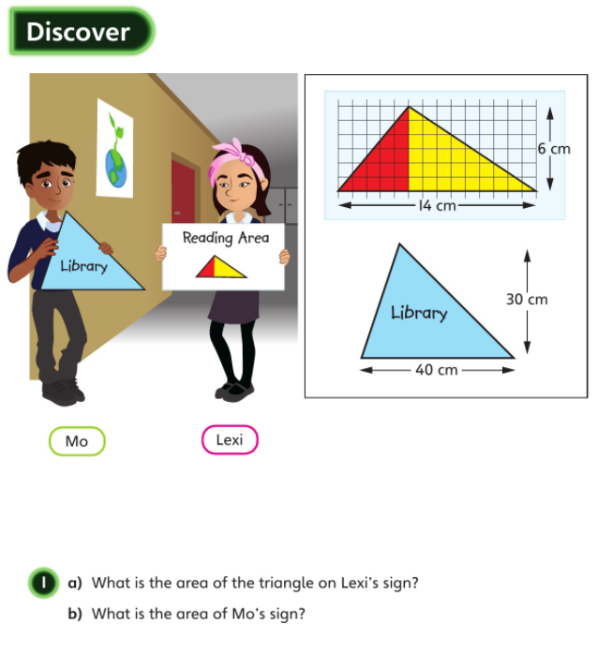


perpendicular height
base

Slide 8
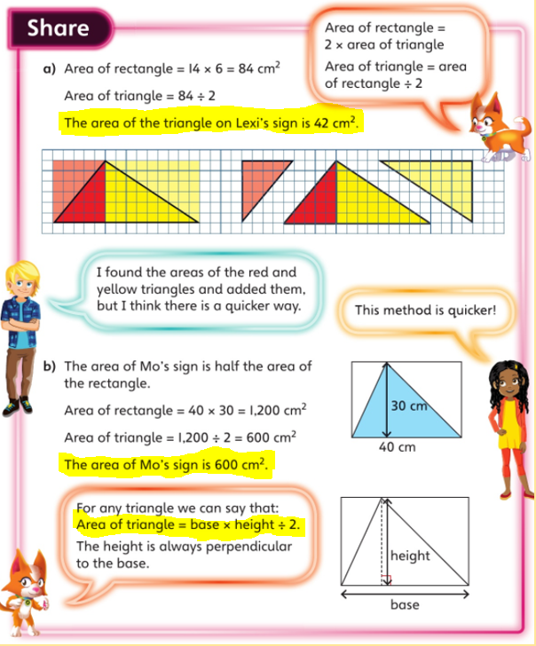
2 different methods shown here

Slide 9
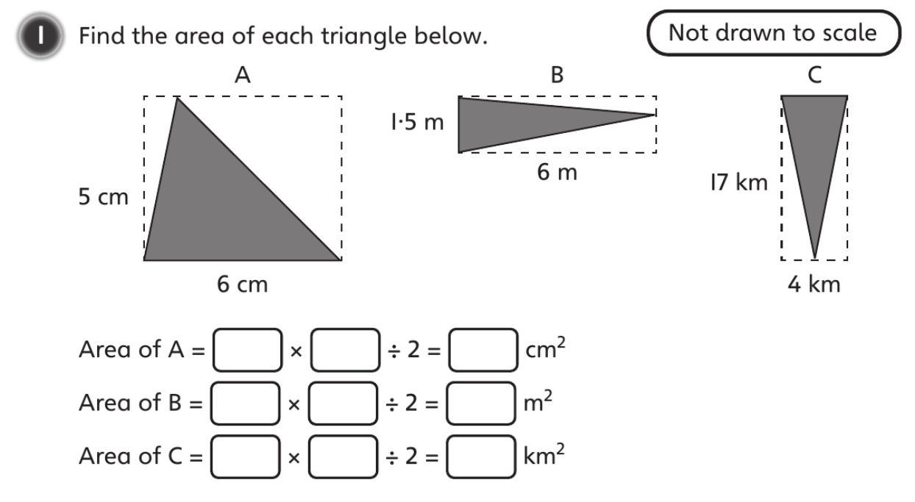

height
Base
Step 1. (Base x height)
Step 2. divided by 2

Slide 10
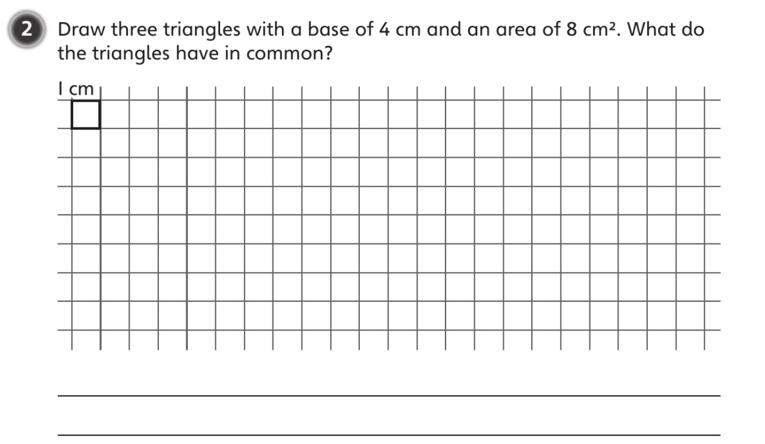

Slide 11
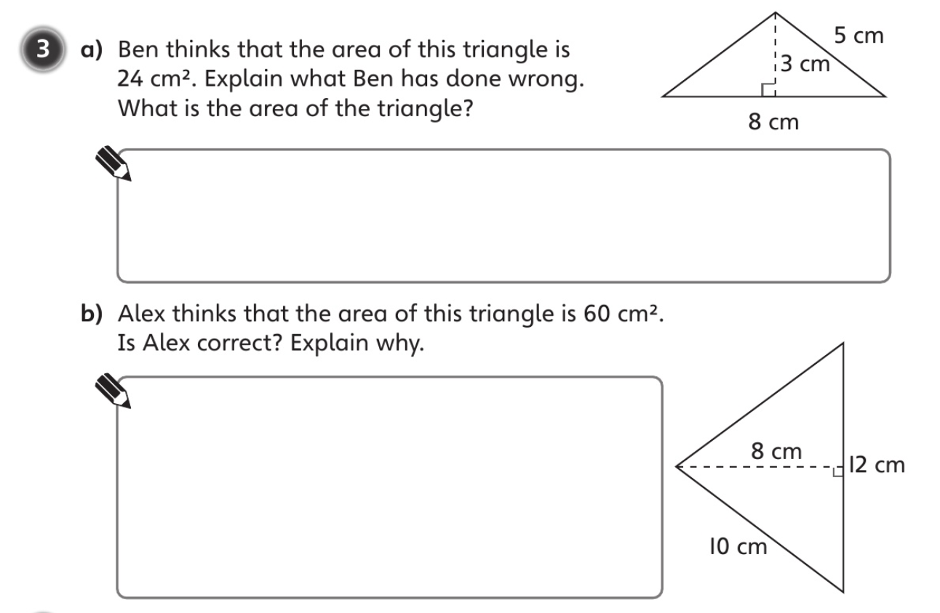

Slide 12
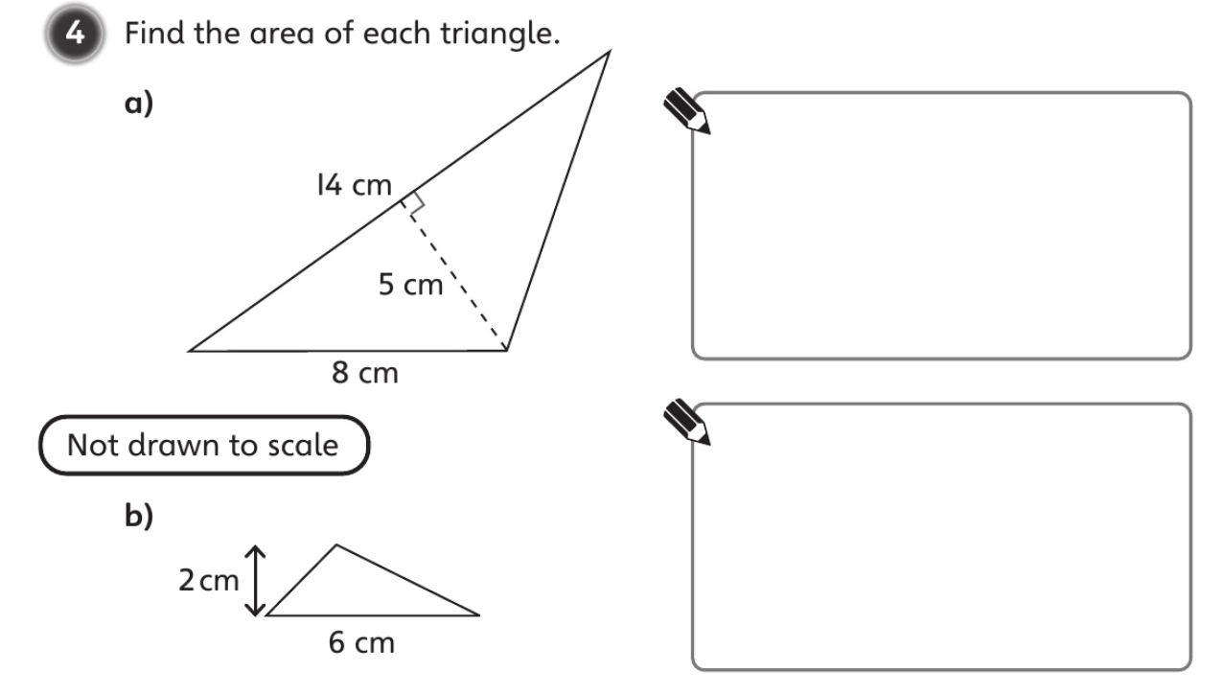

Slide 13
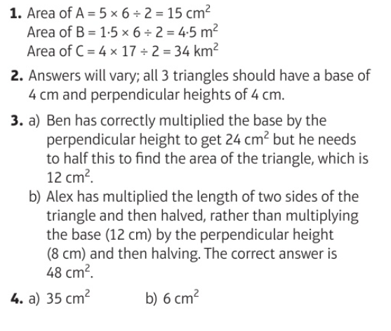

Slide 14
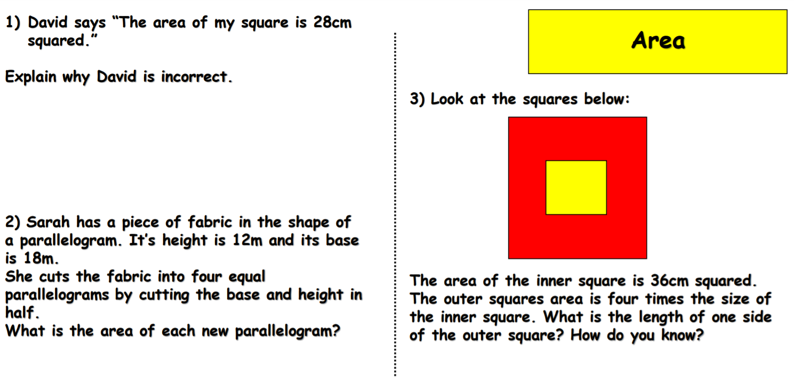
Challenge

Slide 15
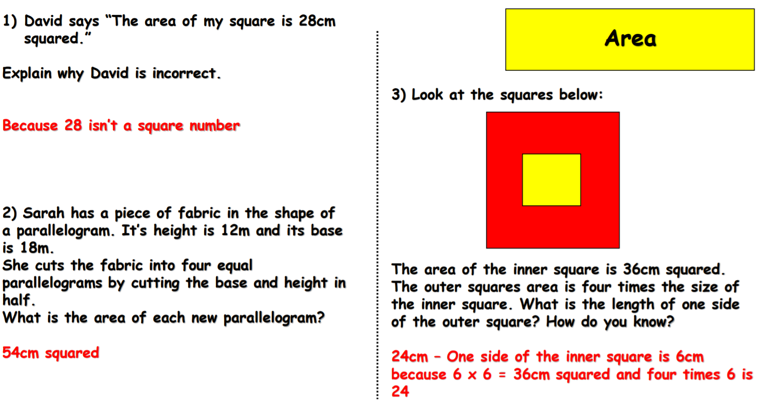
Challenge

