Slide 1


English
Date: 08.02.21
Week 6 – Lesson 1
Hansel and Gretel

Slide 2
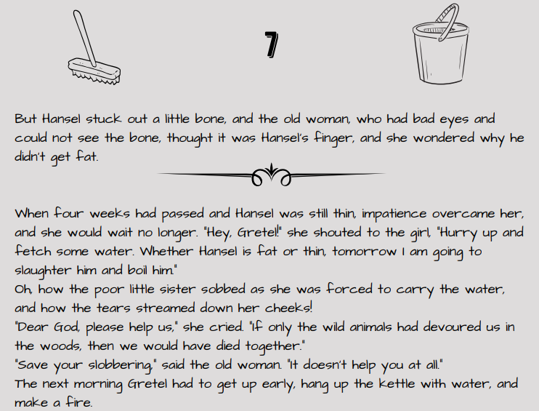

Read pages 7, 8 and 9 of Hansel and Gretel or click on the sound button to hear it being read to you.
The text is also attached to our blog if you want to open or print it this way.

Slide 3
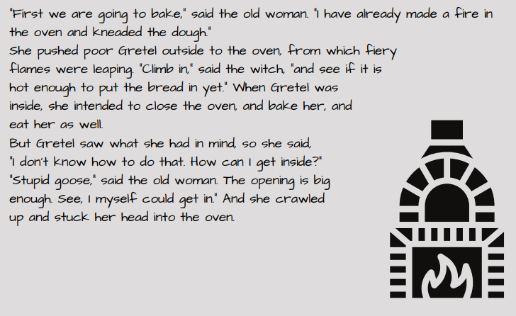
Read pages 7, 8 and 9 of Hansel and Gretel or click on the sound button to hear it being read to you.
The text is also attached to our blog if you want to open or print it this way.

Slide 4
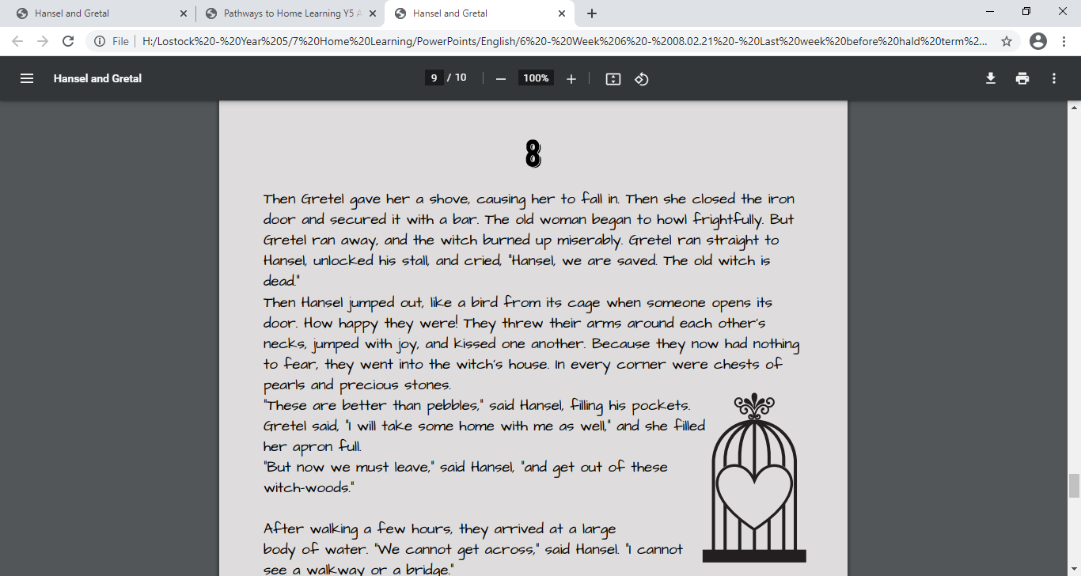
Read pages 7, 8 and 9 of Hansel and Gretel or click on the sound button to hear it being read to you.
The text is also attached to our blog if you want to open or print it this way.

Slide 5
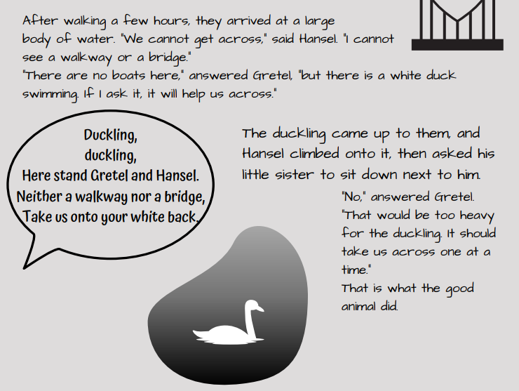
Read pages 7, 8 and 9 of Hansel and Gretel or click on the sound button to hear it being read to you.
The text is also attached to our blog if you want to open or print it this way.

Slide 6
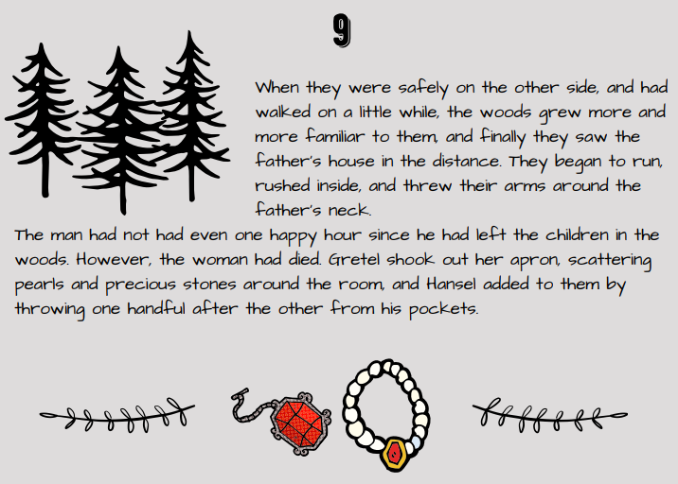
Read pages 7, 8 and 9 of Hansel and Gretel or click on the sound button to hear it being read to you.
The text is also attached to our blog if you want to open or print it this way.

Slide 7
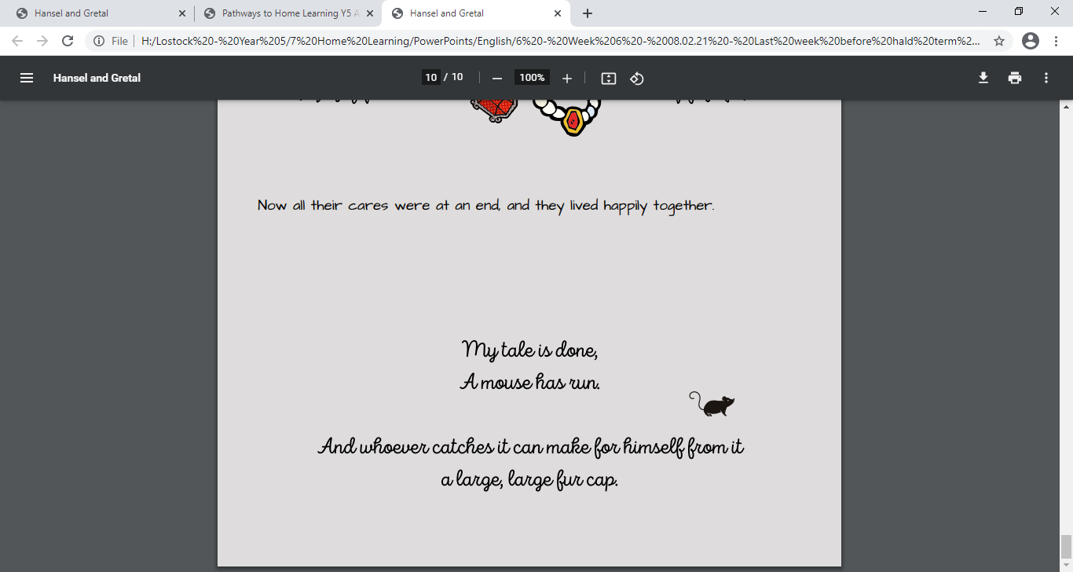
Read pages 7, 8 and 9 of Hansel and Gretel or click on the sound button to hear it being read to you.
The text is also attached to our blog if you want to open or print it this way.

Slide 8
Click on the sound button to hear this slide read to you.
Quick fire questions:
Think about/discuss the ending of the story:
How did it work out for each character?
Was it fair?
Why/Why not?

Slide 9

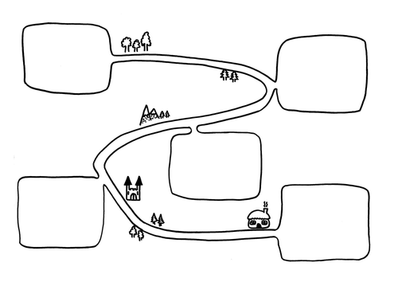
Activity 1:
Click on the sound button to hear activity 1 read to you.
Today we are going to be summarising the main events in the Hansel and Gretel story. We will be creating a timeline or journey map to show the main events.
You may need to go back and read the whole story again (or at least scan the text) so I have uploaded it to our blog this morning.
TASK:
Draw your own forest journey map or timeline and plot each of the main events from the whole Hansel and Gretel story on it.
Do not write more than twelve events and keep words to a minimum.
Remember your events must be in chronological order.

Slide 10
WAGOLL
(What A Good One Looks Like)
Click on the sound button to hear this slide read to you.
Hansel and Gretel were poor
They got home following stones
Dad and Stepmother took them into the forest and left them
Don’t forget to have the Hansel and Gretel text open in front of you to retrieve the main events from – it is attached to our blog today.

Slide 11
Click on the sound button to hear activity 2 read to you.
Activity 2 (Optional):
Retell an oral version of the story using your timeline or journey map to an adult in your house, or you could record a video of yourself retelling it to share with me on school spider.
Try to add in exciting fronted adverbials to your re-tell in order to make it more exciting.
For example:
Once upon a time,
The next day,
After a while,
Suddenly,
Remember to use appropriate tone and intonation.

Slide 12



