Slide 1

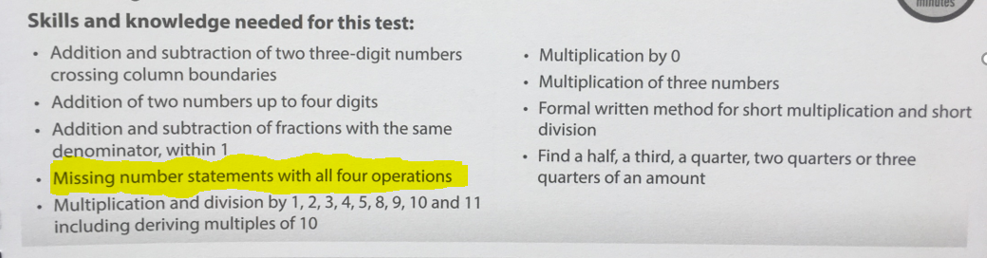

Spring Arithmetic 3
648 + 186 =
1549
+1464
2/6 + 3/6 = ?/6
Times tables
89 x 0 = 0
½ of 30 = 2/4 of 30 =
https://www.topmarks.co.uk/

Slide 2



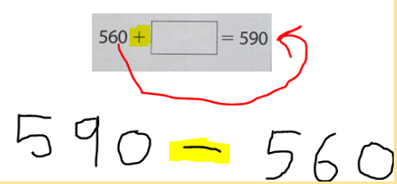
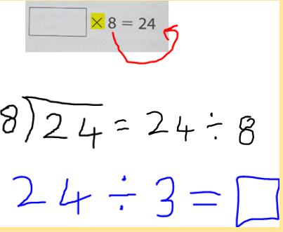
Missing Box problems
e.g.
https://www.topmarks.co.uk/number-facts/number-fact-families

Slide 3

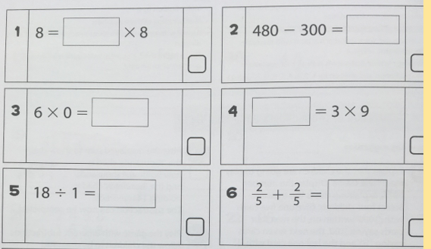

Slide 4
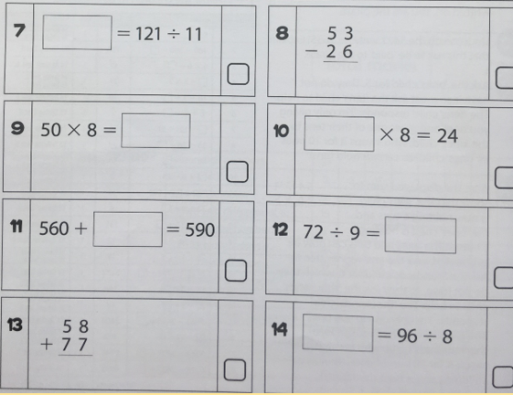

Slide 5
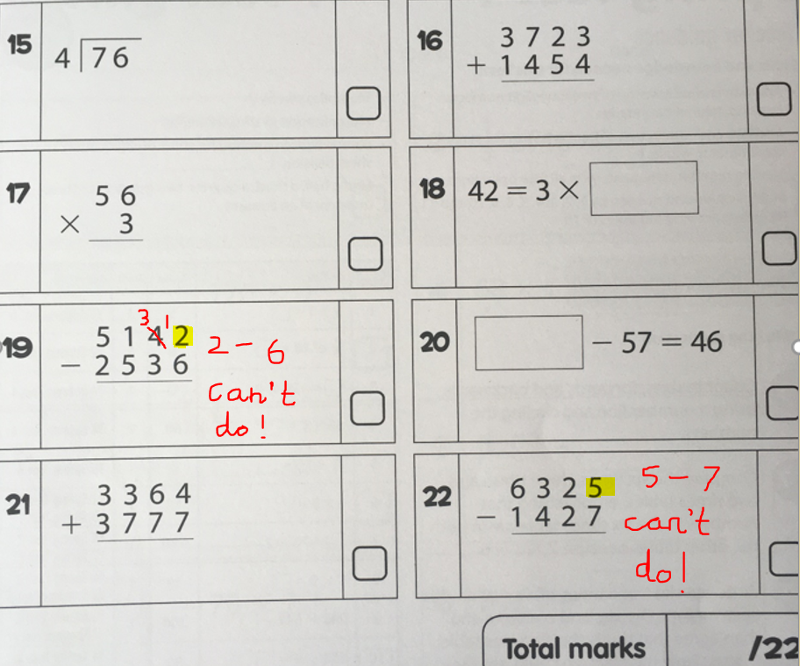

Slide 6
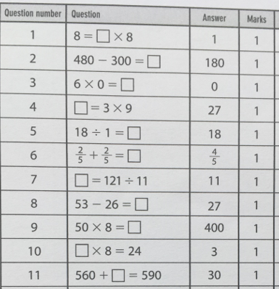


Slide 7

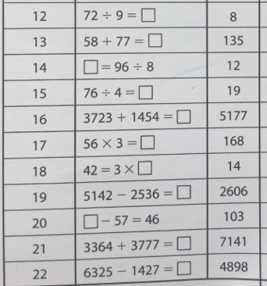

Slide 8
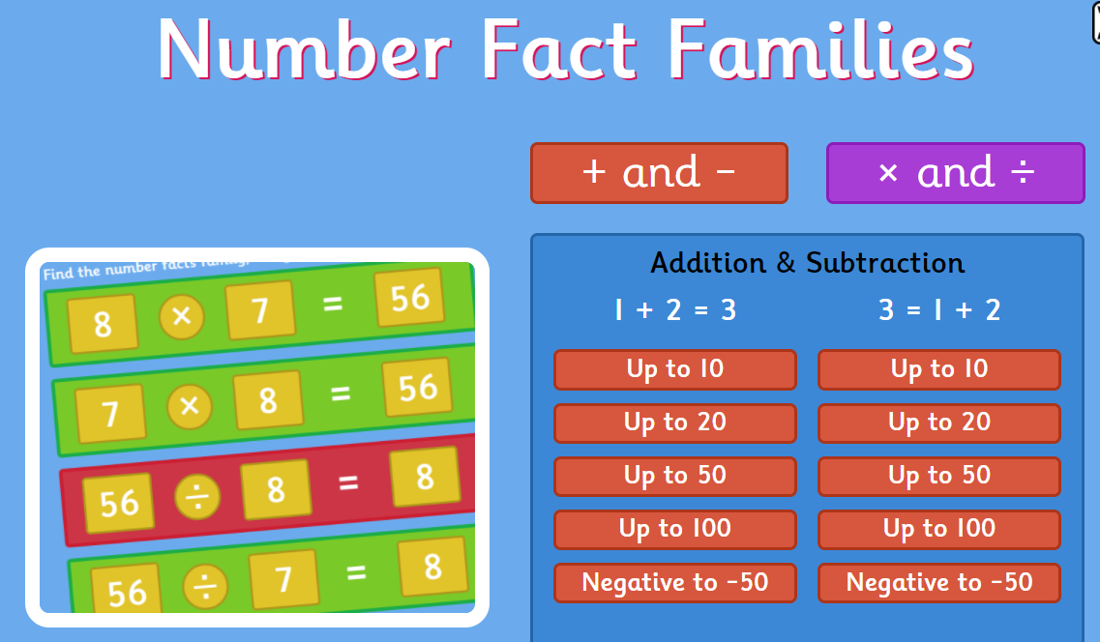
Next Week
6 Times Tables
Adding and subtracting 4 digit numbers
Multiplying 2-digit numbers by a one digit number
https://www.topmarks.co.uk/number-facts/number-fact-families

