Slide 1
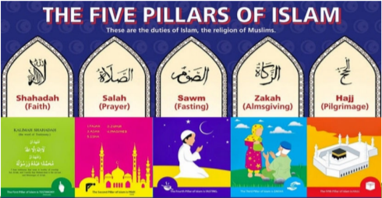

Islam
How do Muslims show community is important in practice? - 5 Pillars of Islam

Slide 2
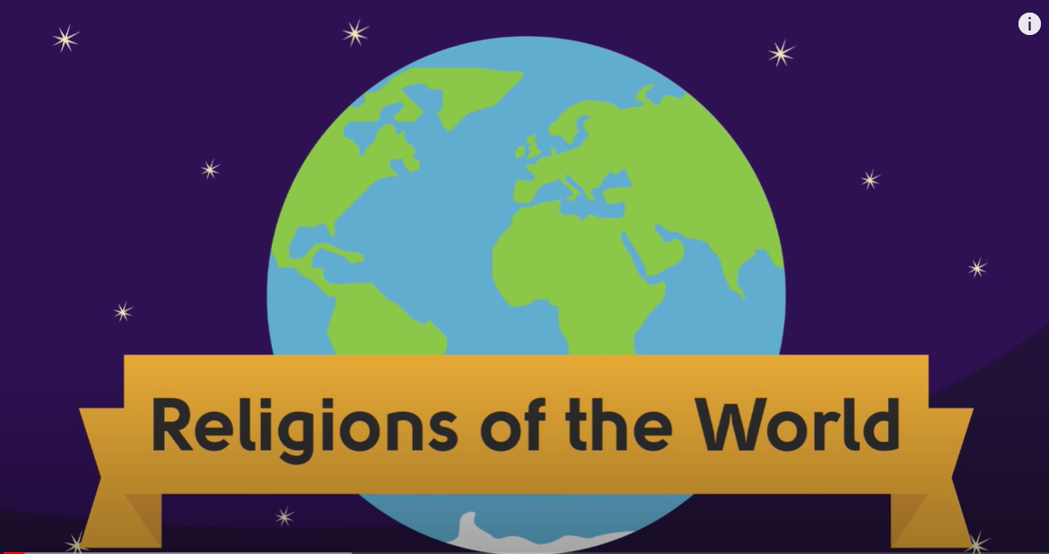
5 Pillars of Islam
Take a look at this video that I mentioned at the end of last week’s RE lesson.
Grab some paper and a pencil. Make some notes on what you find out about the 5 Pillars of Islam as you watch it
https://www.youtube.com/watch?v=H9U8T8x1AhQ

Slide 3
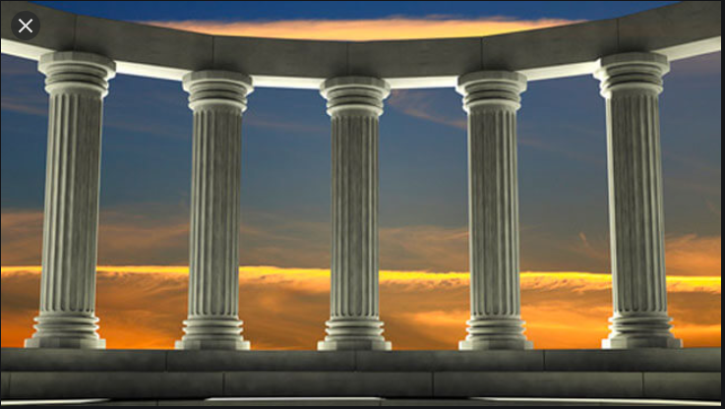
5 Pillars of Islam
Muslims believe there are 5 duties or pillars that hold their community together and their whole way of life is supported by them and they help bind the Umma (Islamic Community) together

Slide 4
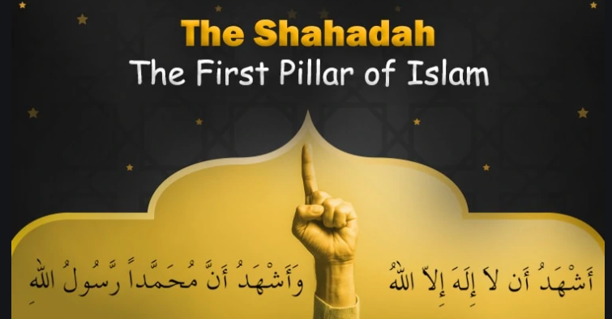

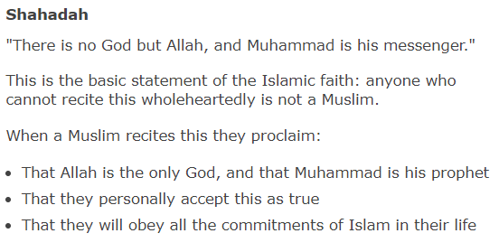
1.
It expresses the belief that there is no god but Allah and that Muhammad is the messenger of Allah.

Slide 5

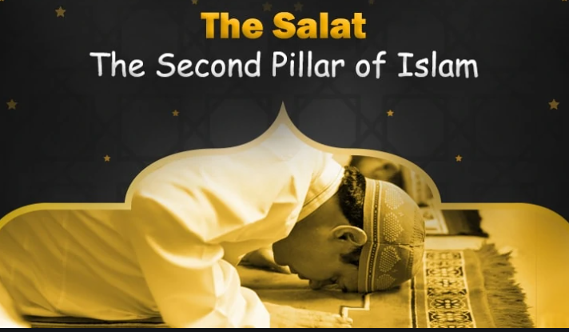
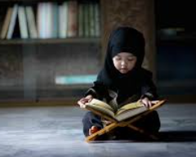
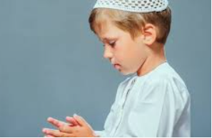
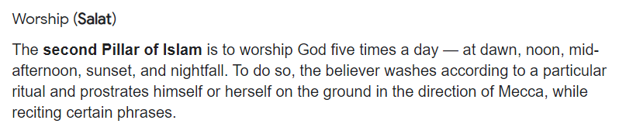
2.

Slide 6
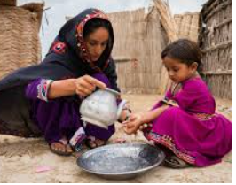
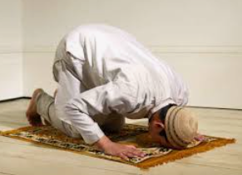
The Salat
Think about how it feels when you wash.
Why do we wash?
How does it make us feel cleansed?
If you can go wash your hands with soap and water, think about how you feel before and after doing this.
Why do you think Muslims bow standing, kneel down, bow kneeling down?
What might their bodies be communicating?
Think about our key words from last week’s lesson – obedience, submission

Slide 7
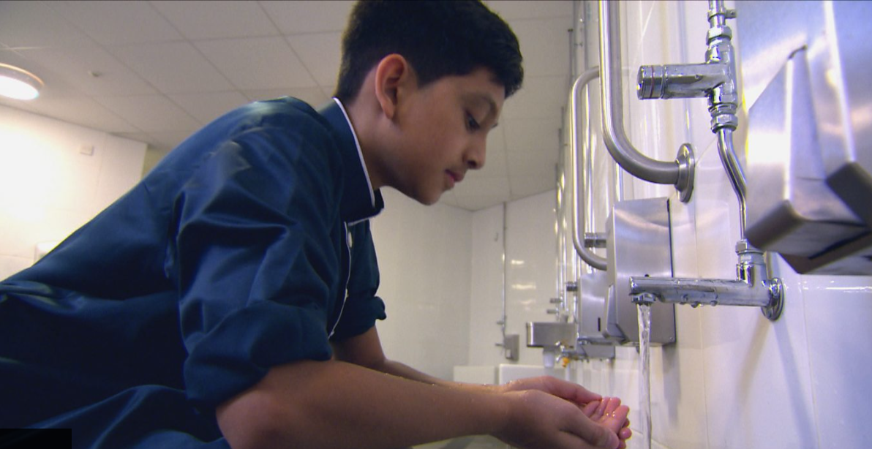
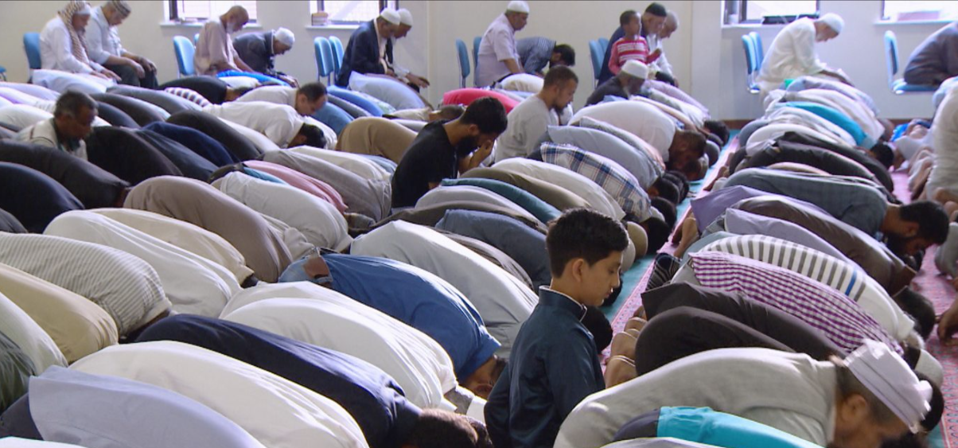
How does the Muslim community show they belong to one united community?
Wudu consists of washing the face, arms, then wiping the head and finally washing the feet with water. Wudu is an important part of ritual purity in Islam.
https://www.bbc.co.uk/programmes/p02mwhw0
Prayer
https://www.bbc.co.uk/programmes/p02q87r8

Slide 8
How does the Muslim community show they belong to one united community?
Through preparation cleansing, showing reverence and respect to Allah, wanting to be aware of Allah all day, through the same prayer positions and 5 times a day, uniting body soul and spirit together, same God, same language, connection with brothers and sisters all over the world.

Slide 9
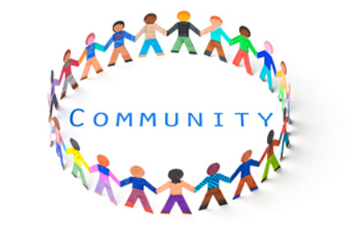

Community
Think about how singing the National Anthem before a game unites everyone.
https://www.youtube.com/watch?v=skgvLrGrjto
Think about fans at a pop concert
https://www.youtube.com/watch?v=w-ZEFt9ZTWo
Remember by sharing a common bond it unites us to form one community

Slide 10
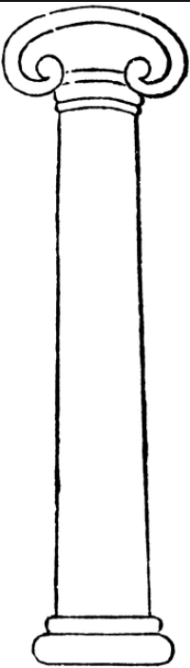
Activity
Draw/write about the first 2 Pillars of Islam – Shahadah, Salah

Slide 11
Next Lesson – we will learn more Sawm, Zakah and Hajj

