Slide 1


Starlings Science Home Learning
Session 2
Friday 5th February2021

Slide 2
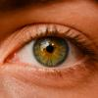
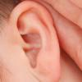


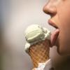
The 5 Senses

Slide 3
The 5 Senses
Touch
Taste
Sight
Hearing
Smell

Slide 4

Hearing
Hear
Sound
Quiet
Loud
Ear

Slide 5

All about our ears

Slide 6
Loud vs Quiet
Loud sounds | Quiet Sounds

Slide 7

Quiz Time!
Click on the sound buttons and see if you can guess what the sounds are.
1. |  | 5.
2. |  | 6.
3. |  | 7.
4. |  | 8.

Slide 8
Did you guess correctly?
Dog
Doorbell
Car engine starting
Phone
Elephant
Horse
Bumble bee
Fireworks

Slide 9
Well Done
Starling Superstars

