Slide 1



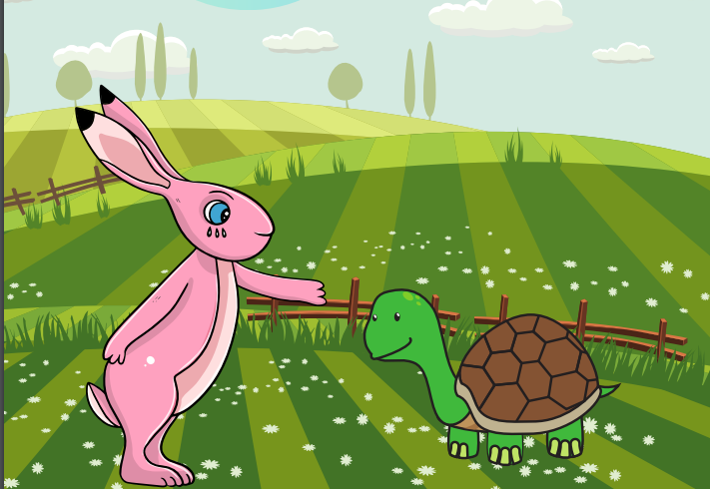
Starlings English Home Learning
Friday 5th February

Slide 2


This is our last session of our fable ‘Tortoise and Hare’ and we are all very proud of all your hard work. Today, you are going to write your own ending and edit and improve your work.
That means you will:
Use your plan to help you write your story.
Use capital letters and full stops.
Extend your sentences with the joining word and
Use prefixes and suffixes in your writing.

Slide 3
Your story will be about two animals (one fast and one slow) having a race and the slowest one wins because the fastest one takes a nap.
Don’t forget you need in include:
Capital letters
Full stops
The joining word and
Prefixes and suffixes – un-, -er, -est, -ed, -ing
Get your story board out from yesterday and retell the ending of your story out loud.

Slide 4

This is Mrs Judge’s story ending – use it to help you and use your phonics to sound out your words (not all words need to be spelt correctly – just try your best)
Koala was the kindest animal and cheered Gazelle up and they became best friends.
Please use the rest of the time to edit and improve your work which means you need to:
Check for sense by reading your story out loud
Check for capital letters and full stops
Check you have extended some sentences with the joining word and
Check if you have used some prefixes and suffixes
Can you give your story a title?

Slide 5

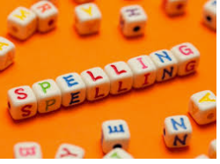




Words of the day!
five six seven
Can you write the word five 5 times in rainbow colours?
Can you write the word six 5 times inside a squiggle?
Can you write the word seven 5 times with your eyes closed?

Slide 6

Red group – Please have a look at the separate RWI PowerPoint for set 1. We have added some special friends work for you.
Green group you need to look out for set 2 videos on the link below:
https://www.youtube.com/channel/UCo7fbLgY2oA_cFCIg9GdxtQ
We would like you to watch 4 videos: set 2 speed sounds, set 2 spelling, red words 1, and read and hold a sentence 1
Pink, yellow and blue groups you need to look out for set 3 videos on the link below.
https://www.youtube.com/channel/UCo7fbLgY2oA_cFCIg9GdxtQ
We would like you to watch 4 videos: set 3 speed sounds, set 3 spelling, red words 2 and read and hold a sentence 2

