Slide 1


Friday 5th February 2021
Can I describe how I see things?
I wonder…
Have a go at the quiz to see what you can remember from last lesson.

Slide 2

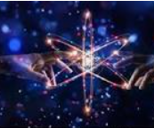
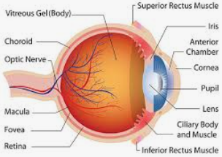
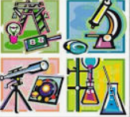
Follow this link to Miss Emm’s Science lesson.
Have a go at the quiz at the start of the lesson and again at the end
to see how much you have learnt.
https://classroom.thenational.academy/lessons/how-can-we-see-objects-6ct6ct
I love this image. I wonder what it is?

Slide 3
The opening at the front of my eye is called the pupil.
To see something we need light and our eyes.
What I know now…
My eye sends signals to my brain to recognise what I am seeing.
The light is reflected from the object into my eye in a straight line.

