Slide 1

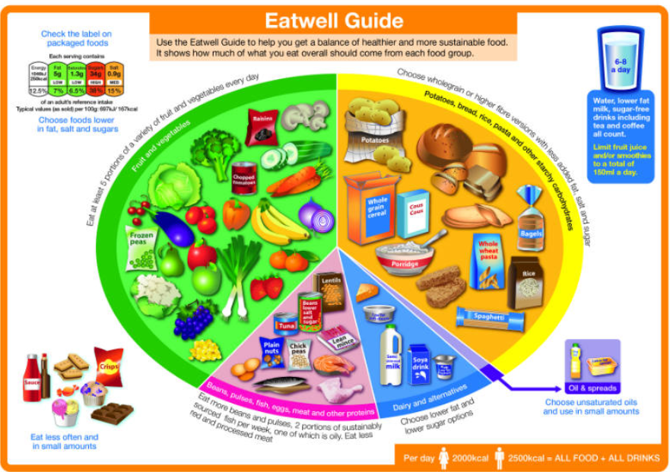


SCIENCE
Diet & Lifestyle
Lesson 3

Slide 2
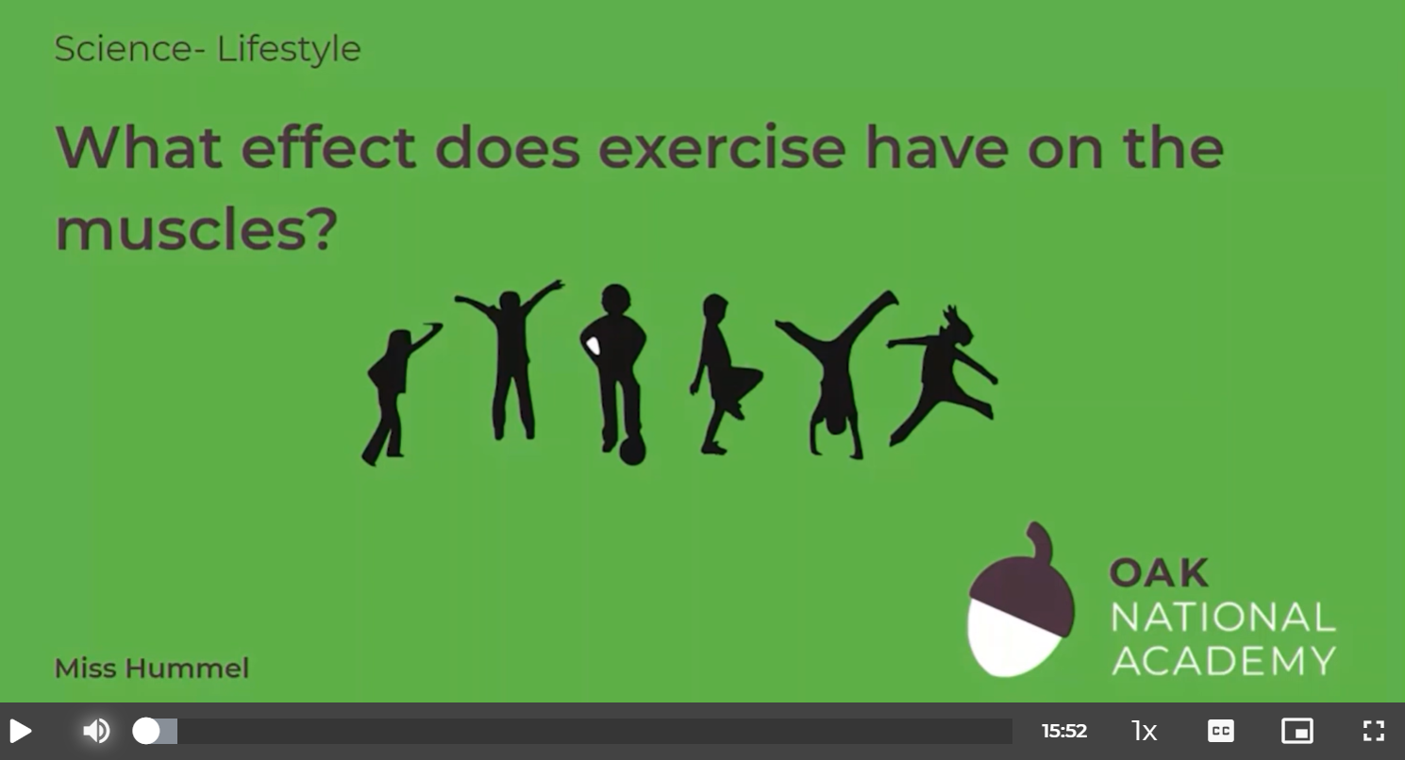
What effect does exercise have on the muscles?
In this lesson we will learn about muscles and how they work. We will also learn what happens to our muscles when we exercise and how people strengthen and grow their muscles.
Click on the following link to watch and take part in the following video lesson. Start with the quiz and the recap of last week’s learning.
https://classroom.thenational.academy/lessons/what-effect-does-exercise-have-on-the-muscles-60up8d
Play the audio first before clicking on the link to the lesson.

Slide 3
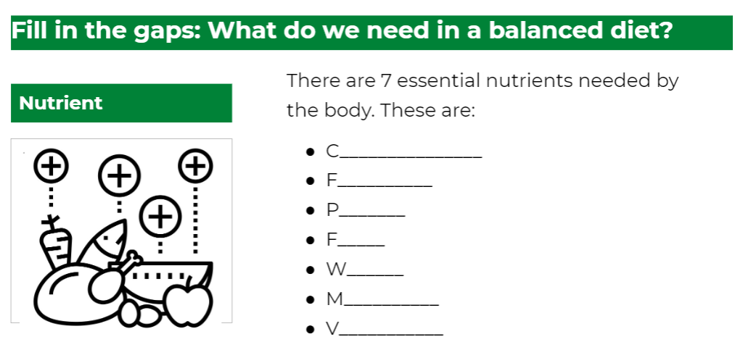
What effect does exercise have on the muscles?
Click on the following link to complete the activities for today’s lesson:
file:///H:/Downloads/science-ks2-lesson-sci-y6-u4-l3.pdf

Slide 4
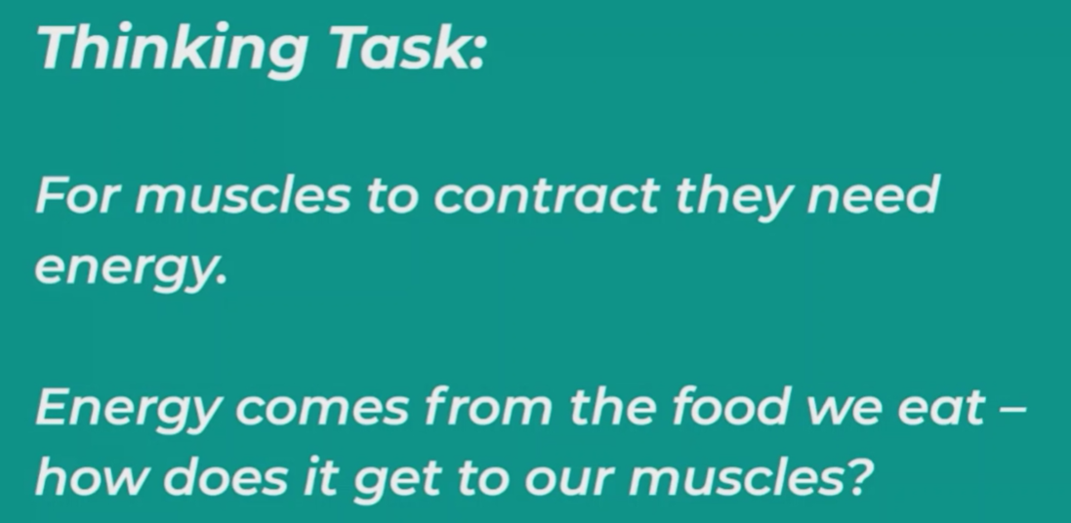
RESEARCH
TASK
You can write your findings for or against on our class discussion feed or you could submit your written or oral recording via the homework section ‘upload your homework’ button.

