Slide 1


Starlings Maths Home Learning
Thursday 4th February

Slide 2
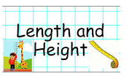
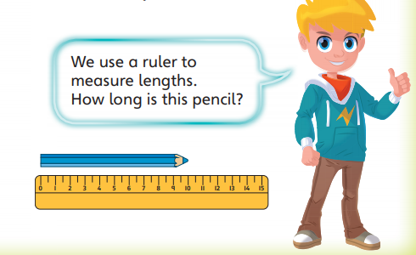
LENGTH & HEIGHT LESSON FOUR
cm

Slide 3
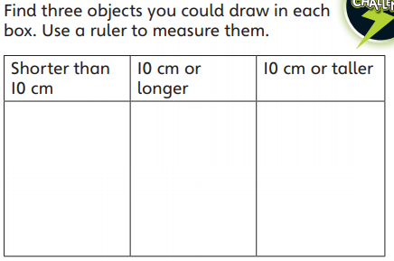
Right, I would like you to go and collect some objects from around your house and measure them in centimetres using a ruler. Remember to start at zero! Off you go! Then see if can order them like below:
A centimetre is about the size of your thumb – measure it and see if I’m right!
All cm are exactly the same which is why we use it to compare lengths and heights.

Slide 4
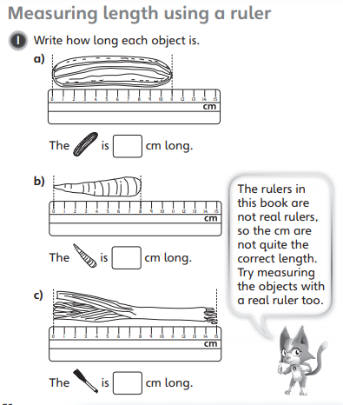
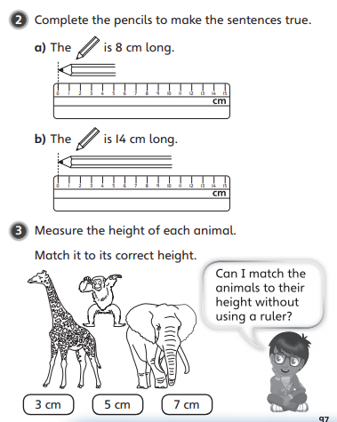

Slide 5

