Slide 1


English
Date: 04.02.21
Week 5 – Lesson 4
Hansel and Gretel

Slide 2
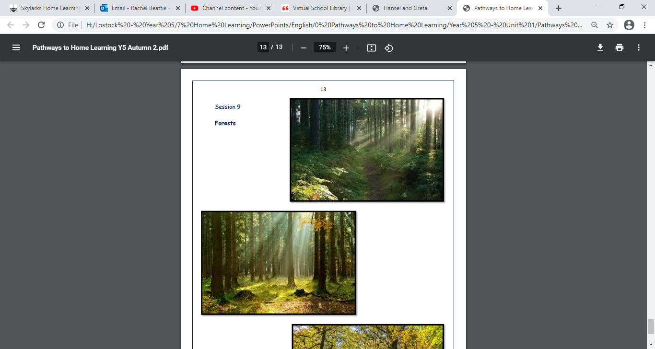

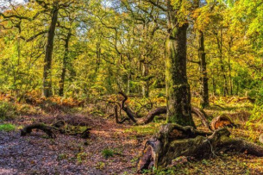
Click on the sound button to hear this slide read to you:
Let’s recap our similes from yesterday’s lesson:
The evergreen trees towering as tall as mountains
Tall tress that stand like silent guards
A forest floor as thick as a wool carpet
Villainous branches reach out like grasping arms
What similes did you come up with?

Slide 3
Click on the sound button to hear activity 1 read to you.
Activity 1:
Using your similes from yesterday’s lesson, create a list poem about the forest.
Most of your sentences should be similes, however you could also add in other language devices such as personification, alliteration and metaphors. You may need to edit/adapt your similes from yesterday's lesson in order to fit your poem.
Your first line should be ‘This is the forest where…’ and you should take a new line for each new sentence.
WAGOLL on next slide…

Slide 4

Click on the sound button to hear the WAGOLL read to you.
Task reminder:
Create a list poem about the forest.
Most of your sentences should be similes, however you could also add in other language devices such as personification and alliteration.
You may need to edit/adapt your similes from yesterday's lesson in order to fit your poem.
Your first line should be ‘This is the forest where…’
You should take a new line for each new sentence.
This is the forest where…
Evergreen trees tower over like mountains
Ancient tree stumps stand silent like guards
Villainous branches reach out to grab you like grasping arms
The thorniest bushes sit on the edge of clearings
Around the forest floor, as thick as a carpet.

Slide 5



