Slide 1






English
Thursday 4th February 2021

Slide 2
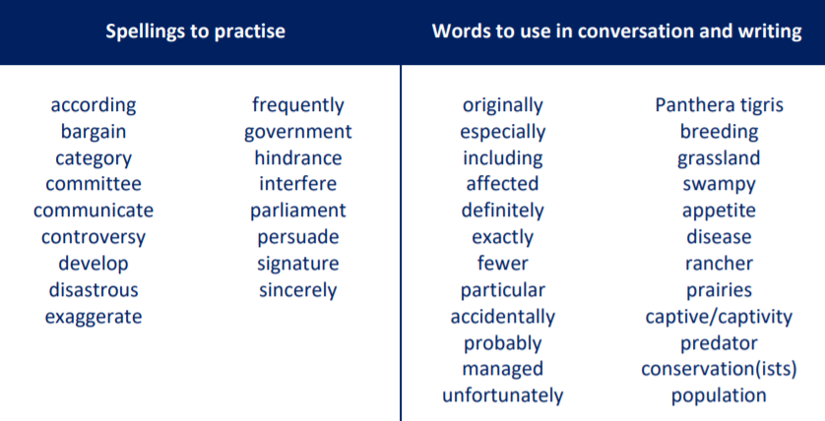
Main outcomes of the session:
To be able to use modal verbs effectively within a sentence.
These are the spelling words that go along with this unit of work exactly like when we’re in school.

Slide 3
Can you remember what modal verbs are?
Take a moment or pause the video to have a think. Can you give some examples?

Slide 4

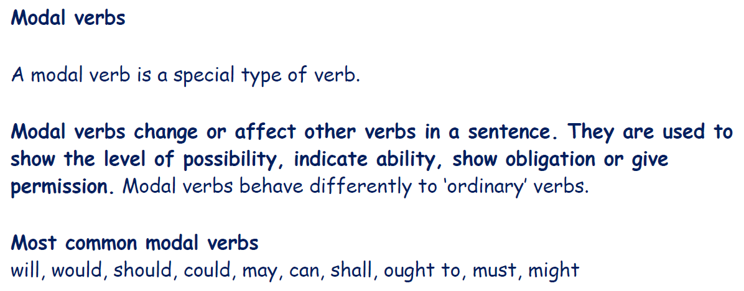

Slide 5
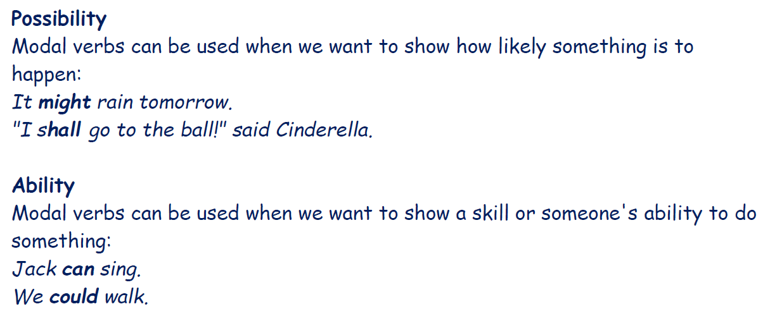

Slide 6
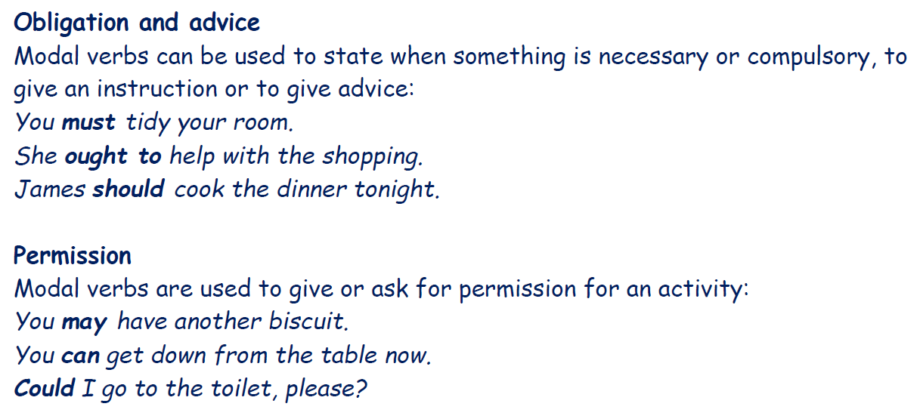

Slide 7
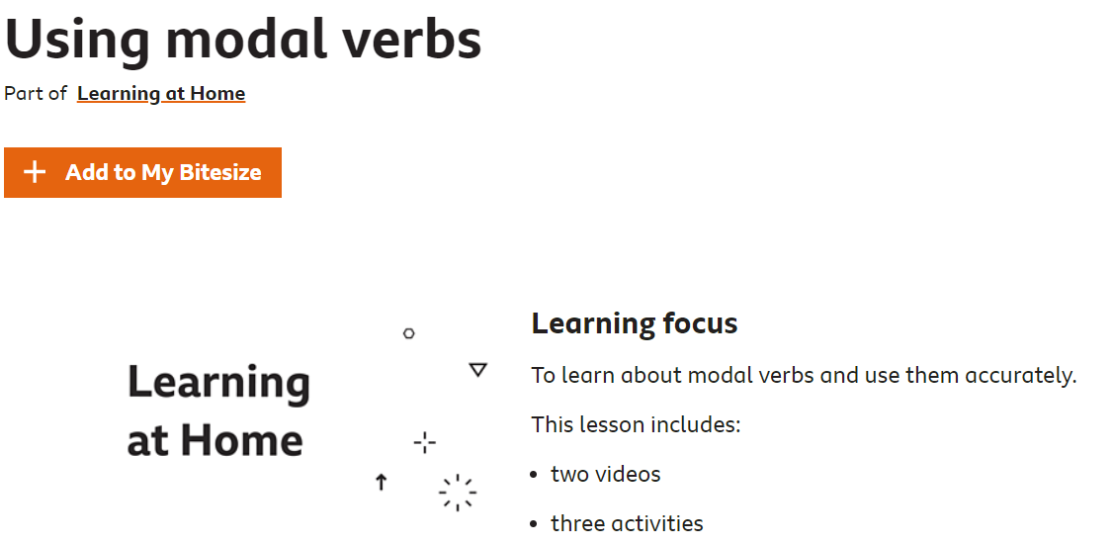
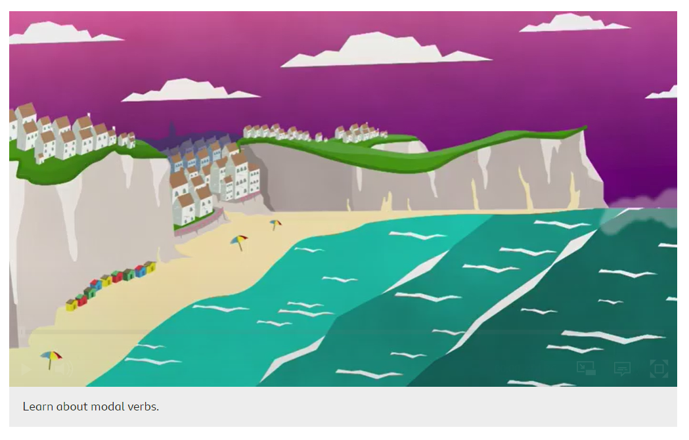
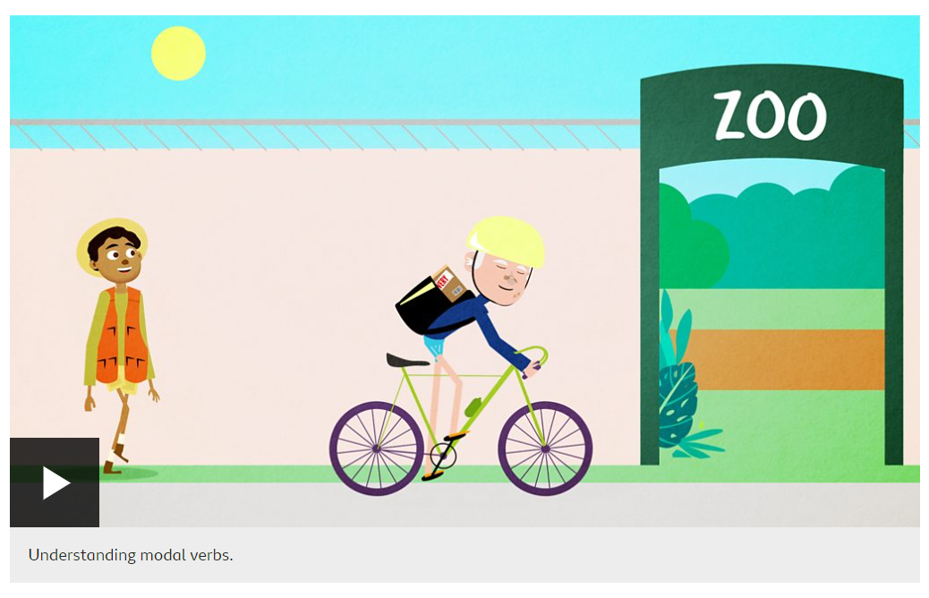
Play my audio first!
If you would like some more information about modal verbs, you can click on the following link and watch the two videos about modal verbs. One video is called ‘Learn about modal verbs’ and the other one is called ‘Understanding modal verbs’.
https://www.bbc.co.uk/bitesize/articles/znd26v4

Slide 8
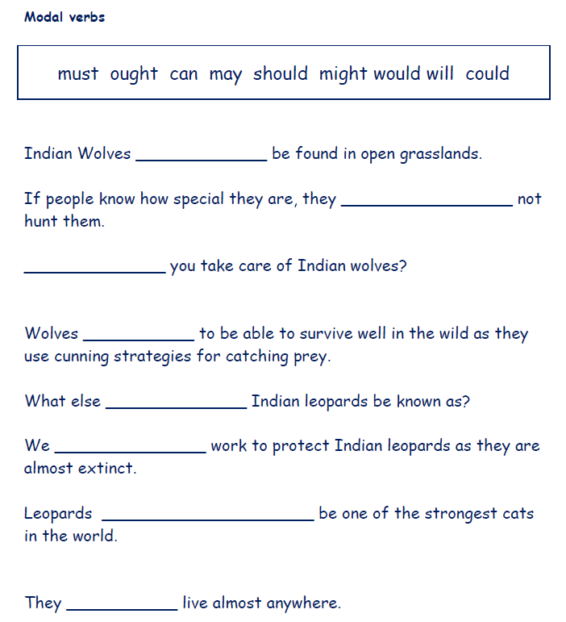
Activity 1
Finish the sentences on this slide by adding a modal verb to each one.
There is not an exact answer for each but try and use a variety that make sense.
Please remember to keep rereading your sentences to check the meaning and that they make sense and are cohesive!
Activity 2
Write your own five sentences that include modal verbs.

Slide 9

Activity 2
Write your own five sentences that include modal verbs.
Model Sentences
With lots of cunning strategies to catch antelope, hares, raccoons and small rodents, they can reach up to an impressive 70 miles per hour.
They hope that if the local people know how special and interesting wolves are, they will not hunt them or destroy their homes.

Slide 10

‘The Explorer’ by Katherine Rundell, read by Mrs Whittingham
Please follow this link to see Mrs Whittingham read our new class novel.
https://youtu.be/k8VuppCyWTM

