Slide 1

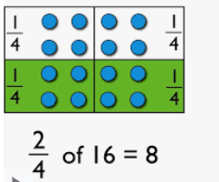

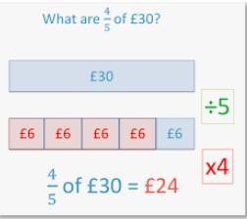

Mathematics
Date: 04.02.21
Calculating fractions of amounts

Slide 2
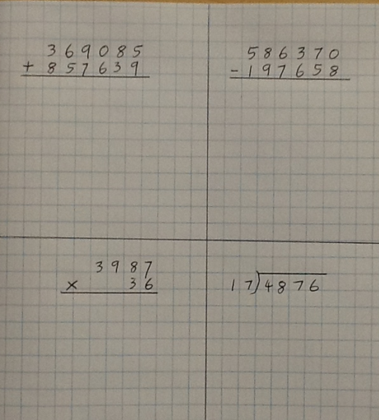
4-A-Day
Remember 0 – 8 you cannot do!
Write down the multiples of 17

Slide 3

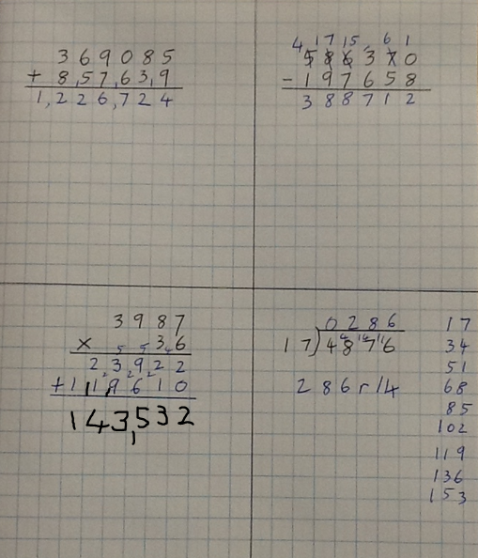
4-A-Day

Slide 4
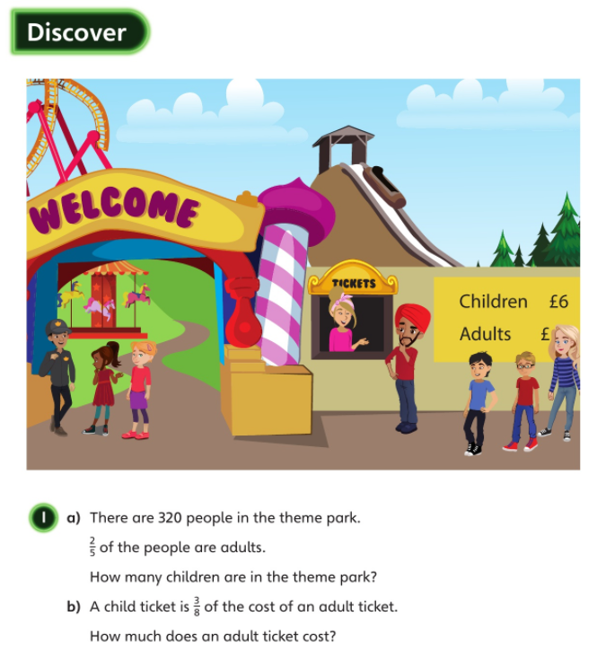


1.a
If 2/5 are adults, then 3/5 are children – we must find 3/5 of 320
3/5 of 320 = ?
Step 1. Find 1/5 by dividing by 5
Step 2. Find 3/5 by multiplying what you got by 2
1.b
3/8 of ? = £6

Slide 5
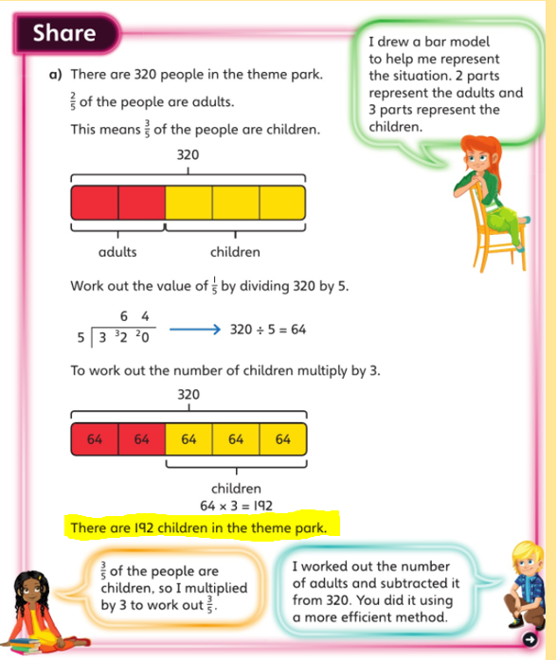

Slide 6


3/8 of ? = £6
£6 divided by 3 = 1/8 = £2
£2 x 8 = £16 = price of an adult ticket

Slide 7

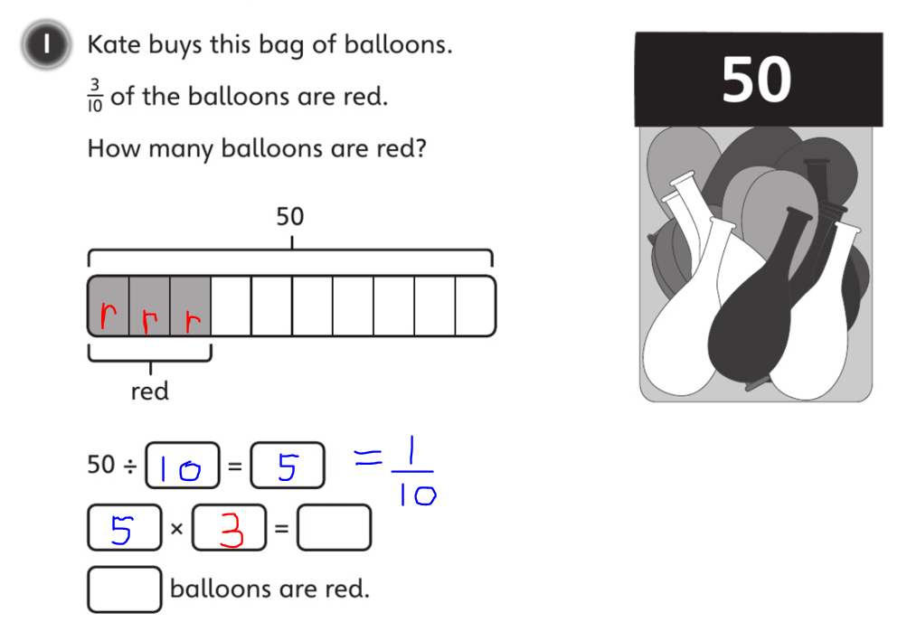

Slide 8
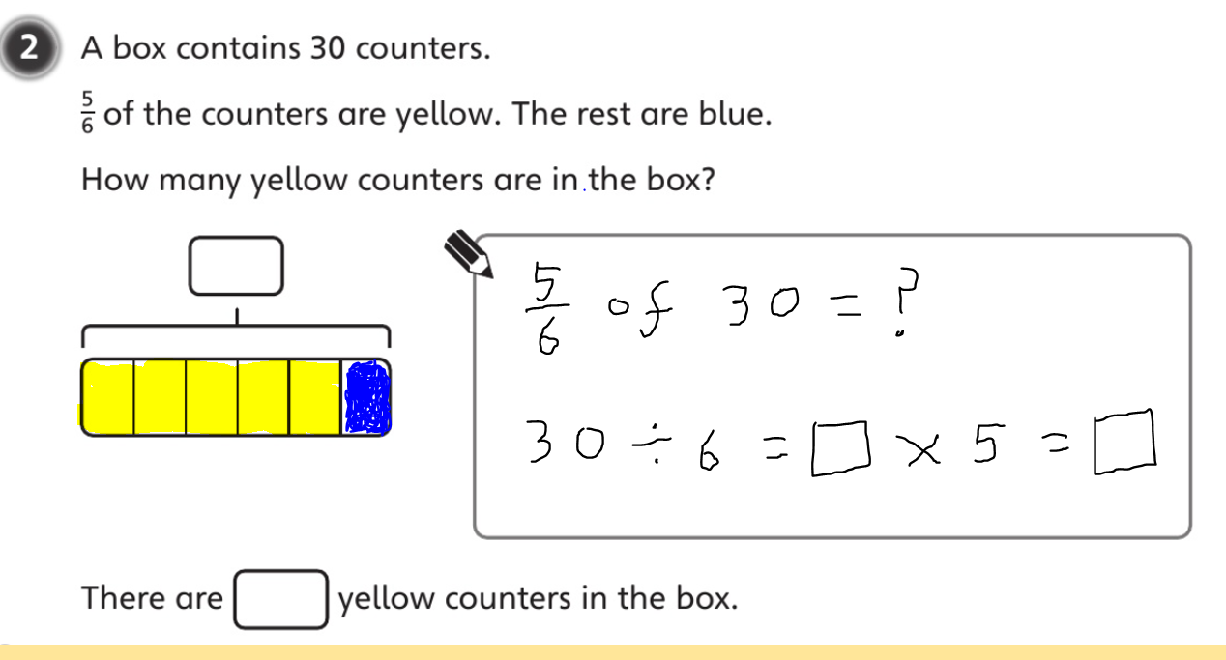

Slide 9
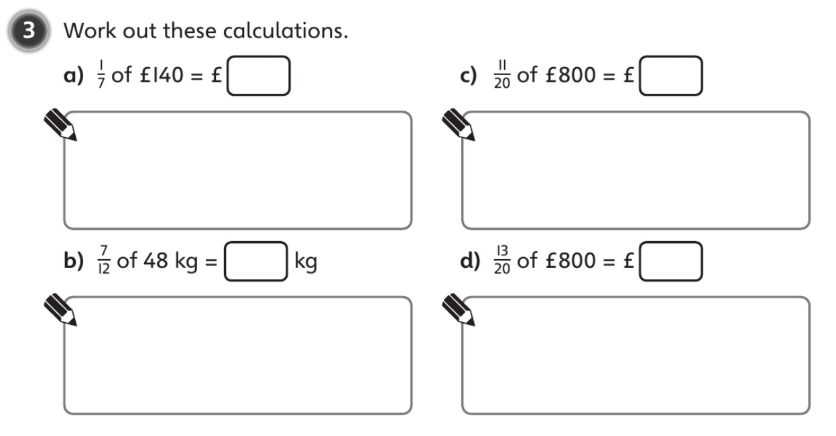

Slide 10
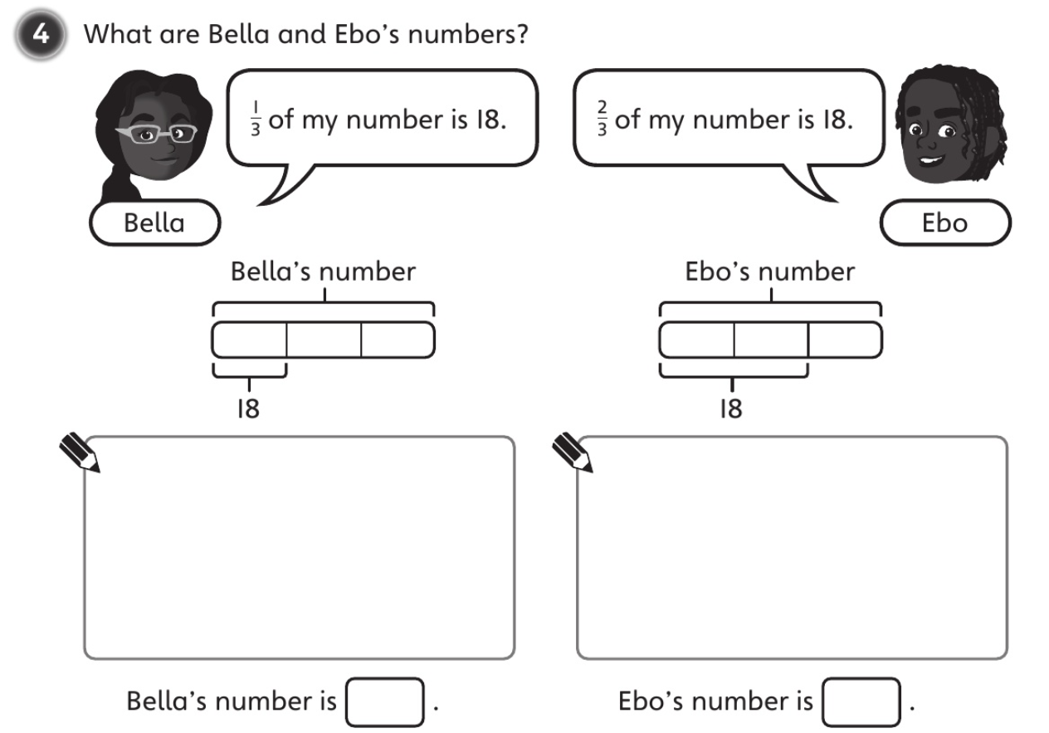
When finding Ebo’s number, calculate half of 18 to find 1/3

Slide 11
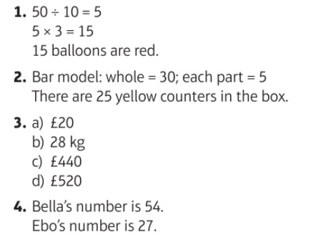

Slide 12
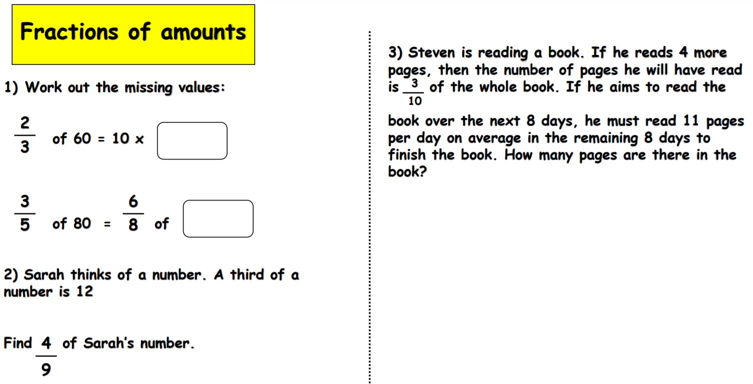
Challenge

Slide 13
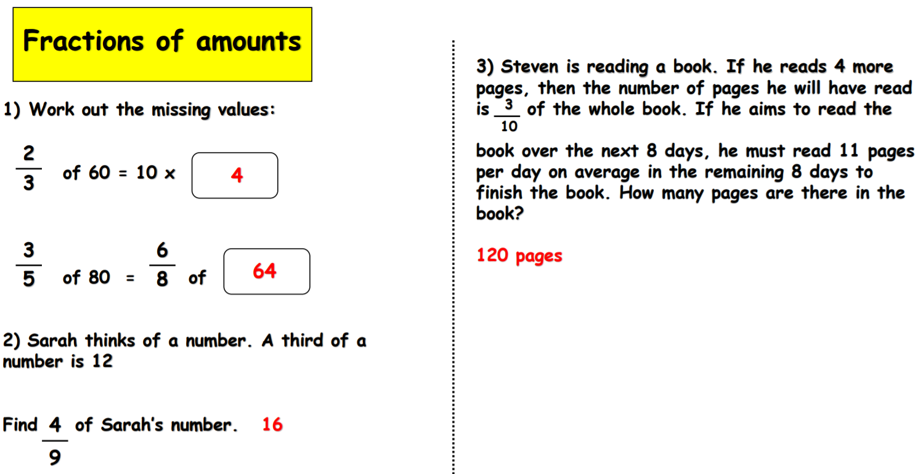
Challenge

