Slide 1


Starlings Maths Home Learning
Wednesday 3rd February

Slide 2
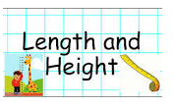
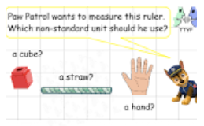
LENGTH & HEIGHT LESSON THREE
Good Morning Starlings. In this lesson, we are going to continue to work with nonstandard units to measure length and height (so no rulers again). You will learn that the appropriate choice of non-standard unit is dependent on the object being measured.
Which non-standard unit was the easiest to measure yesterday and with and why?
Will the measurement be the same if you use your hands as when you use your feet?

Slide 3
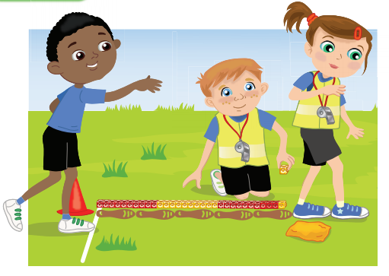
What else could you use to measure the distance?
Do you think the measurement would be the same if an adult used their feet?
Is there a quick way of counting the cubes?

Slide 4
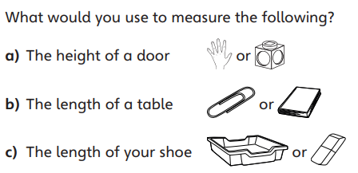

Slide 5
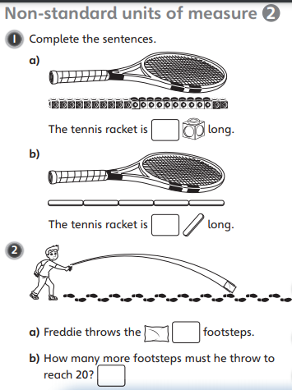
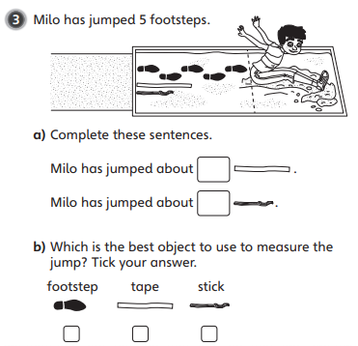
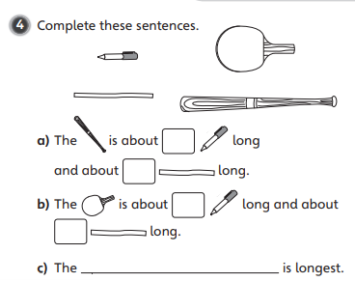


Slide 6

