Slide 1


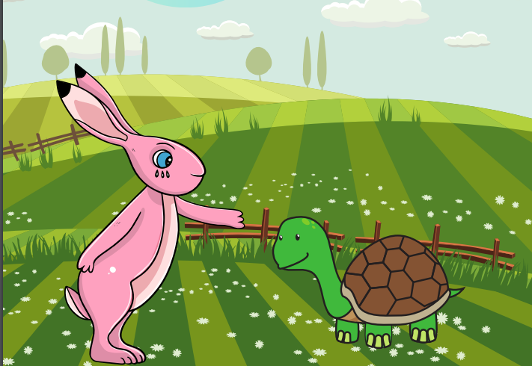
Starlings English Home Learning
Wednesday 3rd February

Slide 2


Today you are going to write the beginning of your own version of the fable ‘Tortoise and Hare’ using two new animals.
That means we will:
Use your plan to help you write your story.
Use capital letters and full stops.
Extend your sentences with the joining word and
Use prefixes and suffixes in your writing.

Slide 3
Your story will be about two animals (one fast and one slow) having a race and the slowest one wins because the fastest one takes a nap.
Can you remember which animals you chose to use in your story? You should have one fast and one slow animal.
Don’t forget you need in include:
Capital letters
Full stops
The joining word and
Prefixes and suffixes – un-, -er, -est, -ed, -ing
Get your story board out from yesterday and retell the beginning of your story out loud.

Slide 4
This is the beginning of Mrs Judge’s story – use it to help you and use your phonics to sound out your words (not all words need to be spelt correctly – just try your best)
Koala and Gazelle
Once upon a time, Gazelle was unkind and he was teasing Koala for being too slow. He thought he could run quicker than everyone and liked to boast about how fast he was. Koala said he could plod and plod and challenged Gazelle to a race.

Slide 5
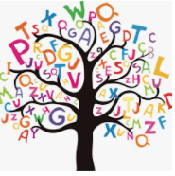
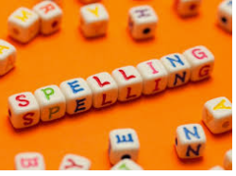



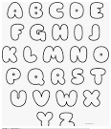
Words of the day!
Sunday zero one
Can you write the word Sunday 5 times inside your squiggles?
Can you write the word zero 5 times in joined up handwriting?
Can you write the word one 5 times in bubble writing?

Slide 6

Red group – Please have a look at the separate RWI PowerPoint for set 1. We have added some special friends work for you.
Green group you need to look out for set 2 videos on the link below:
https://www.youtube.com/channel/UCo7fbLgY2oA_cFCIg9GdxtQ
We would like you to watch 4 videos: set 2 speed sounds, set 2 spelling, red words 1, and read and hold a sentence 1
Pink, yellow and blue groups you need to look out for set 3 videos on the link below.
https://www.youtube.com/channel/UCo7fbLgY2oA_cFCIg9GdxtQ
We would like you to watch 4 videos: set 3 speed sounds, set 3 spelling, red words 2 and read and hold a sentence 2

