Slide 1


Mathematics
Date: 03.02.21
Week 5 – Lesson 3
Estimating Area

Slide 2
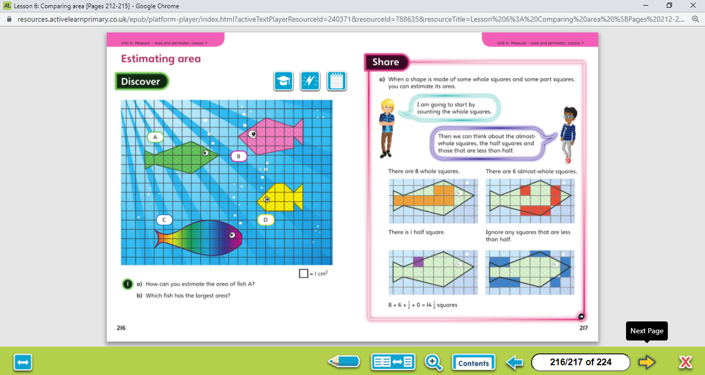

Let’s work together!
Look at the picture clue. What can you see?
Have a look at the questions.
Click on the sound button below to hear the questions read to you. We will also talk through the questions together like we do in school.
We will go through the possible methods and answers on the next slide.

Slide 3
Let’s work together!
Click on the sound button below to hear the answers and possible methods for question A.

Slide 4
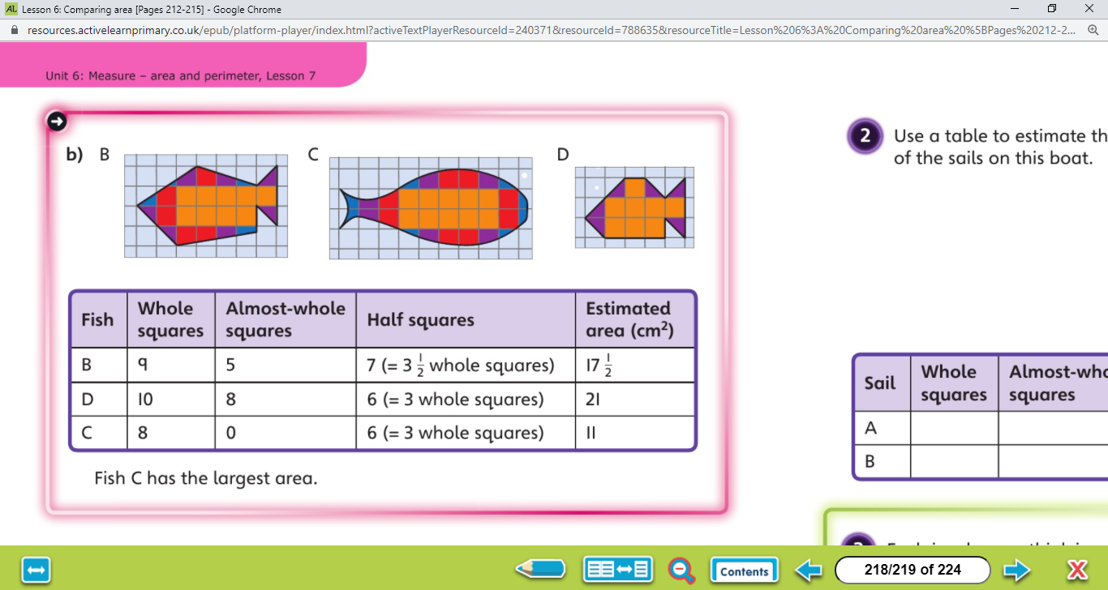
Click on the sound button to hear the answers and possible methods for question B.
Let’s work together!

Slide 5
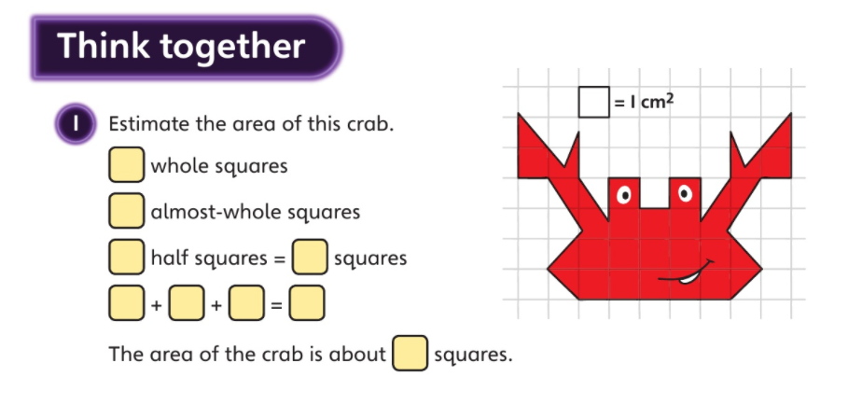
Click on the sound button below to hear the question read to you. We will work together to reach the answer.
Let’s work together!
Click on the sound button below to hear the answers.

Slide 6
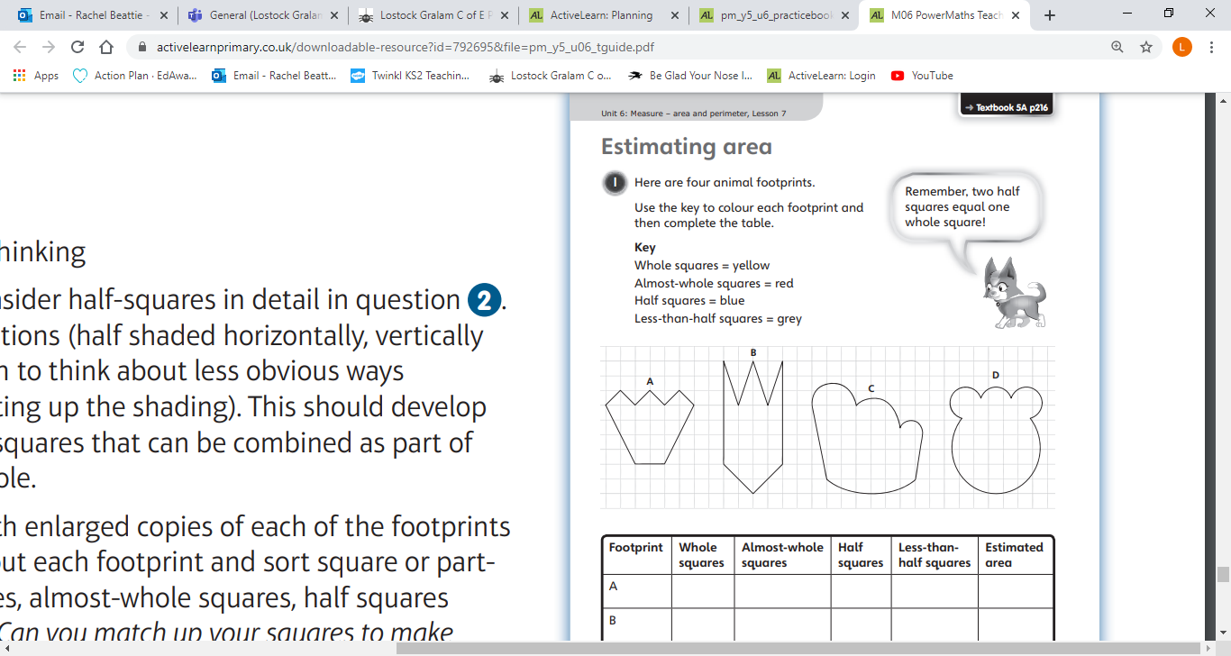
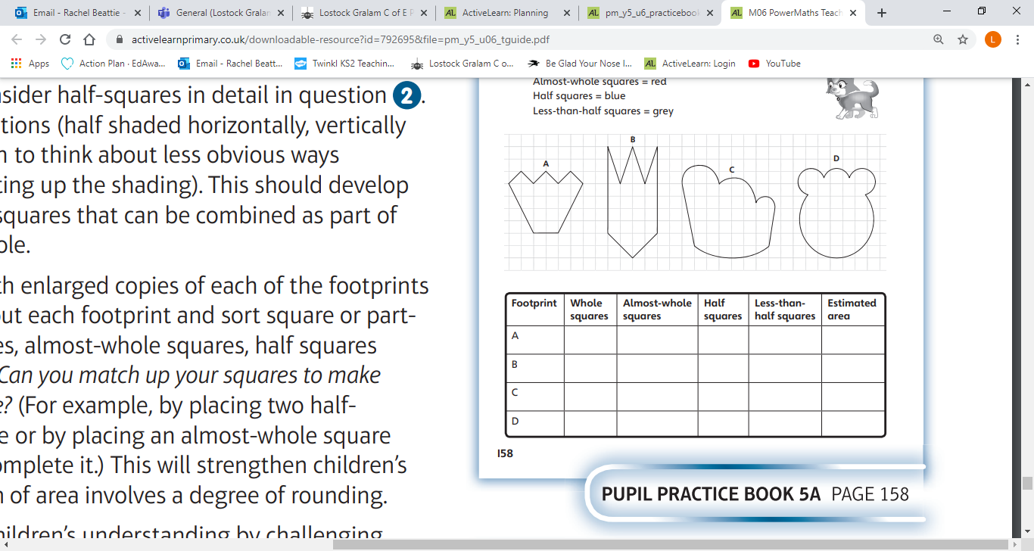
Your Turn…
Have a go at these questions independently. Click on the button below if you would like the questions read to you.
We will go through the answers for questions 1, 2 and 3 after completing all of the questions.

Slide 7
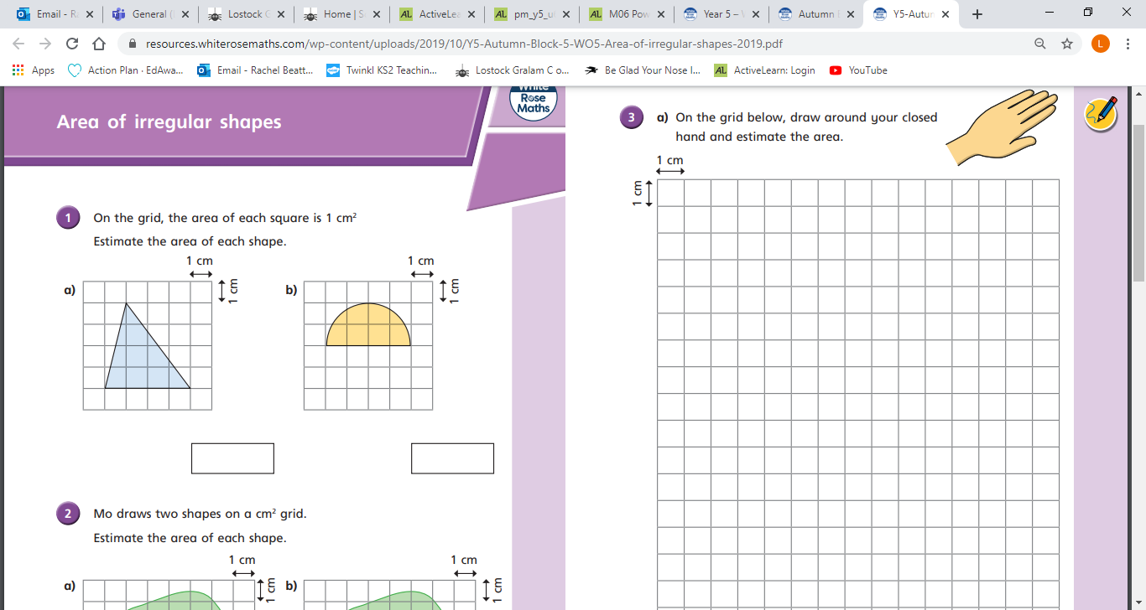
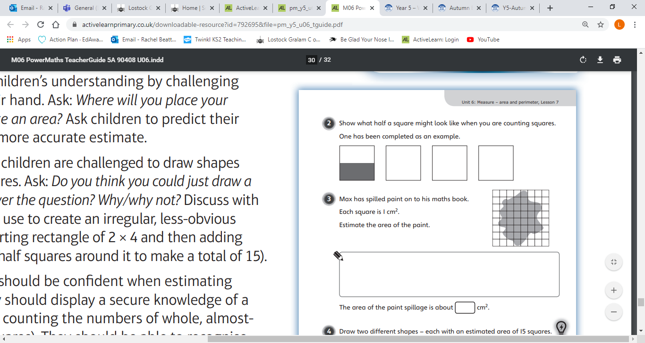
Have a go at these questions independently. Click on the button below if you would like the questions read to you.
Your Turn…
We will go through the answers for questions 1, 2 and 3 after completing all of the questions.

Slide 8
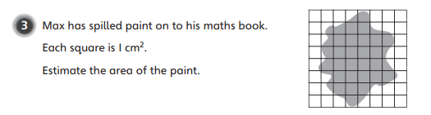
Your Turn…
Have a go at these questions independently. Click on the button below if you would like the questions read to you.
We will go through the answers for questions 1, 2 and 3 after completing all of the questions.

Slide 9
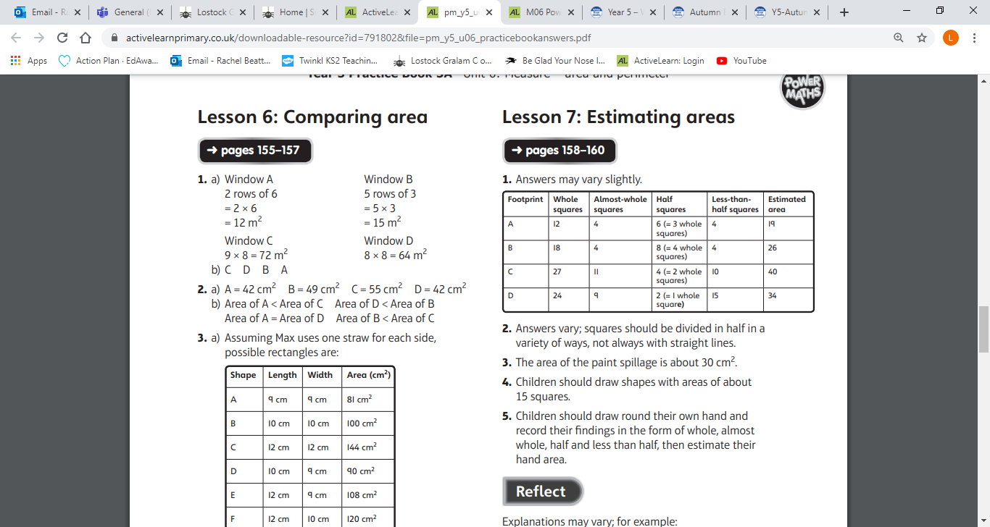
Your Turn…
Questions 1 – 3 Answers:
Click on the sound button to hear the answers being read to you.
2. Approximately: 8cm² and 6cm²

Slide 10
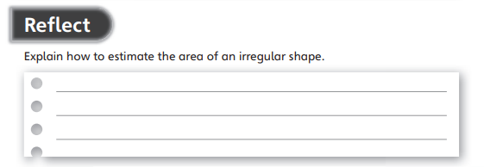
Reflect
Your Turn…
Click on the button below if you would like the question read to you.
Click on the button below to hear the answer.

