Slide 1


English
Date: 03.02.21
Week 5 – Lesson 3
Hansel and Gretel

Slide 2

Click on the sound button to hear this slide read to you:
What is a simile?
A simile is when we compare two things using ‘like’ or ‘as’.
Across pages 1 to 5 of Hansel and Gretel, the author used various similes:
the white pebbles in front of the house were glistening like silver stones
a pile of twigs as high as a mountain
pebbles that glistened like newly minted coins
a woman as old as the hills

Slide 3
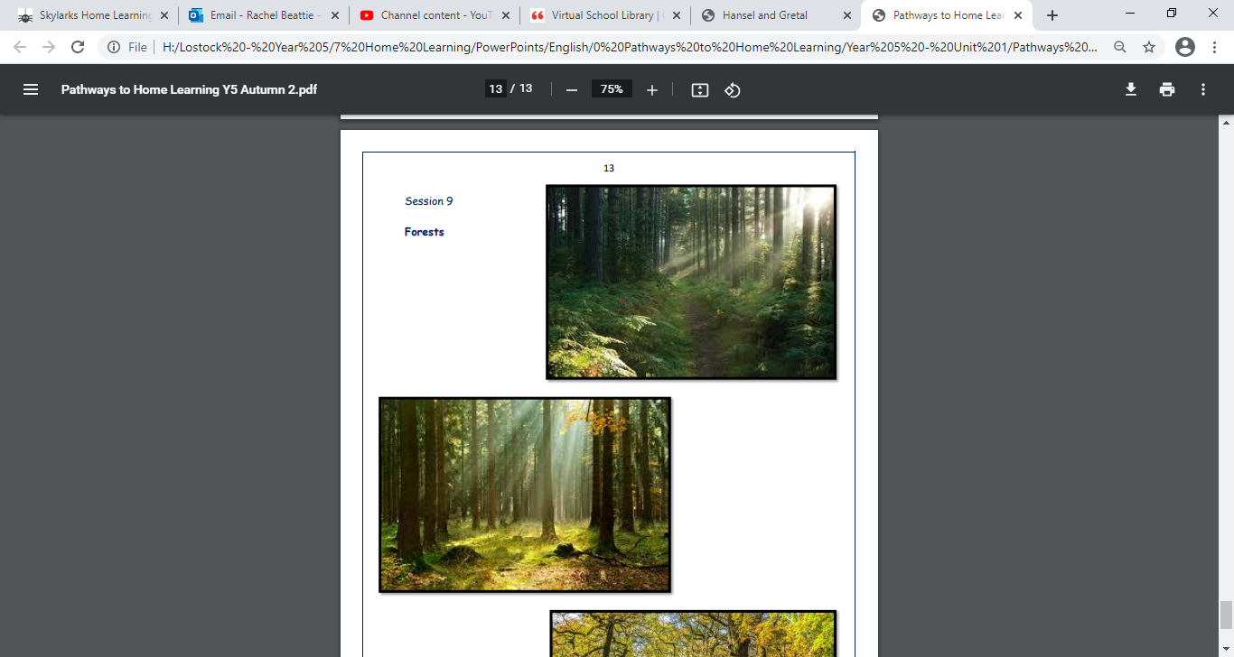
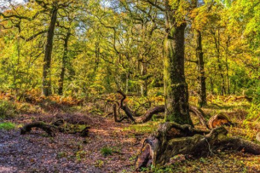
Activity 1:
Click on the sound button to hear activity 1 read to you:
Look at the pictures of forests and list all the things that you can see.
For example:
Sun rays
Trees
Bushes
Branches
Forest floor
Now, choose adjectives to describe each of the things listed above.
For example:
Blinding sun rays
Towering evergreen trees
Thorny bushes
Villainous branches
Thick forest floor

Slide 4
Click on the sound button to hear activity 2 read to you:
Activity 2:
Use the noun phrases that you have just created to write your own similes. Remember to use the words ‘like’ or ‘as’ in your comparisons.
For example:
The evergreen trees towering as tall as mountains.
Tall tress that stand like silent guards.
A forest floor as thick as a wool carpet.
Villainous branches reach out like grasping arms.
My noun phrases:
Blinding sun rays
Towering evergreen trees
Thorny bushes
Villainous branches
Thick forest floor
Keep your work from today somewhere safe as we will need our list of similes for tomorrow’s lesson.

Slide 5
