Slide 1






English
Wednesday 3rd February 2021

Slide 2
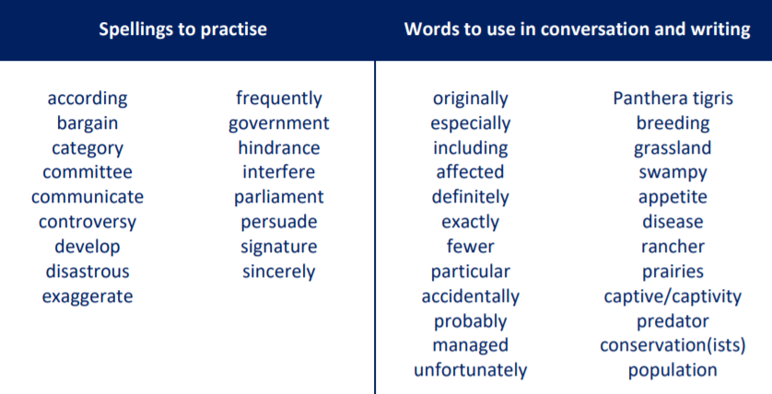
Main outcomes of the session:
To be able to summarise the text and pick out key facts
These are the spelling words that go along with this unit of work exactly like when we’re in school.

Slide 3
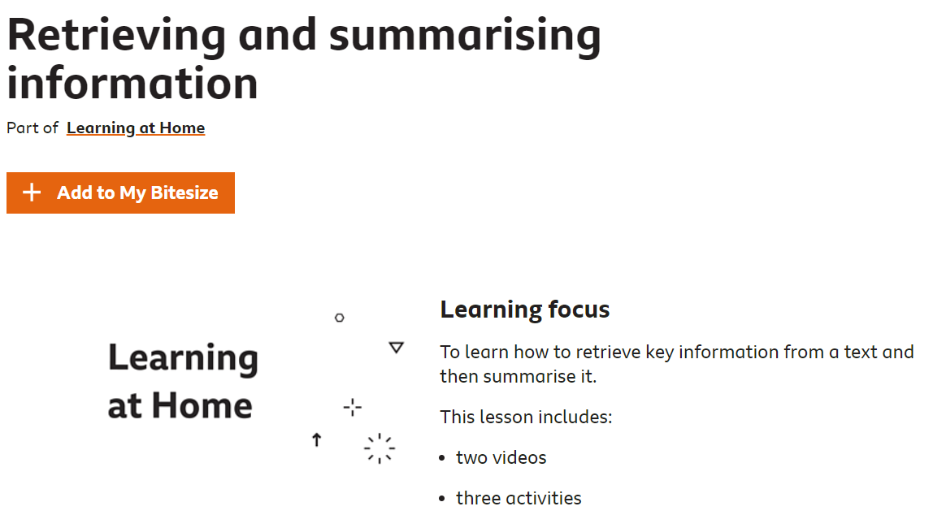
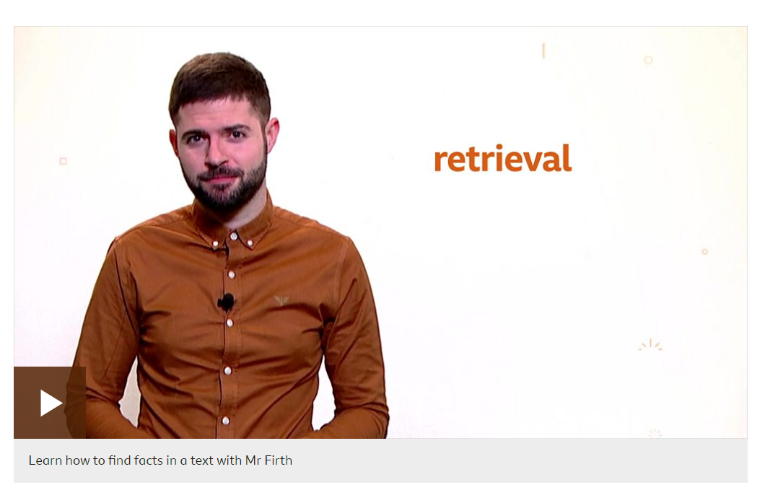
Play my audio first!
After listening to my audio, click on this link. It’s also on our blog. Please scroll down the page and click on the very first video. It’s a 5 minute video revising key reading skills. Pay particular attention around 4:04 where Mr Firth explains summarising. This is what I want you to practice today!
https://www.bbc.co.uk/bitesize/articles/zvtbf82

Slide 4
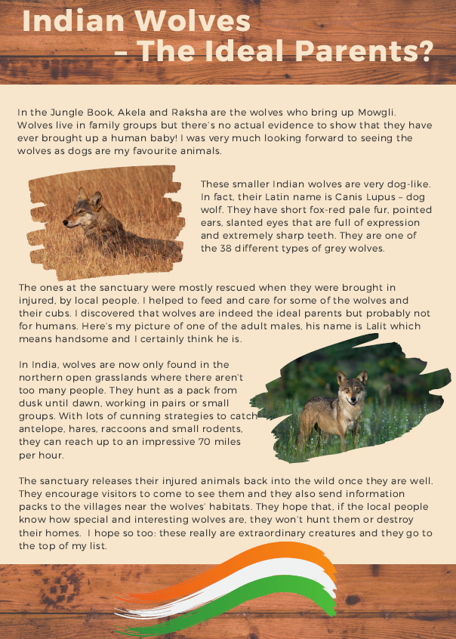
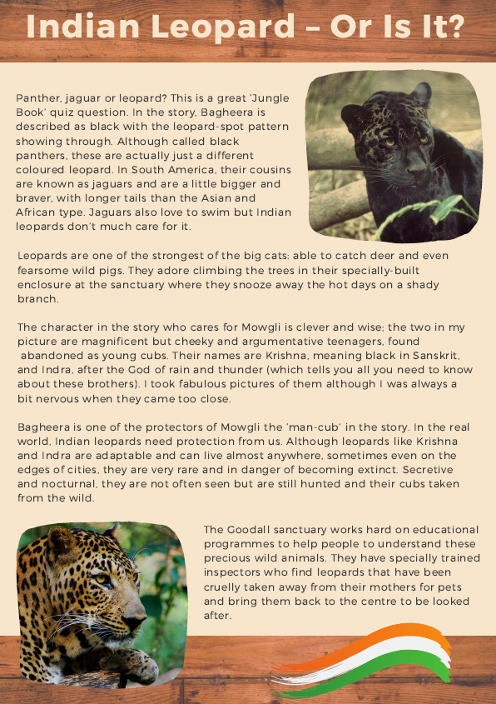
Activity 1
Read both ‘Indian Wolves’ and ‘Indian Leopards’.
After reading, choose one of these animals to focus on.

Slide 5
Activity 2
Go back through the text and highlight any factual information or key words about the animal
(not The Jungle Book facts).
Just do this for the one animal you have chosen to focus on.
Activity 3
Summarise the text to 5 key facts.
Activity 4
Write 5 bullet points about the animal in your own words.
Top tips for summarising:
• Highlight key words
• Don’t copy out whole sentences
• Read for meaning and then write your own fact
• Set yourself word limits e.g. summarise paragraph 1 to ten words

Slide 6

‘The Explorer’ by Katherine Rundell, read by Mrs Whittingham
Please follow this link to see Mrs Whittingham read our new class novel.
https://youtu.be/mLrFDgRJuPw

