Slide 1


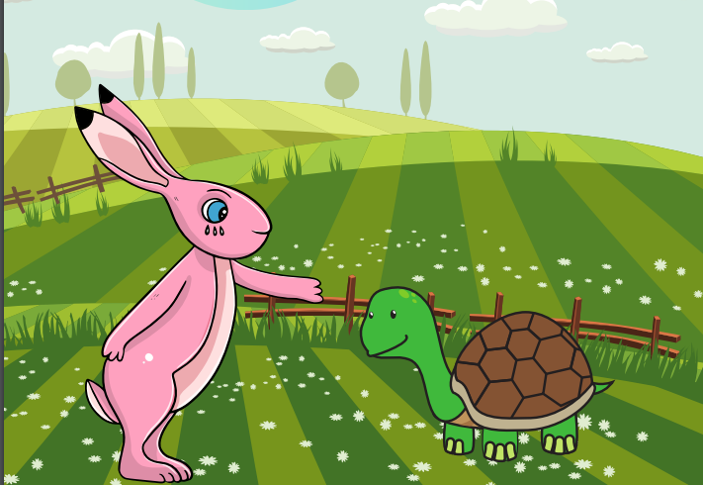
Starlings English Home Learning
Tuesday 2nd February

Slide 2


Today we are going to plan our own version of our story (which we will write over the next few days) ‘Tortoise and Hare’ using different animals.
That means you will:
Think of different animals who are fast or slow.
Plan your story by drawing pictures on the planning grid.
Retell your story orally (by saying it) using your pictures to help you.

Slide 3
First of all we are going to remind ourselves of the order of our story.
Beginning:
Hare was teasing Tortoise for being too slow so Tortoise challenged Hare to a race.
Middle:
The next day, Owl arranged a race for them and all the other animals came to watch.
Hare was smug and he thought he would definitely win so he decided to take a nap.
While Hare slept, Tortoise overtook him and won the race!
End:
Tortoise cheered Hare up and he realised fastest did not mean best.
Hare and Tortoise became best friends.

Slide 4
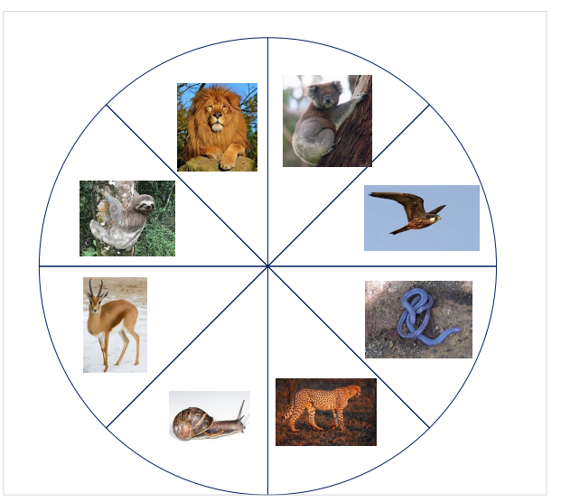
For your story, I would like you to choose two different animals – a fast and a slow one.
You can think of your own or choose two from my wheel….. place a paper clip in the middle of the circle, hold in place with the tip of a pen/pencil and spin the paperclip or just close you eyes and point.
Mrs Judge landed on a koala (slow) and a gazelle (fast).

Slide 5

Now I would like you to plan your story – draw pictures and add key words if you like and then retell your story out loud
Remember that 2 animals (one fast and one slow) have a race and the slowest one wins because the fastest one takes a nap.

Slide 6

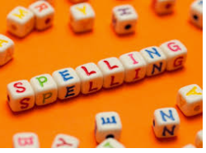


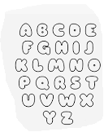

Words of the day!
Thursday Friday Saturday
Can you write the word Thursday 5 times whilst pulling a silly face?
Can you write the word Friday 5 times in bubble writing?
Can you write the word Saturday 5 times back to front (dehctaw) ?

Slide 7

Red group – Please have a look at the separate RWI PowerPoint for set 1. We have added some special friends work for you.
Green group you need to look out for set 2 videos on the link below:
https://www.youtube.com/channel/UCo7fbLgY2oA_cFCIg9GdxtQ
We would like you to watch 4 videos: set 2 speed sounds, set 2 spelling, red words 1, and read and hold a sentence 1
Pink, yellow and blue groups you need to look out for set 3 videos on the link below.
https://www.youtube.com/channel/UCo7fbLgY2oA_cFCIg9GdxtQ
We would like you to watch 4 videos: set 3 speed sounds, set 3 spelling, red words 2 and read and hold a sentence 2

