Slide 1



Starlings Maths Home Learning
Tuesday 2nd February

Slide 2
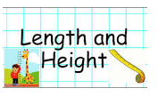
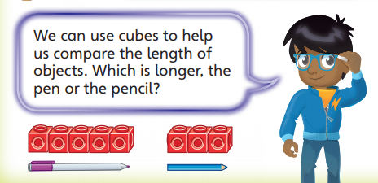
LENGTH & HEIGHT LESSON TWO
Good Morning Starlings! Today we are carrying on with our length and height topic.
We are going to measure objects using non-standard units which means use things around the house to measure objects. We don’t need a ruler today.

Slide 3
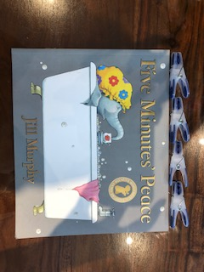
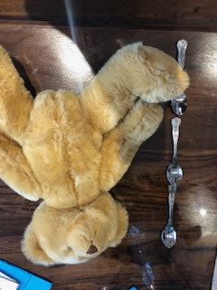
Now I want to have some fun measuring objects in your house – use cubes, paperclips, your hands or feet – anything you have to measure. Don’t use a ruler just yet! Make sure your measuring objects go right from one end to the other.

Slide 4
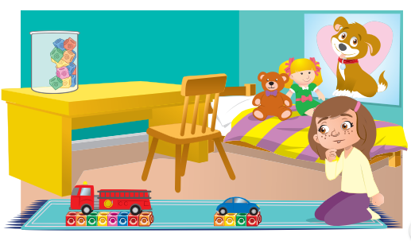
Which is longer? The car or fire truck?
How many cubes long are the fire truck and the car?

Slide 5
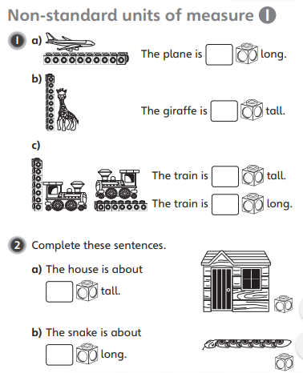
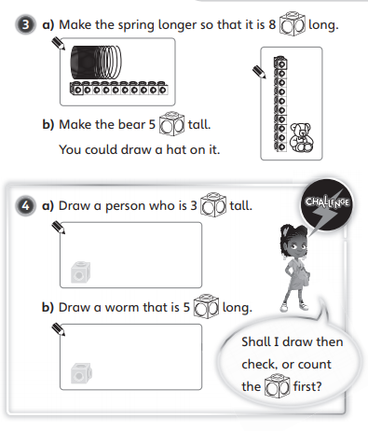

Slide 6

