Slide 1


English
Date: 02.02.21
Week 5 – Lesson 2
Hansel and Gretel

Slide 2

Click on the sound button to hear this slide read to you:
Lets recap our learning from yesterday:
We used the text and our inference skills to create a grid that described the old woman’s appearance and personality:
Description of the old woman’s appearance | Description of the old woman’s personality
She is as old as the hills.
She is leaning on a crutch.
Disrespectful because she spoke scornfully to Hansel and Gretel.
Manipulative because she pretended to be friendly.

Slide 3
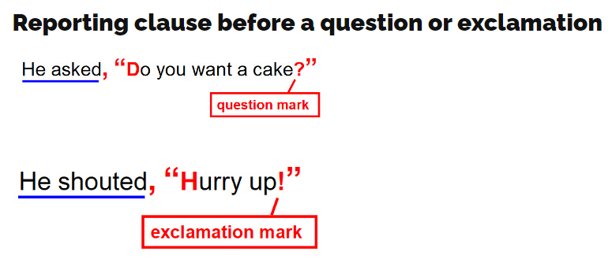
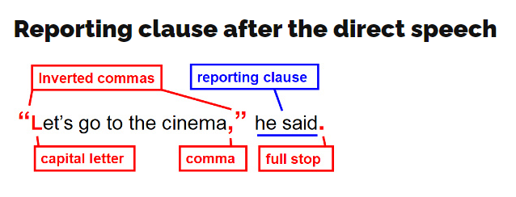
Speech Rules:
Click on the sound button to hear this slide read to you:
Today we are going to write some speech for the old woman. What kind of things might she say? Think about her personality to help you.
Let’s recap our speech rules:
Use a capital letter at the start of the speech
Use either a comma, full stop, ? or ! at the end of the speech
Choose an appropriate verb for the reporting clause (said, explained, questioned, shouted, whispered)
Write speech by a new character on a new line

Slide 4
Click on the sound button to hear activity 1 read to you.
Activity 1:
Write 5 sentences that use direct speech for the witch/old woman. Try to place your reporting clause at both the beginning and end of your sentences and use a different synonym for ‘said’ each time.
Remember to use our speech rules:
Use a capital letter at the start of the speech
Use either a comma, ? or ! at the end of the speech
Choose an appropriate verb for the reporting clause (explained, questioned, shouted, whispered)
Write speech by a new character on a new line
Example:
“Come in children and I will feed you as much food as you like,” declared the old woman with a cunning look on her face.
“What are you doing nibbling on my house dear children?” she asked slyly.
The old woman laughed and spoke bitterly, “You will never escape from me now!”

Slide 5
