Slide 1






English
Monday 1st February 2021

Slide 2
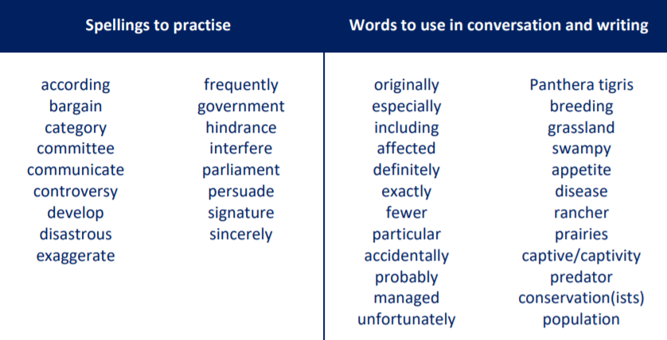
Main outcomes of the session:
To produce a piece of writing about a day trip of holiday that you have been on.
Practise using punctuation ( ).
These are the spelling words that go along with this unit of work exactly like when we’re in school.

Slide 3
What can you remember about brackets and dashes from last week?
( ) -

Slide 4
Remember…
Brackets are used to add extra information in a sentence – an informal comment, extra detail or a list of items
e.g. I loved France (especially the food!) and I’ll definitely visit again.
Dashes are used in a similar way but are useful for adding additional comments at the end of the sentence e.g. I visited the beach in Wales – it was stunning!

Slide 5
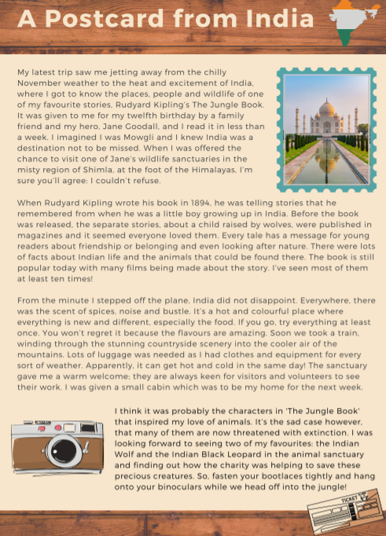
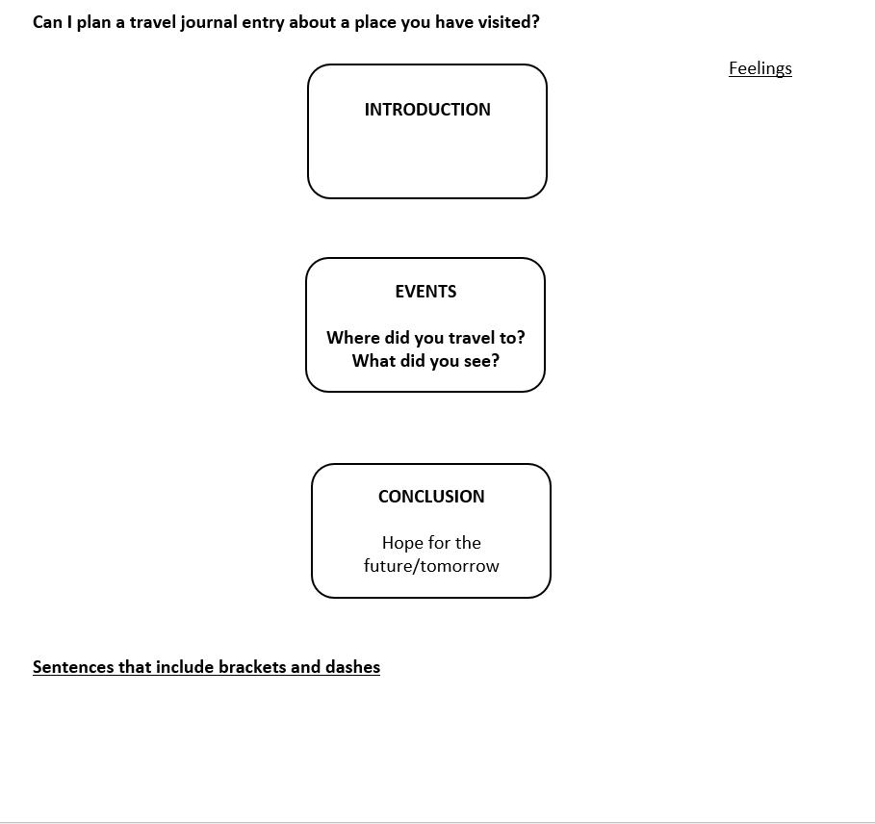
Main Outcome
Write a travel journal entry about a place you have visited.
Activity 1
Plan your travel journal. Only spend around 10-15 minutes completing this. Use my model on the next few slides to help.

Slide 6
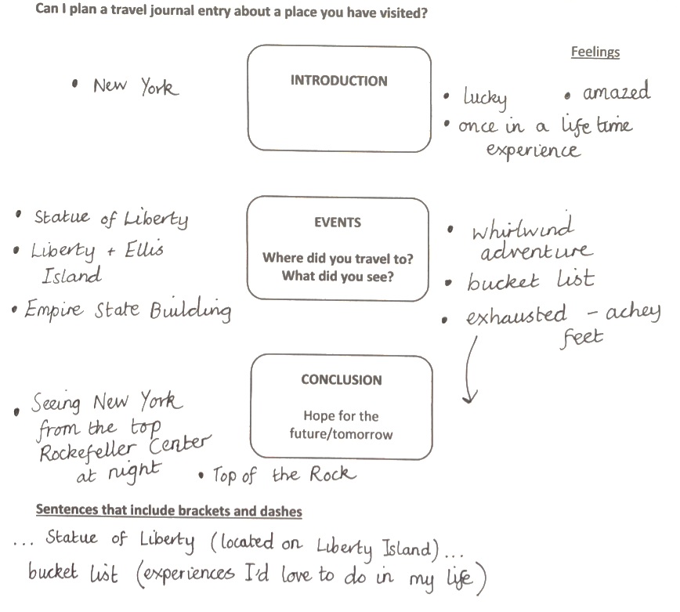

Slide 7
Main Outcome
Write a travel journal entry about a place you have visited.
Activity 2
Write your travel journal.
Only focus on your introduction/first paragraph today.
Make sure you use both brackets and dashes to introduce and share your opinion.
You are allowed to pinch/magpie some of the paragraph and sentence introductions that Martha used.
Today, I would just like you to focus on only the first paragraph of your writing.
I will model this for you on the next slide. I have used Martha’s postcard to help me write the first paragraph of my own travel journal entry about the time I visited New York.
Use this paragraph to help you to write your introduction

Slide 8
