Slide 1



Starlings Maths Home Learning
Monday 1st February

Slide 2
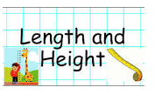
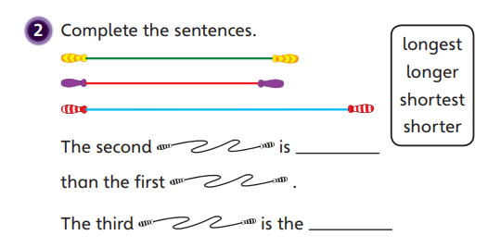
LENGTH & HEIGHT LESSON
Good Morning Starlings and here’s to our fifth week of home learning! This week, we are going to start a new topic all about length and height.
Today, we are going to compare the length and heights of objects – have a look at the words above which we are going to use.

Slide 3
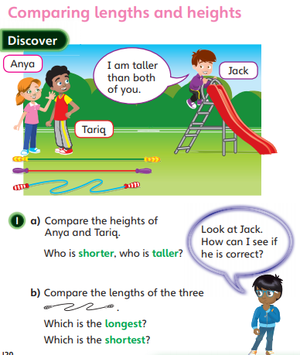
See if you can get all your family members to stand next to each other and tell me who is the shortest and who is the tallest. No cheating by standing on a cushion – your feet all need to start at the same point.
Can you find two pens or pencils and line them up and find the longest or shortest? It might help if you line up the objects against a wall so they all start at the same point. What else can you compare?
You could even trace around the outlines of the objects and then directly compare the traced images by laying them on top of one another.

Slide 4
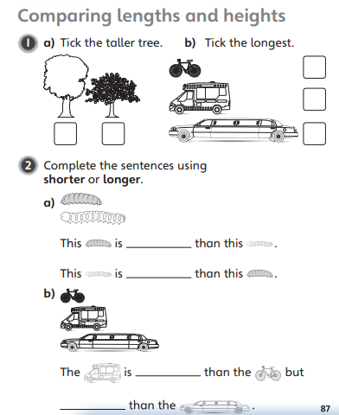
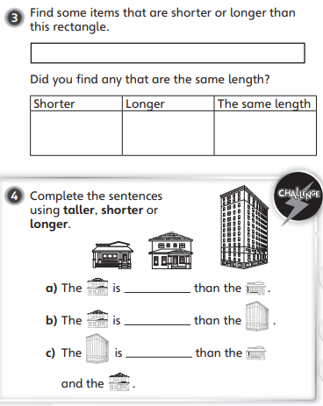

Slide 5
