Slide 1



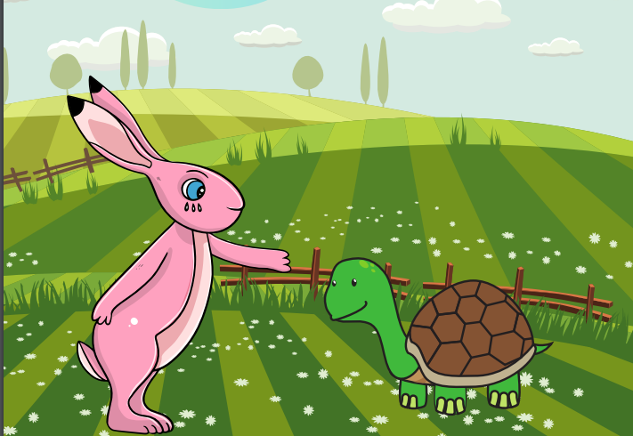
Starlings English Home Learning
Monday 1st February

Slide 2


Today you are going to compare yourselves with the characters in the text ‘Tortoise and Hare’
That means we will:
Explain why you are similar to Tortoise or Hare.
Explain why you are different to Tortoise or Hare.
Write some sentences to compare yourself with the characters using the suffix –er and -est.

Slide 3
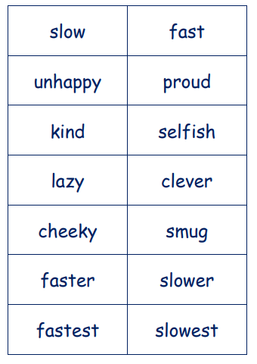
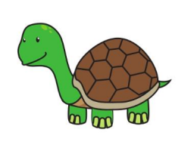
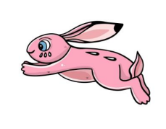

I would like you to think about our main characters and decide which one you are most like. Why?
SAME:
We are both kind.
We are both fast.
Now think about the other character and decide why
you are different.
DIFFERENT:
Hare is meaner.
Tortoise is slower
-est
-er
Use some suffixes

Slide 4
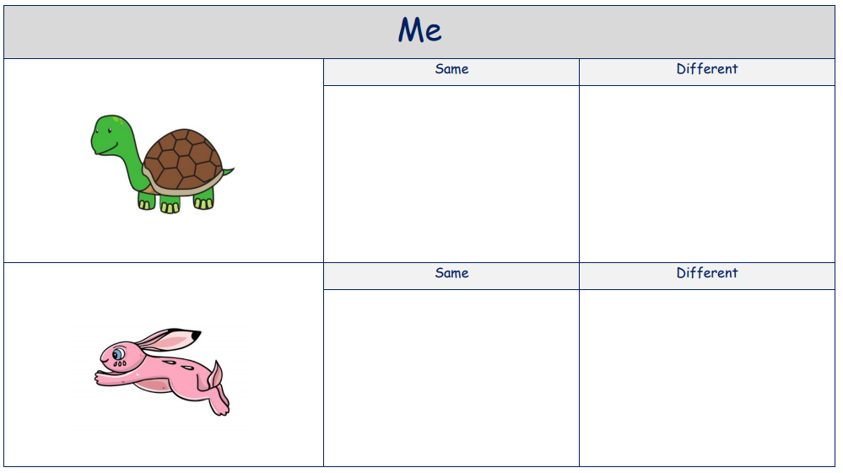
Can you write some sentences to compare yourselves with the characters? See if you can use the suffix –er or –est.

Slide 5

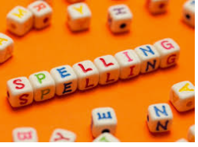




Words of the day!
Monday Tuesday Wednesday
Can you write the word Monday 5 times using your other hand?
Can you write the word Tuesday 5 times in your prettiest handwriting?
Can you write the word Wednesday 5 times in rainbow colours ?

Slide 6

Red group – Please have a look at the separate RWI PowerPoint for set 1. We have added some special friends work for you.
Green group you need to look out for set 2 videos on the link below:
https://www.youtube.com/channel/UCo7fbLgY2oA_cFCIg9GdxtQ
We would like you to watch 4 videos: set 2 speed sounds, set 2 spelling, red words 1, and read and hold a sentence 1
Pink, yellow and blue groups you need to look out for set 3 videos on the link below.
https://www.youtube.com/channel/UCo7fbLgY2oA_cFCIg9GdxtQ
We would like you to watch 4 videos: set 3 speed sounds, set 3 spelling, red words 2 and read and hold a sentence 2

