Slide 1

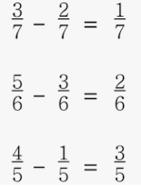


Mathematics
Date: 01.02.21
Subtracting Fractions

Slide 2
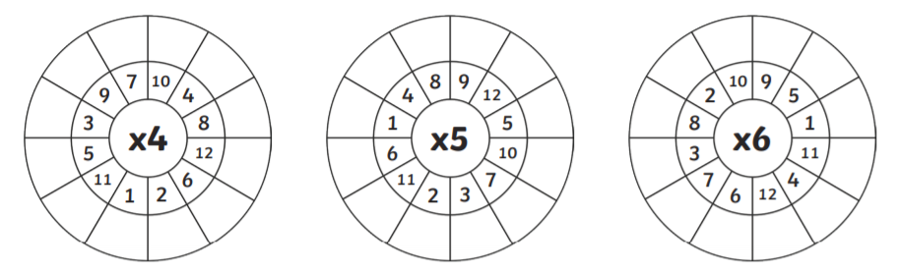
Mental Arithmetic Starter
Complete the times tables wheels as quick as you can

Slide 3

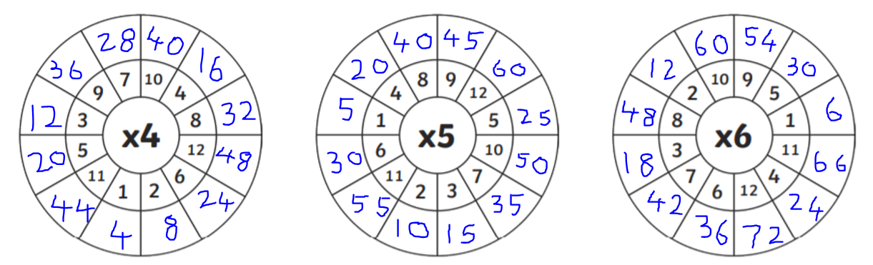
Mental Arithmetic Starter

Slide 4
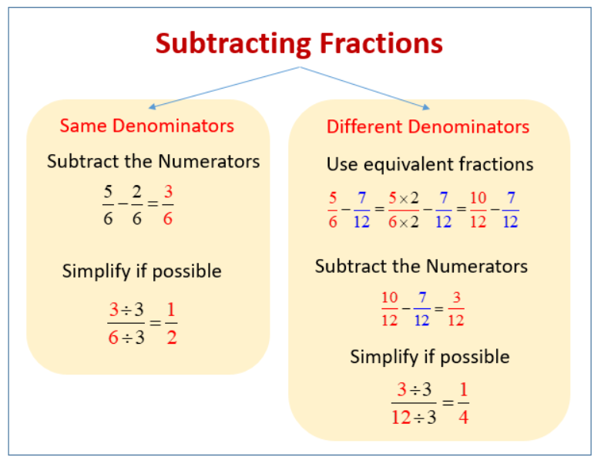
Methods
A
B
Look for the lowest common denominator

Slide 5
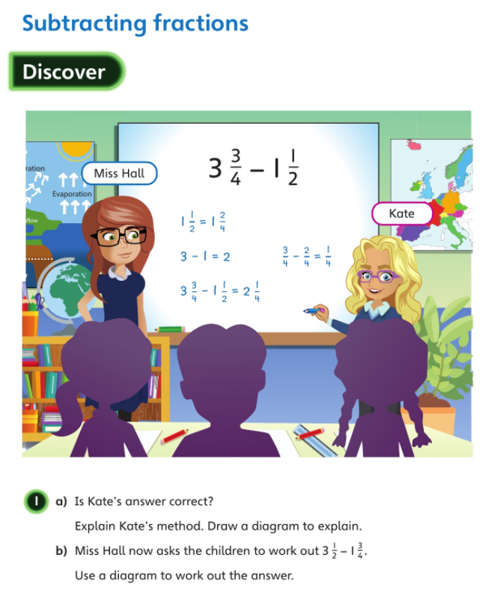


Clue for 1a
= 3 wholes and 3/4
Clue for 1b
= 3 wholes and 1/2
Remember ½ = 2/4

Slide 6
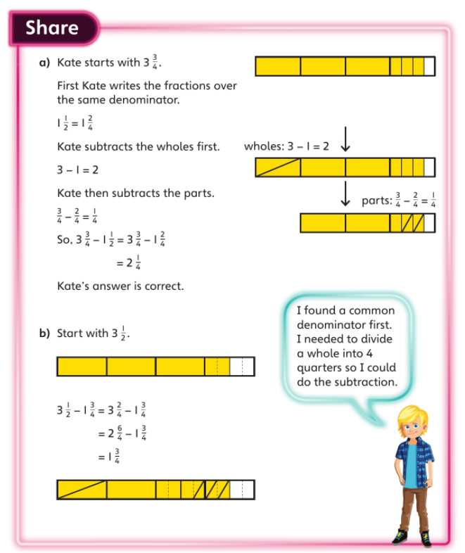
Remember you cannot subtract 3/4 from 2/4, therefore you need to break down the whole unit into quarters
1 whole = 4/4

Slide 7

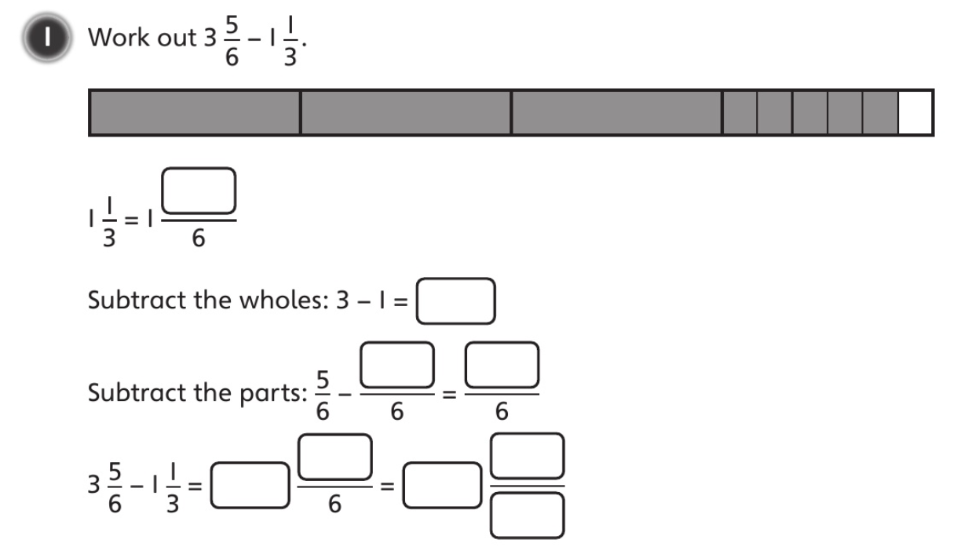

Slide 8
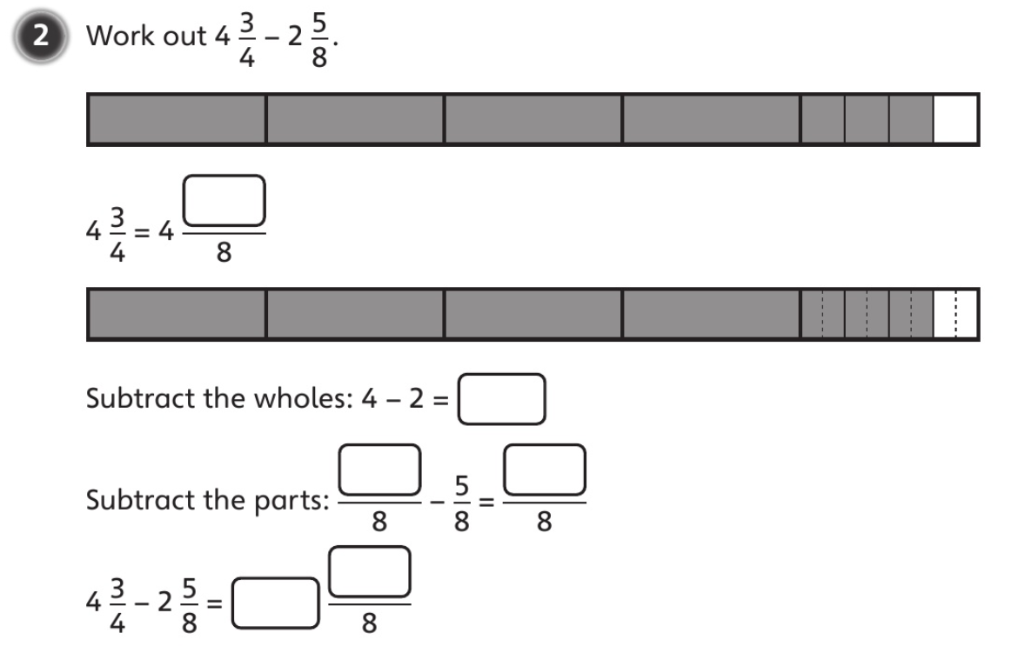

Slide 9
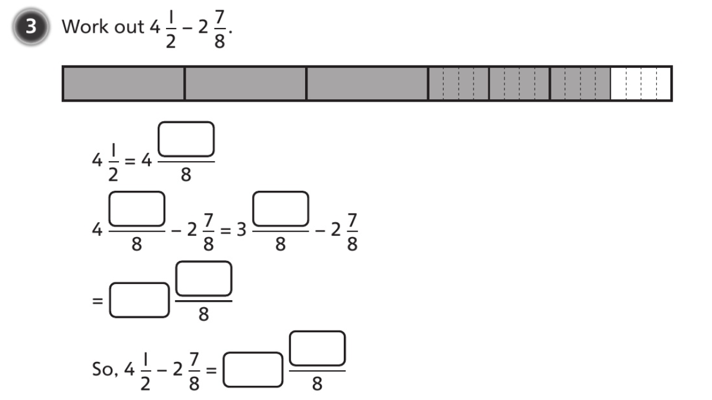
Remember you cannot subtract 7/8 from 4/8

Slide 10
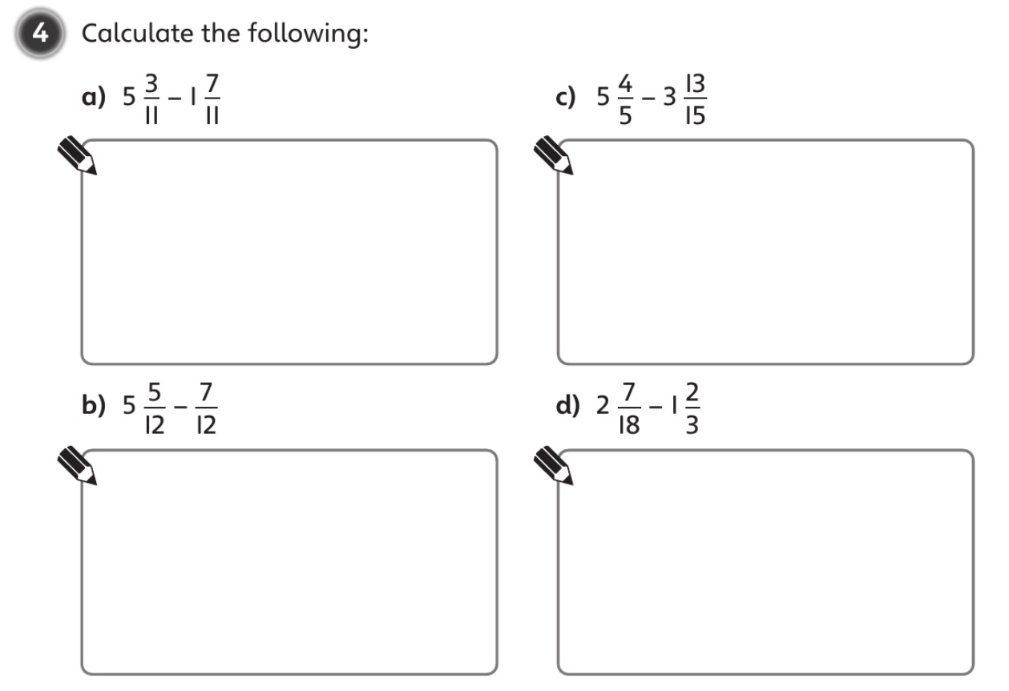

Slide 11
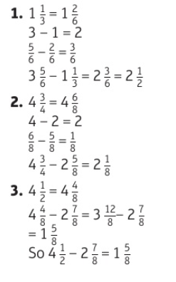


Slide 12
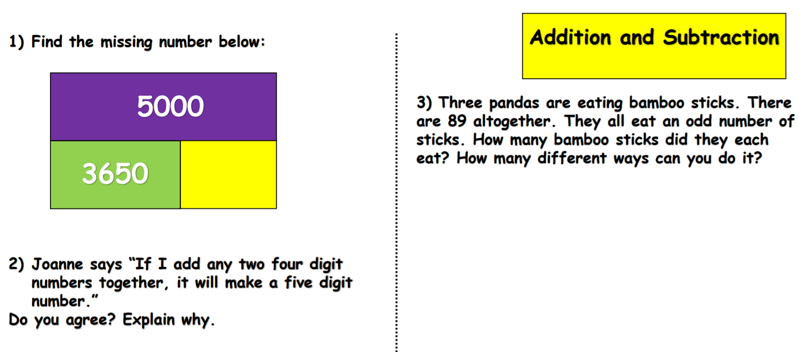
Challenge

Slide 13
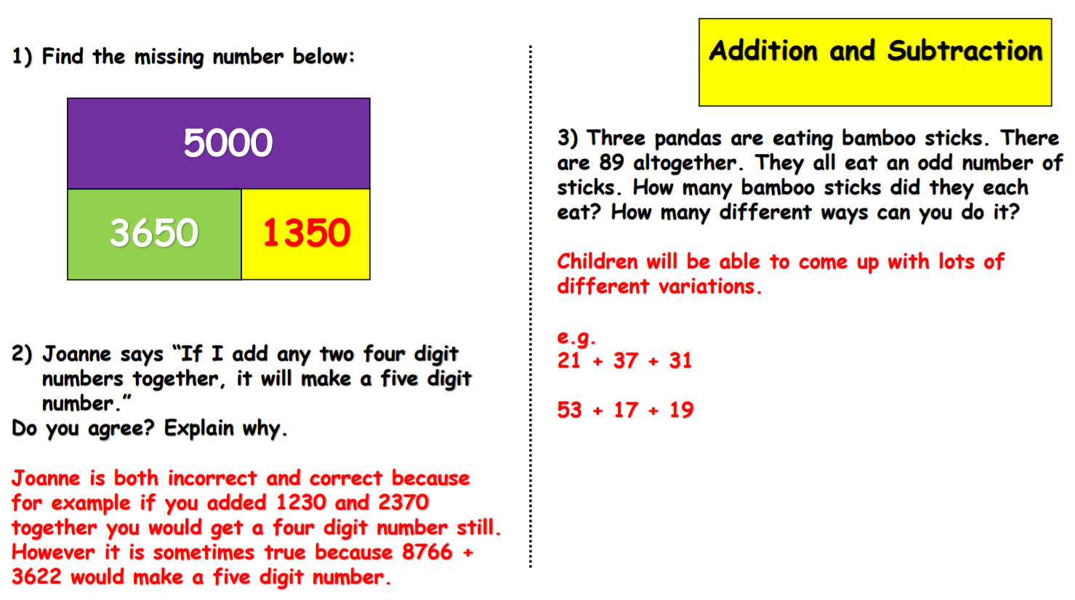
Challenge Answers

