Slide 1


English
Date: 01.02.21
Week 5 – Lesson 1
Hansel and Gretel

Slide 2
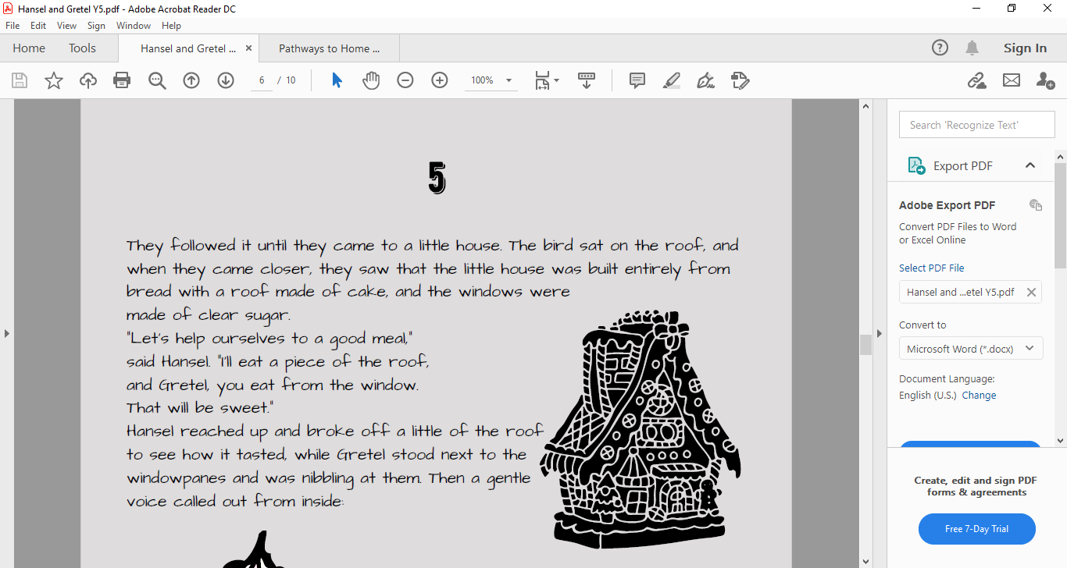

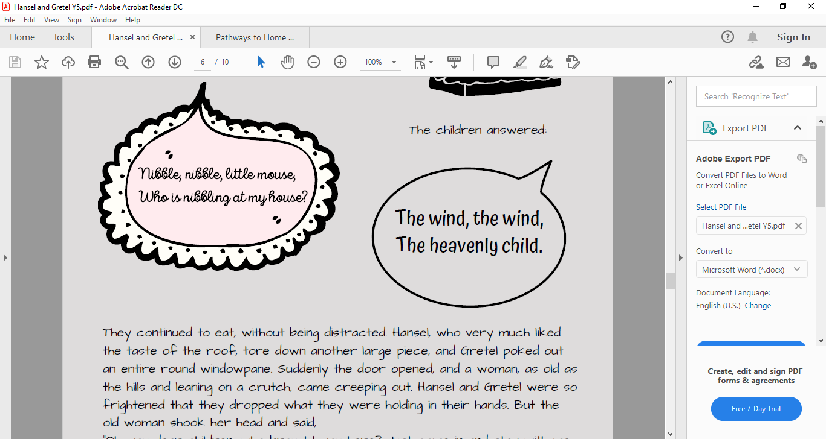
Re-read pages 5 and 6 or click on the sound button to hear it being read to you.
The text is also attached to our blog if you want to open or print it this way.
While you are reading, think about what have we found out about the old woman. What does she look like? What is her personality like?

Slide 3
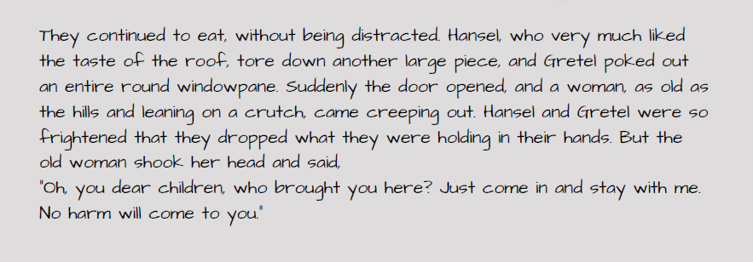
Re-read pages 5 and 6 or click on the sound button to hear it being read to you. The text is also attached to our blog if you want to open or print it this way.
While you are reading, think about what have we found out about the old woman. What does she look like? What is her personality like?

Slide 4
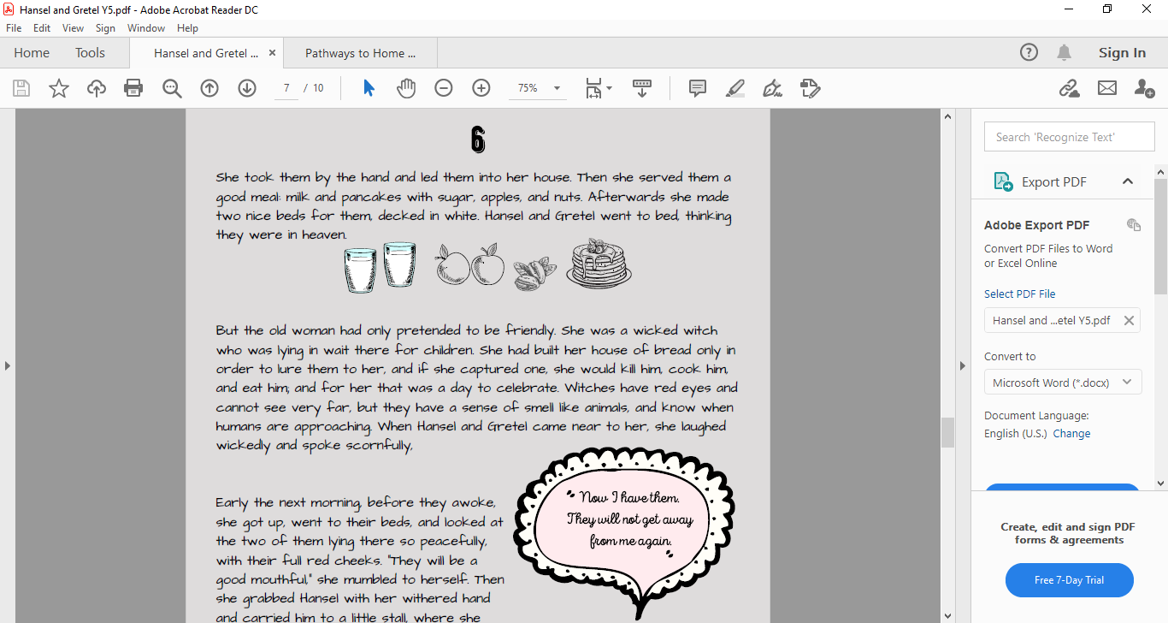
Re-read pages 5 and 6 or click on the sound button to hear it being read to you.
The text is also attached to our blog if you want to open or print it this way.
While you are reading, think about what have we found out about the old woman. What does she look like? What is her personality like?

Slide 5
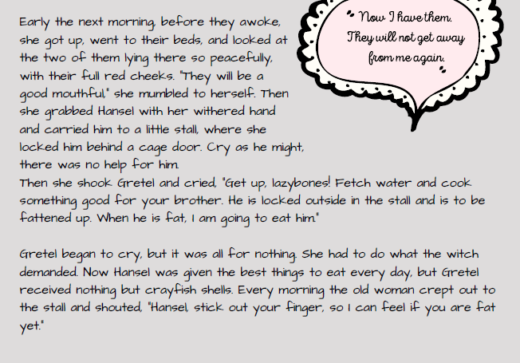
Re-read pages 5 and 6 or click on the sound button to hear it being read to you.
The text is also attached to our blog if you want to open or print it this way.
While you are reading, think about what have we found out about the old woman. What does she look like? What is her personality like?

Slide 6
Click on the sound button to hear this slide read to you:
Before we get started:
Divide a page into two columns. Give each column the following sub-headings:
Description of the old woman’s appearance | Description of the old woman’s personality

Slide 7
Activity 1:
Click on the sound button to hear activity 1 read to you:
Go back through the text and find/copy descriptions about the witch’s appearance and add to the first column of your grid.
E.g. as old as the hills.
leaning on a crutch.
Use you imagination and inference skills to describe what the witch’s personality is like and add this to the second column of your grid.
E.g. Disrespectful because she spoke scornfully
to Hansel and Gretel.
Manipulative because she pretended to be
friendly.
Description of the old woman’s appearance | Description of the old woman’s personality

Slide 8
