Slide 1
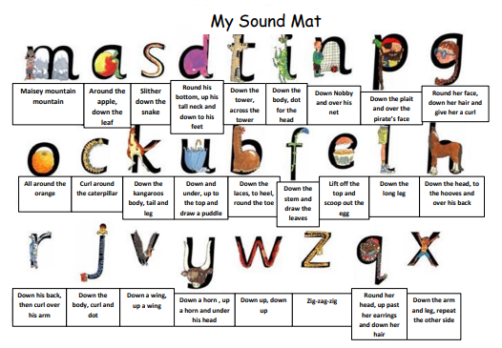


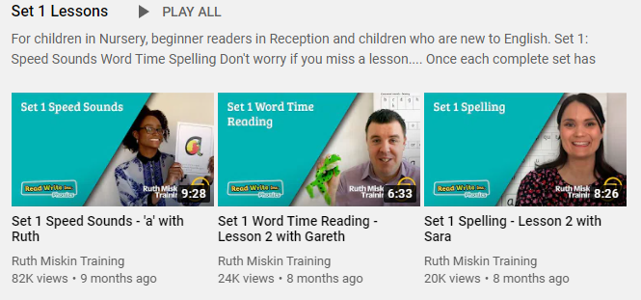
Read Write Inc
Set 1
Please follow the link below to your Read Write Inc lesson today. Each day you will need to click on the video’s shown in the screen shots below. Please remember that although the screen shot says /a/, the sound will change each day but will be found in the same place.
https://www.youtube.com/channel/UCo7fbLgY2oA_cFCIg9GdxtQ
Video 1: Please watch ‘Set 1 Speed sound’ lesson.
Video 2: Please watch ‘Set 1 Word Time’ lesson.
Video 3: Please watch ‘Set 1 Spelling’ Lesson
Please complete all video’s each day ☺

Slide 2

ck
nk
ng

Slide 3

sock

Slide 4

song

Slide 5

sink

