Slide 1
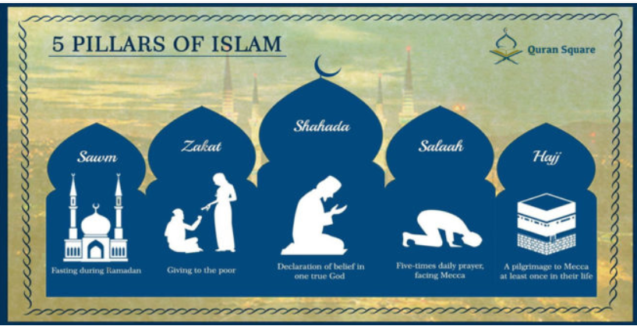

Islam
How do Muslims show community is important in practice? - 5 Pillars of Islam

Slide 2
Islam
Lets start by thinking about this words – surrender, obedience, submission.
What do each of these words mean?
Use this on-line dictionary if you are unsure –
https://www.dictionary.com/
Can you role play a scenario to show these 3 ideas positively e.g. following a teacher’s instruction or obeying Mum.

Slide 3
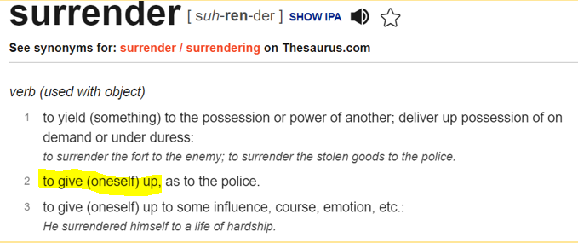
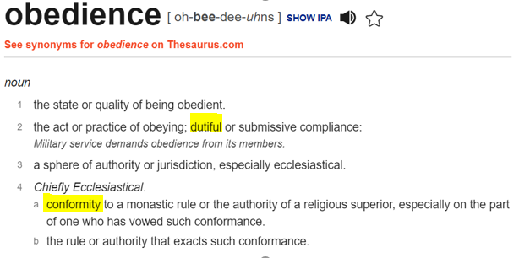
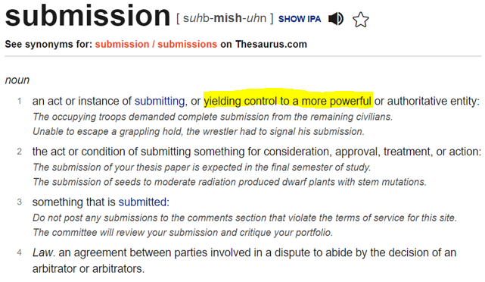

Slide 4
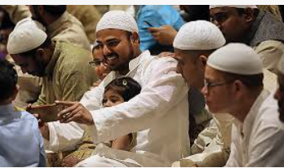
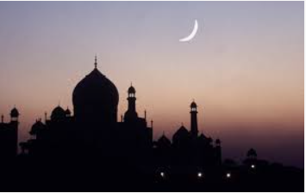
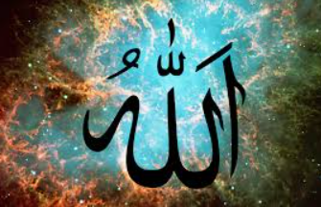
Lets now look at these words – Islam, Muslim, Allah
A
B
C
Can you think about which word would match with which picture?

Slide 5
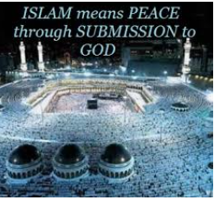
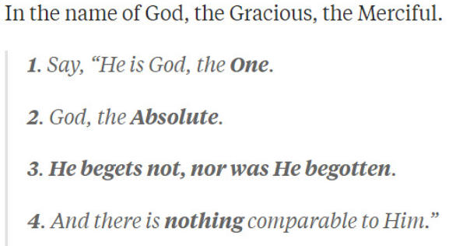

Can you think about which word would match with which definition?
Islam, Muslim, Allah
2
3
1

Slide 6
Islam Muslim Allah
Now lets reveal…
B
2
A
3
C
1

Slide 7
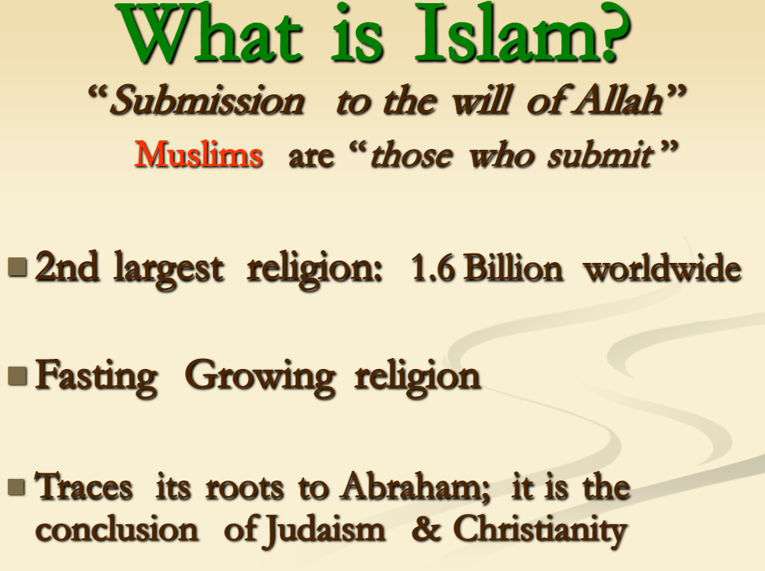

Slide 8
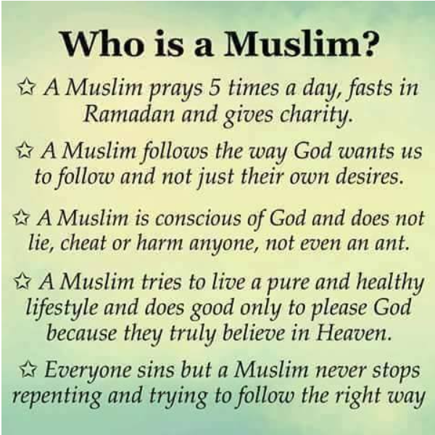

Slide 9
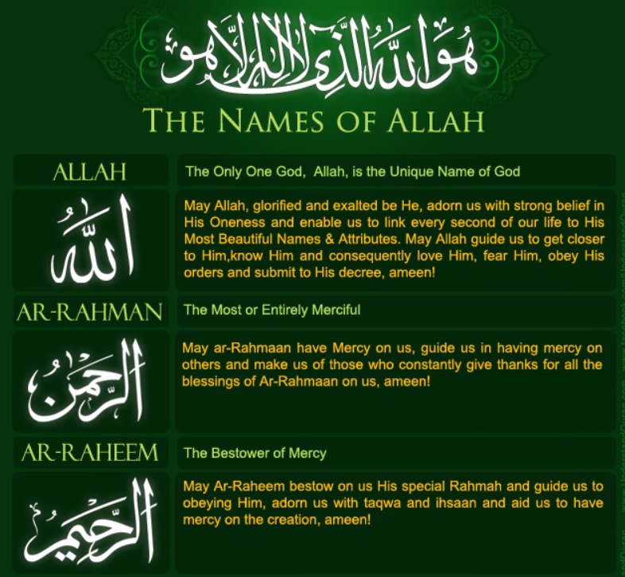
No images of Allah only words
99 names

Slide 10
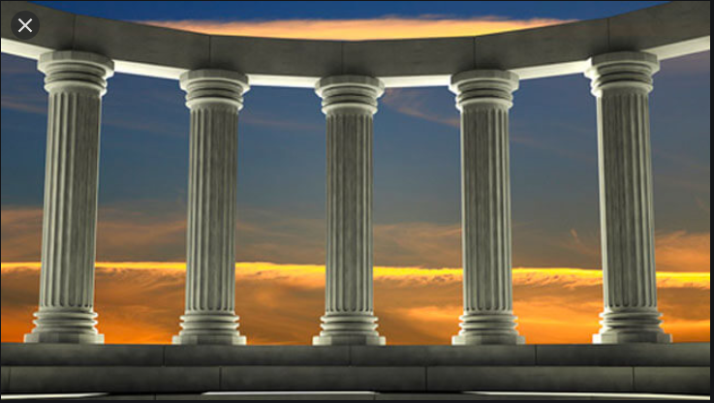
Pillars
Why are these important for a building?

Slide 11
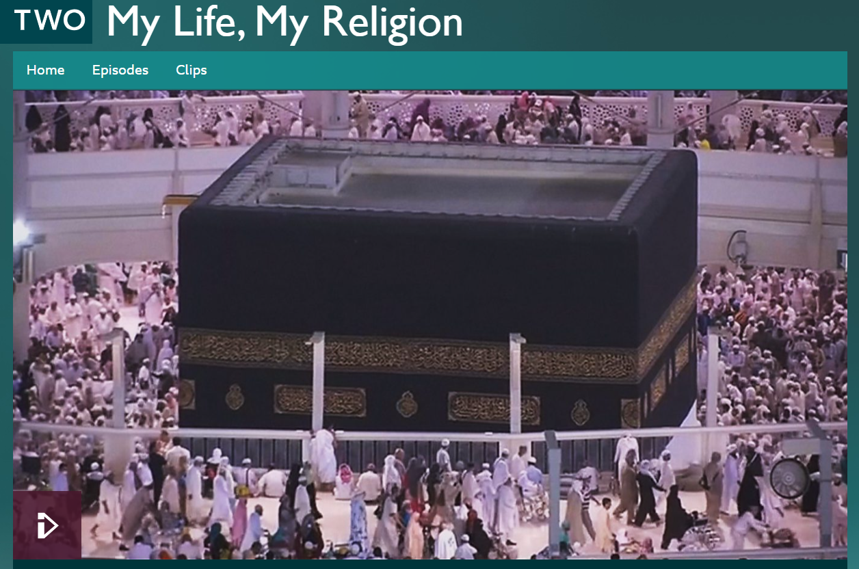
5 Pillars of Islam
A pillar supports the building, is built on foundation.
Muslims believe that there are 5 duties or pillars that hold their community together.
They believe that their whole way of life is supported by these pillars
Watch this video learn more about the 5 Pillars of Islam
http://www.bbc.co.uk/programmes/p02mwkxn

Slide 12
.
http://www.bbc.co.uk/programmes/p02mwkxn
Watch the video again and take note of what Sara considers is important as a Muslim.
Can you make notes about the pillars?

Slide 13
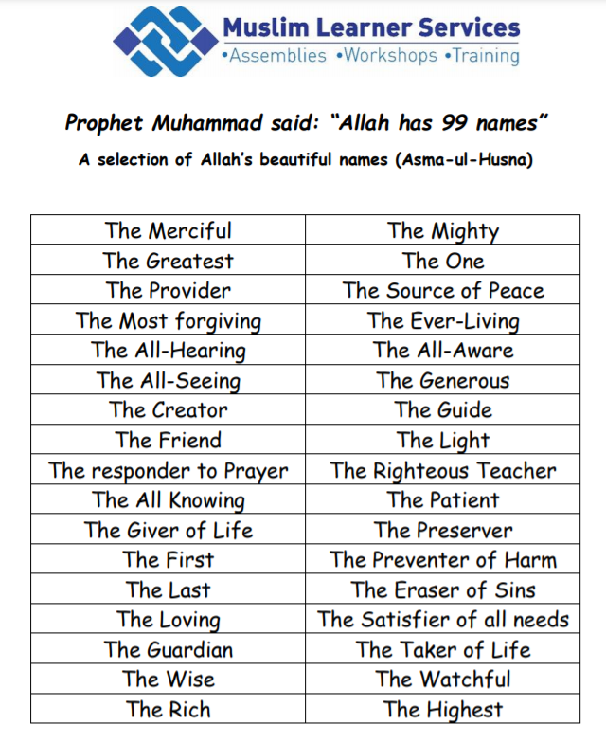
Imran Kotwal
Think of an action and create a still pose/body sculpture

Slide 14
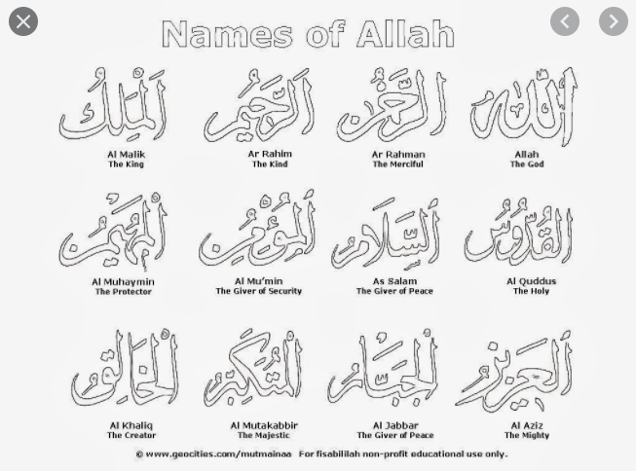

Slide 15
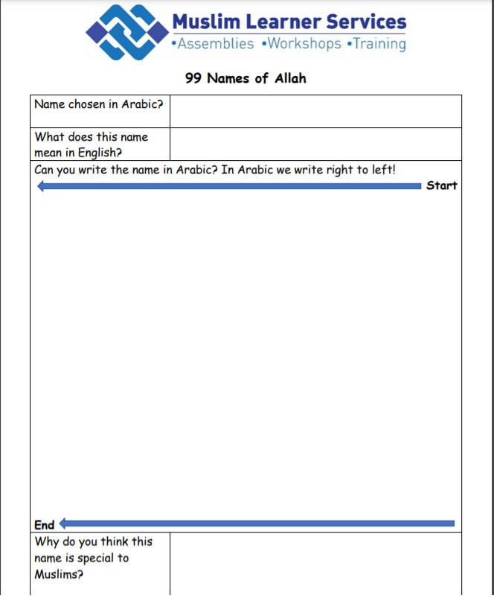
Have a go at writing a name
Challenge: Can you write it starting
on the right!

Slide 16
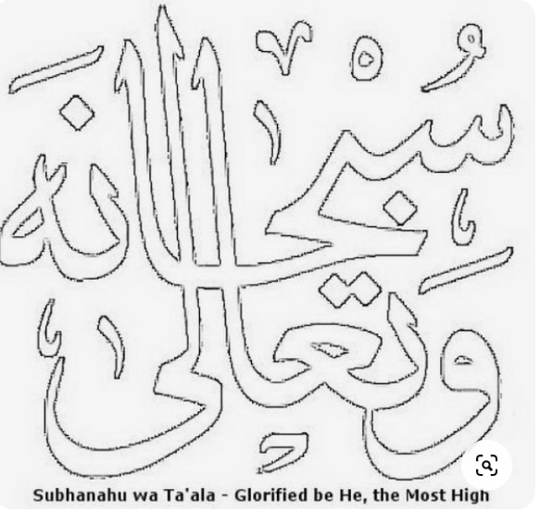
Colour in rather than draw if too hard

Slide 17
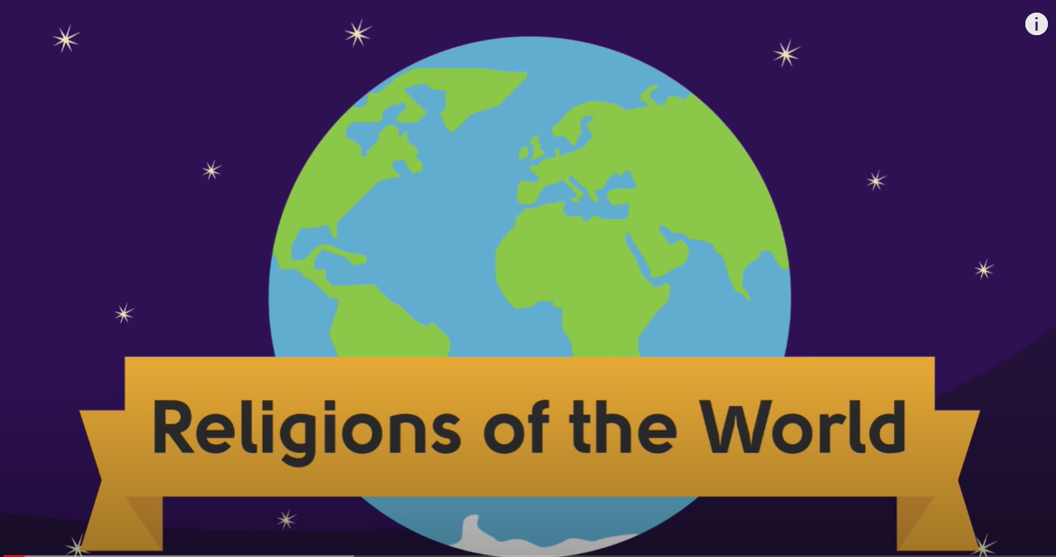
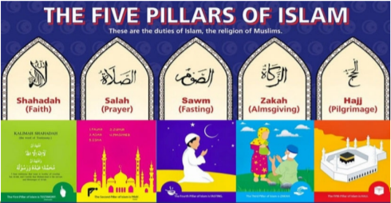
Next Week – we will look more at the 5 Pillars of Islam and explore the beliefs behind each one in more detail
Take a look at this website to help prepare you for what we will cover in next week’s lesson
https://www.youtube.com/watch?v=H9U8T8x1AhQ

