Slide 1

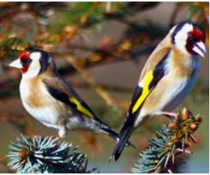
Goldfinches Arithmetic Lesson
1.2.21

Slide 2

Times Tables
Can we begin by counting in 9s.
Can you write down these multiples and then you can check them on the next slide.

Slide 3
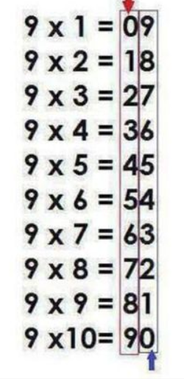
Times Tables
Multiples of 9 – 9, 18, 27, 36, 45, 54, 63, 72, 81, 90, 99, 108

Slide 4
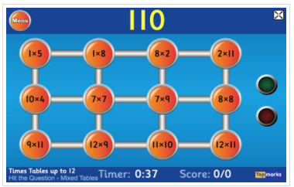
Times Tables
Now here’s a game to revise our Times Tables – Hit The Button
https://www.topmarks.co.uk/maths-games/hit-the-button
You can choose ‘Mixed’ for a variety of times tables or choose a specific one to work on e.g. ‘x 9’

Slide 5
Four Rules of Number - Multiplication
Lets start with some quick fire multiplication facts
4 x 6 =
7 x 8 =
9 x 3 =
6 x 7 =
8 x 5 =
4 x 9 =

Slide 6
Four Rules of Number - Multiplication
How did you get on?
4 x 6 = 24
7 x 8 = 56
9 x 3 = 27
6 x 7 = 42
8 x 5 = 40
4 x 9 = 36

Slide 7
Four Rules of Number - Multiplication
What happens when you multiply by 0?
4 x 0 =
7 x 0 =
9 x 0 =
6 x 0 =
8 x 0 =
4 x 0 =

Slide 8
Four Rules of Number - Multiplication
Did you remember that the answer is always 0?
4 x 0 = 0
7 x 0 = 0
9 x 0 = 0
6 x 0 = 0
8 x 0 = 0
4 x 0 = 0

Slide 9
Multiplying 3 numbers
Remember to use brackets and do what is inside them first?
2 x 9 x 5 = (2 x 9) x 5 = 18 x 5 = (10 x 5) + (8 x 5) = 50 + 40 = 90
Try these 2 yourself
6 x 4 x 9 =
8 x 3 x 6 =

Slide 10
Multiplying 3 numbers
How did you get on?
6 x 4 x 9 = 6 x (4 x 9) = 6 x 36 = (6 x 30) + (6 x 6) = 180 + 36 = 216
8 x 3 x 6 = 8 x (3 x 6) = 8 x 18 = (8 x 10) + (8 x 8) = 80 + 64 = 144

Slide 11
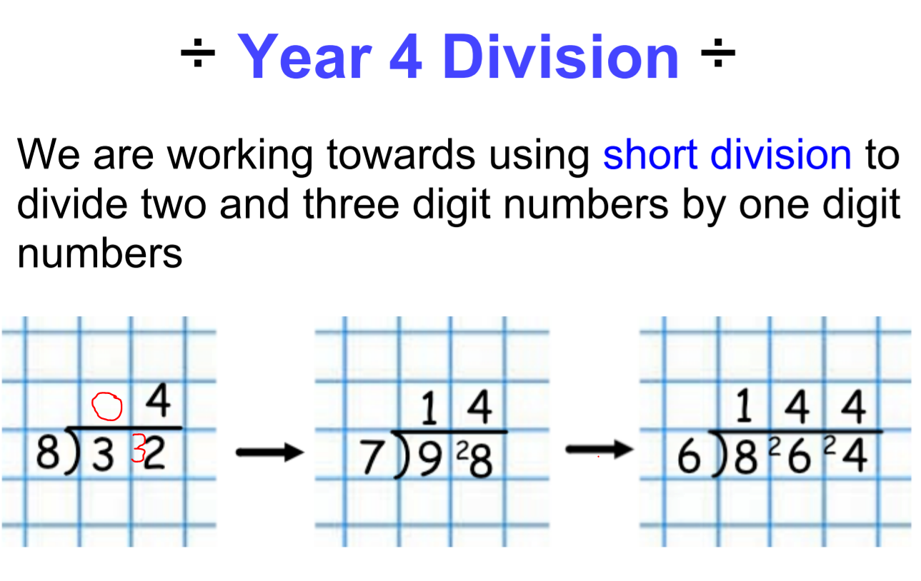
Short Division

Slide 12
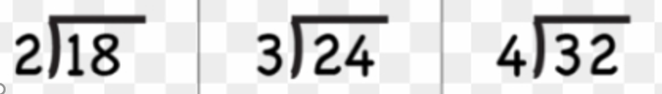
Short Division

Slide 13
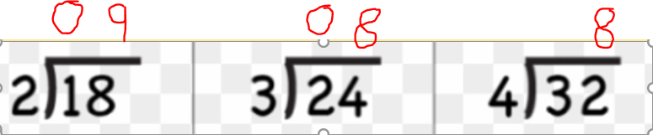
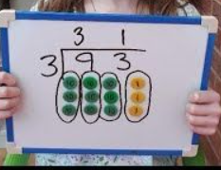
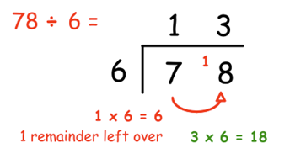
Short Division

Slide 14
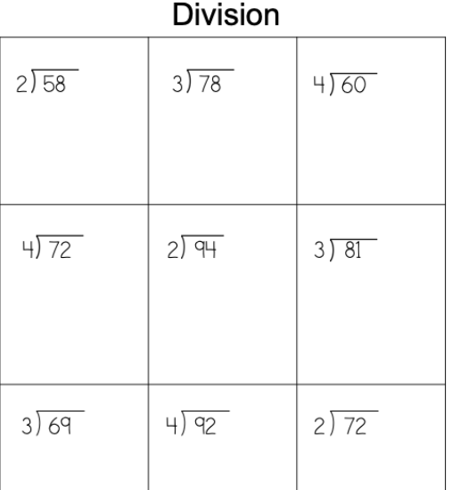

Slide 15

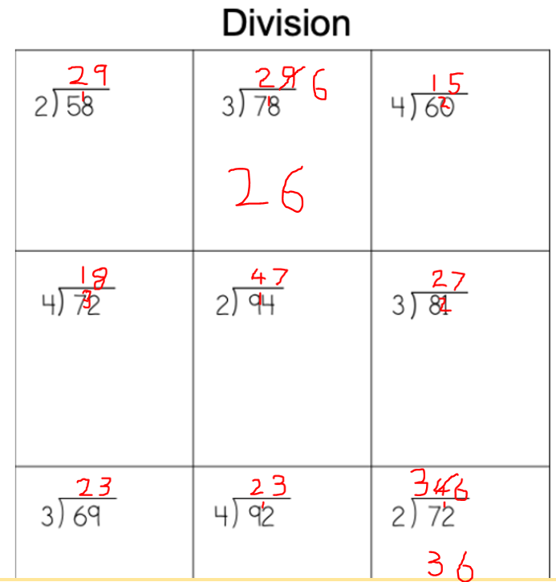

Slide 16
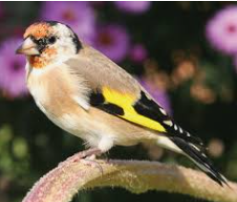
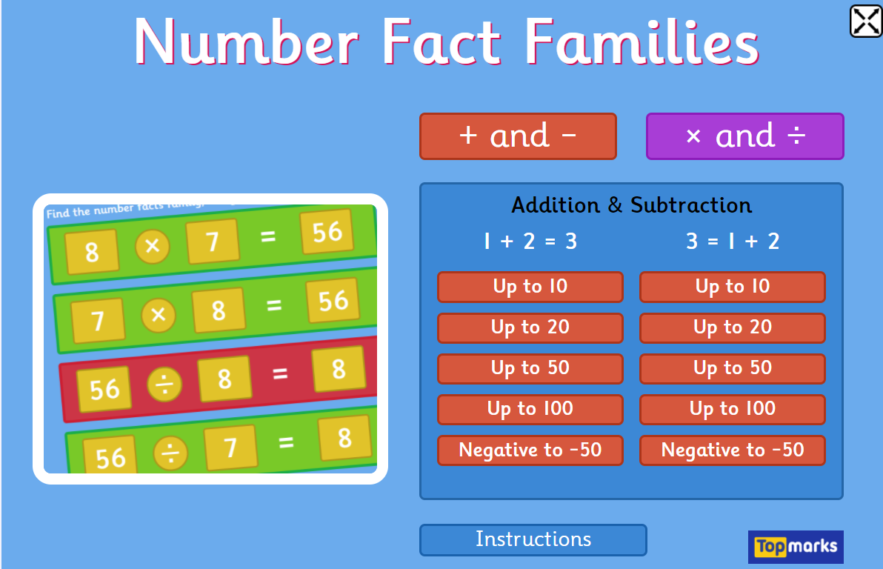
Next Week
Arithmetic test, just like we do in class and we will go through the answers together.
Now have a go at this game Number Fact Families and focus on the Multiplication and Division Facts.
https://www.topmarks.co.uk/number-facts/number-fact-families

