Slide 1


Starlings Maths Home Learning
Friday 29th January

Slide 2
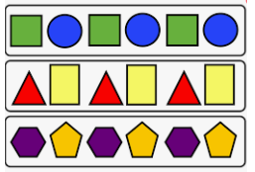
SHAPE LESSON FIVE
Good Morning and welcome to our last lesson on shape. You have worked so hard on this topic and I hope you have enjoyed it.
Today we are going to identify (find) 2D and 3D shapes within repeating patterns.
You will also describe the patterns and identify missing shapes.

Slide 3
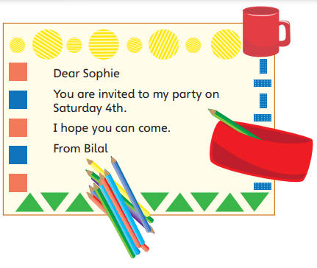
Have a look at the party invite:
What shape is under the cup?
How many rectangles are there?
Can you think of a question to ask
your grown up?

Slide 4
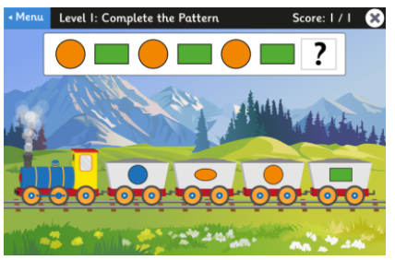
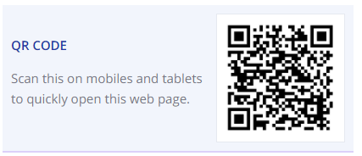
Have fun completing the patterns on this game. Follow the link below or scan the QR code:
https://www.topmarks.co.uk/ordering-and-sequencing/shape-patterns

Slide 5
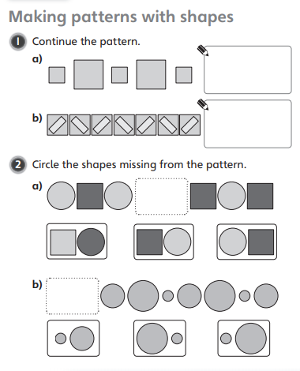
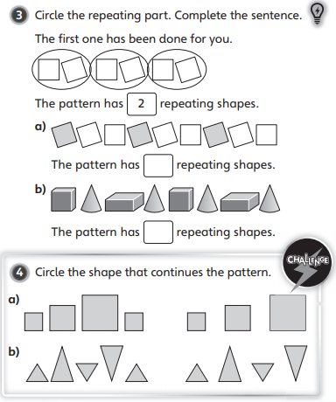

Slide 6

