Slide 1



SCIENCE
Diet & Lifestyle
Lesson 2

Slide 2
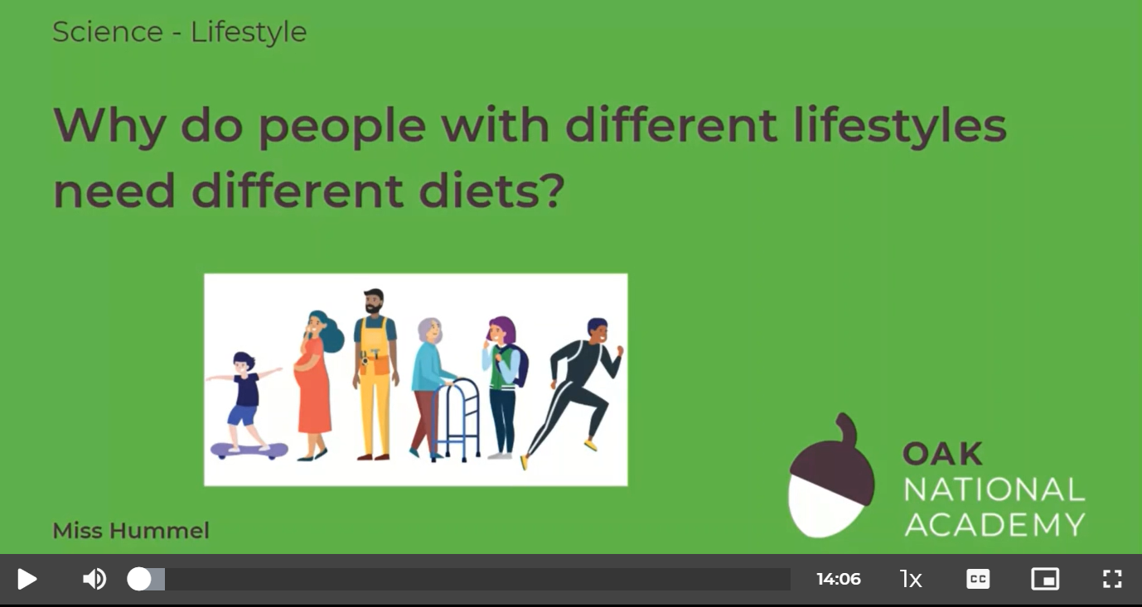
Why do people with different lifestyles need different diets?
In this lesson, we will learn about different lifestyles and characteristics and how these will affect the amount of energy that those people need. We will also learn about nutritional deficiencies as well as discuss whether there could be a solution to all of our unbalanced diet problems.
Click on the following link to watch and take part in the following video lesson.
https://classroom.thenational.academy/lessons/why-do-people-with-different-lifestyles-need-different-diets-6nj66r
Play the audio first before clicking on the link to the lesson.

Slide 3
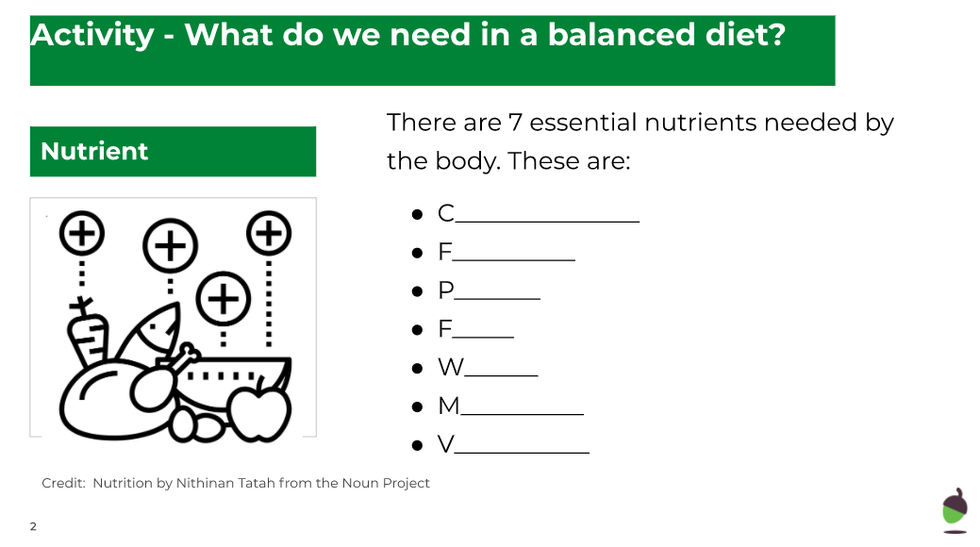
Why do people with different lifestyles need different diets?
Click on the following link to complete the activities for today’s lesson:
https://classroom.thenational.academy/lessons/why-do-people-with-different-lifestyles-need-different-diets-6nj66r?step=2&activity=worksheet

Slide 4
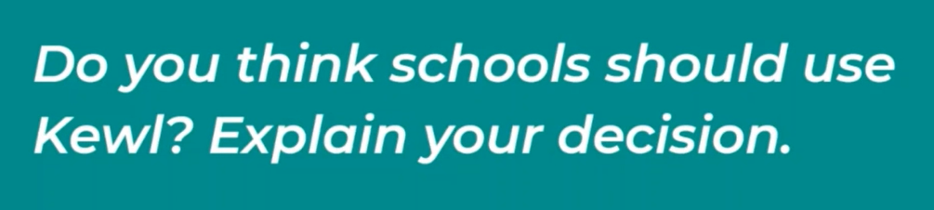
Write or record orally your argument…
You can write your arguments for or against on our class discussion feed or you could submit your written or oral recording via the homework section ‘upload your homework’ button.

