Slide 1


English
Date: 29.01.21
Week 4 – Lesson 5
Hansel and Gretel

Slide 2

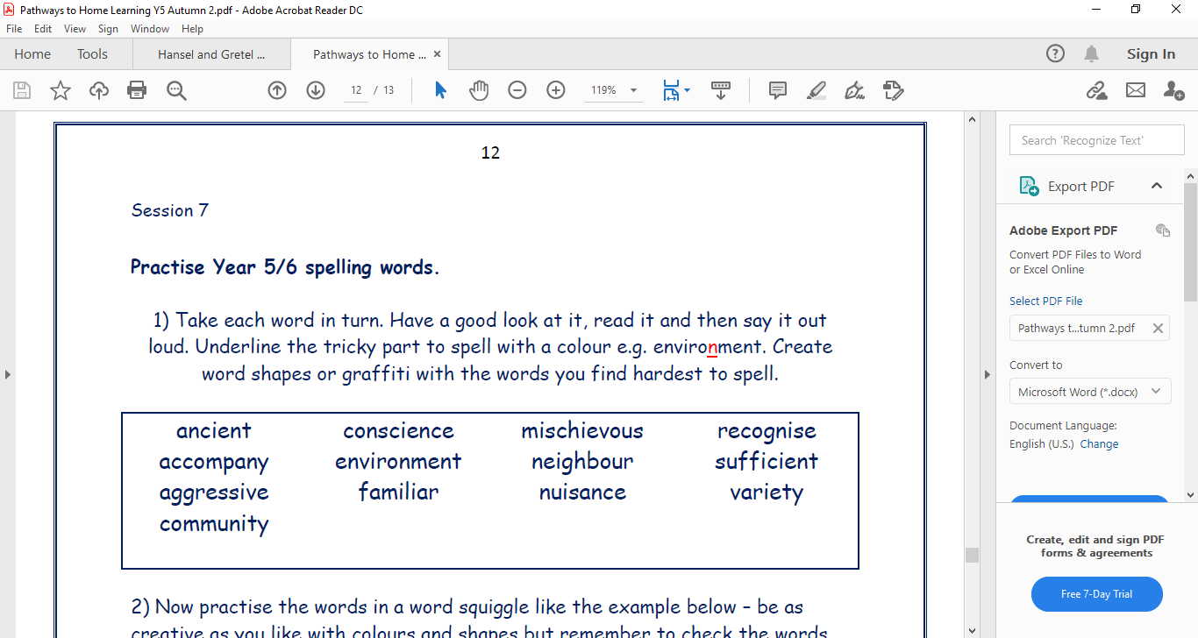
Click on the sound button to hear activity 1 read to you:
Activity 1:

Slide 3
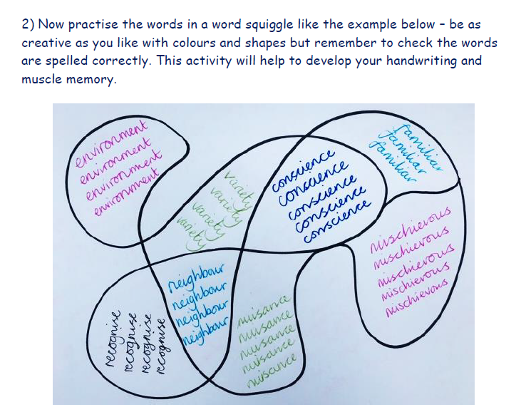
Activity 2:
Click on the sound button to hear activity 2 read to you:

Slide 4
Click on the sound button to hear activity 3 read to you:
Activity 3:
Choose 5 of these words to write in sentences – try to link your sentences to Hansel and Gretel.
Check your spelling of these words as you go – they’re tricky!
For example:
The children were scared because they were in an unfamiliar environment.
The aggressive, wicked stepmother didn’t have a clear conscience.

Slide 5
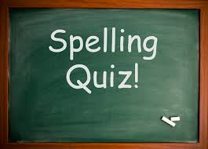
Click on the sound button to hear the spellings for this week’s quiz.

Slide 6
Answers:
Terribly
Horribly
Possibly
Responsibly
Incredibly
Click on the sound button to hear the spelling quiz answers.

Slide 7
