Slide 1


Friday 29th January 2021
Can I explain what light and dark are?
I wonder…

Slide 2

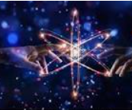
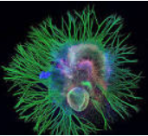

Follow this link to Miss Emm’s Science lesson.
Have a go at the quiz to see how much you have learnt.
https://classroom.thenational.academy/lessons/what-is-light-c4w30d
I love this image. I wonder what it is?

Slide 3
Light is a type of energy that travels in a wave.
What I know now…
That a window is not a source of light.

