Slide 1
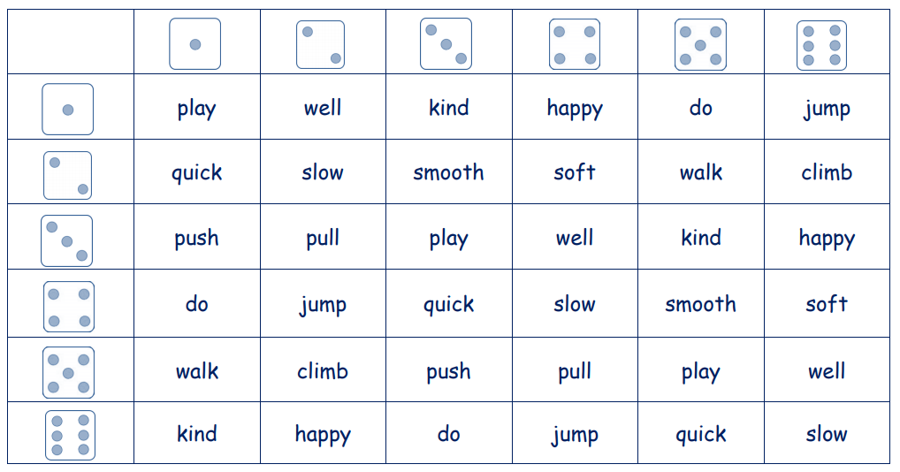
I’d like you to play a game where you roll dice (you can do this with online dice – just type in ‘online dice roller’ to Google) and with your root word (these are all root words below) then see which prefix or suffix you could use to make a new word. Write a list of as many as you can e.g. unkind, softer, quickest

