Slide 1
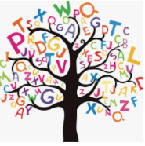
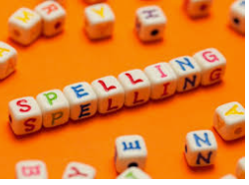


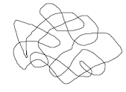

Words of the day!
gather gathered cheeky
Can you write the word gather 5 times as small as you can?
Can you write the word gathered 5 times in a squiggle?
Can you write the word cheeky 5 times as tall as you can ?

