Slide 1



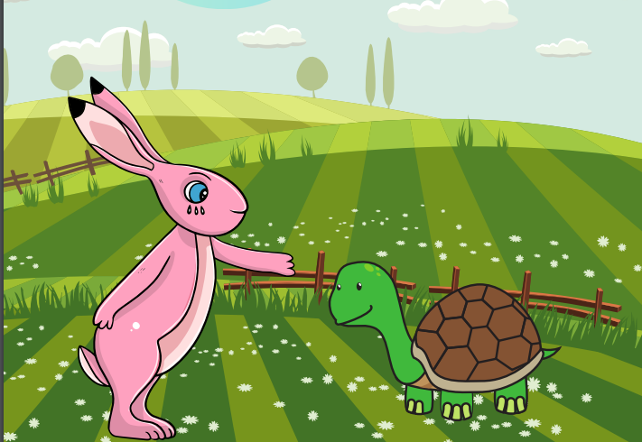
Starlings English Home Learning
Thursday 28th January

Slide 2


Today we are going to add prefixes and suffixes to create new words.
You will:
Add prefixes (at the front of a root word).
Add suffixes (at the end of a root word).
Use prefixes and suffixes to create new words.

Slide 3
un-
Prefixes are a group of letters that change the meaning of a root word when they are added to the start.
-ing
-er
-est
-ed
Suffixes are a group of letters that change the meaning of a root word when they are added to the end.

Slide 4
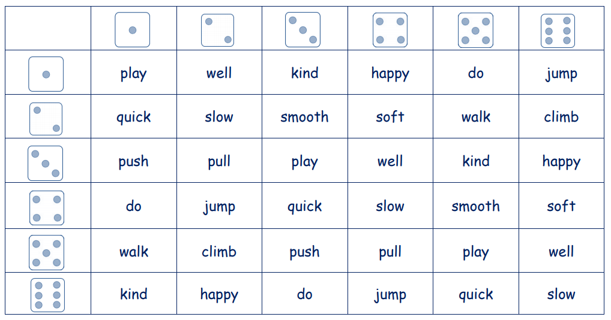
I’d like you to play a game where you roll dice (you can do this with online dice – just type in ‘online dice roller’ to Google) and with your root word (these are all root words below) then see which prefix or suffix you could use to make a new word. Write a list of as many as you can e.g. unkind, softer, quickest

