Slide 1


Starlings Maths Home Learning
Thursday 28th January

Slide 2
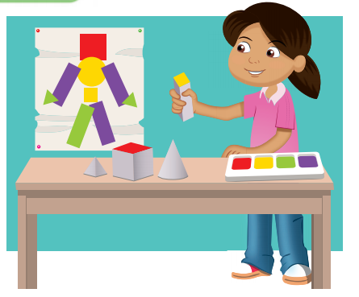
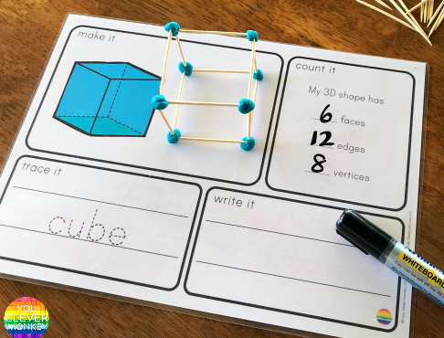
SHAPE LESSON FOUR
Good Morning Starlings
Today we are thinking about 2D and 3D shapes and what shapes they can create.
OPTIONAL: If you like, you could have some fun printing some shapes using your objects (Irene has printed a robot using her shapes above) or you could use play doh/plasticine/frozen peas with cocktail sticks/straws/pipe cleaners (see the picture above) to make a cube or other shapes.
OR you could ‘print’ online. Follow this link: https://apps.mathlearningcenter.org/pattern-shapes/

Slide 3
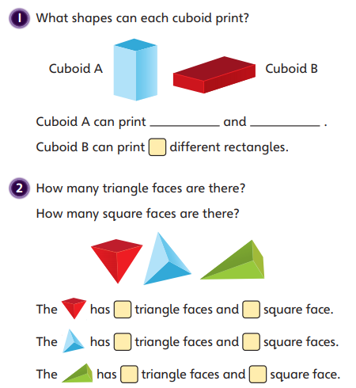
If you are doing some printing, you could practise before you answer these questions.
What shapes can print a circle?
A sphere looks like a circle….would it print a circle?

Slide 4
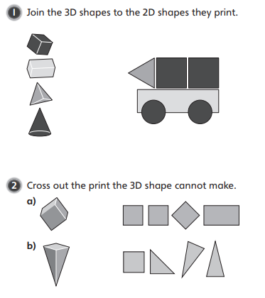
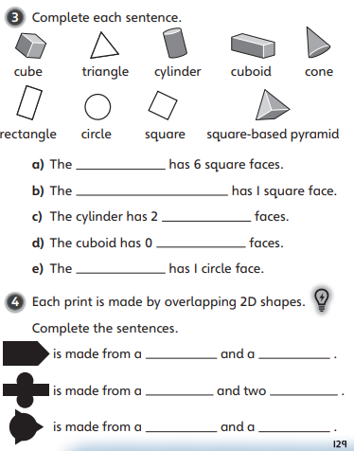

Slide 5

