Slide 1






English
Thursday 28th January 2021

Slide 2
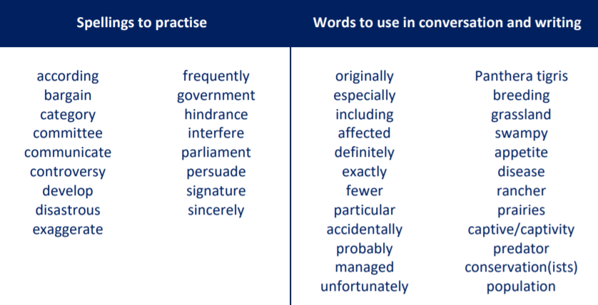
Main Session Outcome:
Know the difference between fact and opinion
Practice using the punctuation brackets and dashes
These are the spelling words that go along with this unit of work exactly like when we’re in school.

Slide 3
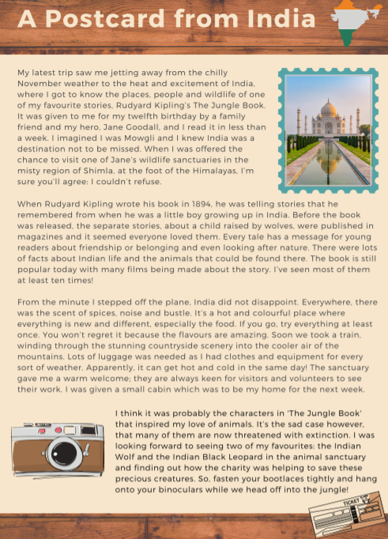
Activity 1
Read ‘A postcard from India’ again.
Have a think about the information in the text.
How much is description?
How much is fact?

Slide 4
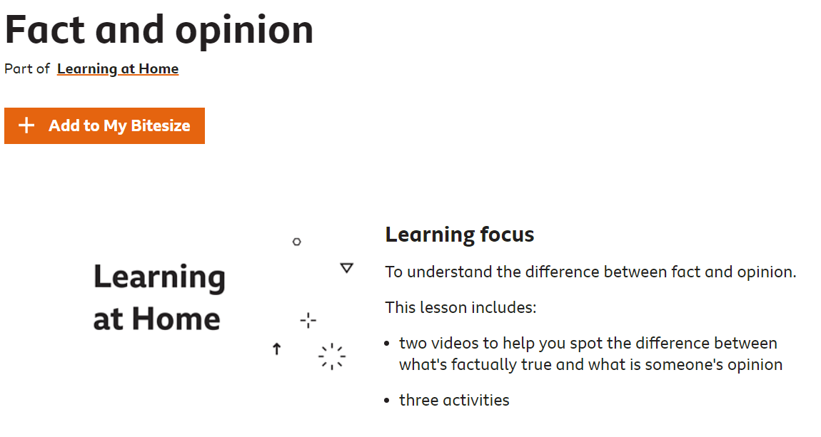
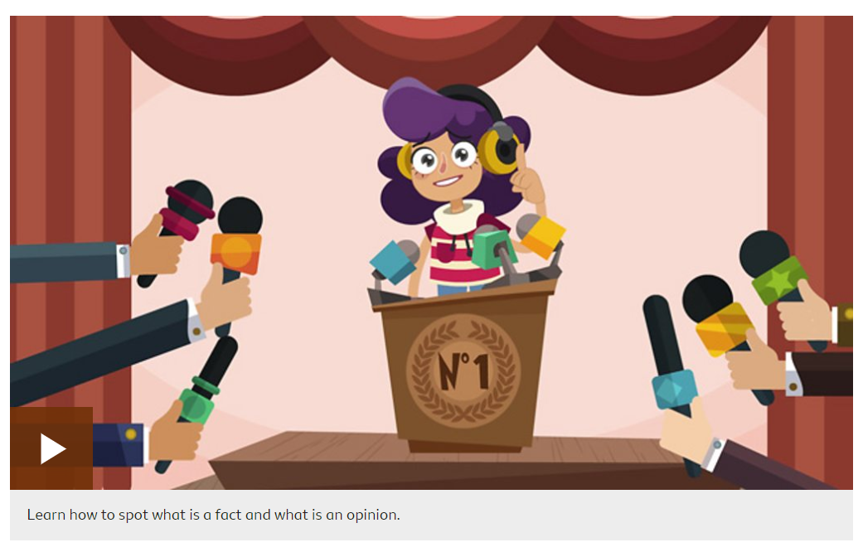
Activity 2
Please have a look at the following link about facts and opinions:
https://www.bbc.co.uk/bitesize/articles/zn4dqp3
Watch the video!
If you think you need a little more help, then you can have a go at the activities that follow underneath the video too.
Play audio first before clicking on the link.

Slide 5
Activity 3
Find examples of where the author has shared their opinion e.g. ‘one of my favourite stories’?

Slide 6
Remember…
Brackets are used to add extra information in a sentence – an informal comment, extra detail or a list of items
e.g. I loved France (especially the food!) and I’ll definitely visit again.
Dashes are used in a similar way but are useful for adding additional comments at the end of the sentence e.g. I visited the beach in Wales – it was stunning!
USE YOUR FACT FILE FROM YESTERDAY’S LESSON TOO!

Slide 7
Activity 4
Practise writing sentences with opinions on scrap paper or a whiteboard which use brackets or dashes.
Model Sentences
I loved France (especially the food!) and I’ll definitely visit again.
I visited the beach in Wales – it was stunning!

Slide 8

‘The Explorer’ by Katherine Rundell, read by Mrs Whittingham
Please follow this link to see Mrs Whittingham begin to read our new class novel.
https://www.youtube.com/watch?v=V0iOHYX2e5k&feature=youtu.be

