Slide 1


English
Date: 28.01.21
Week 4 – Lesson 4
Hansel and Gretel

Slide 2
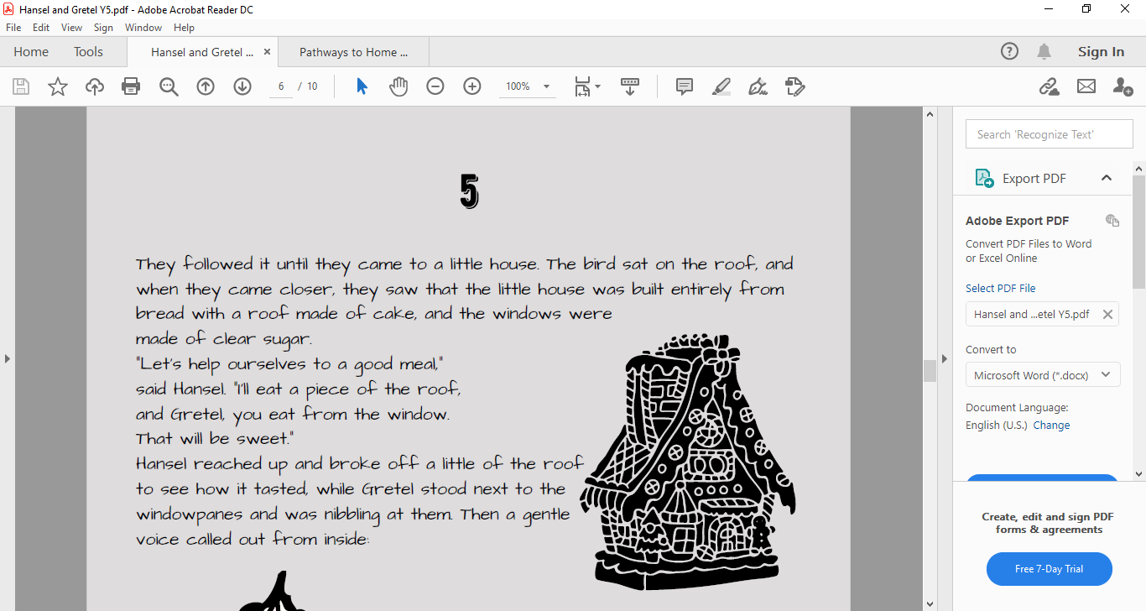

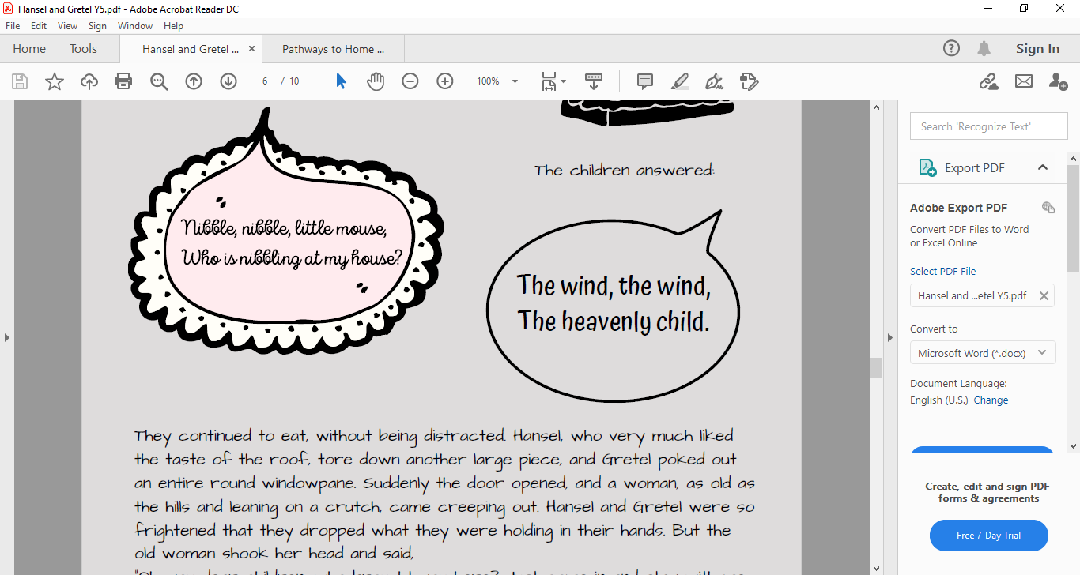
Read pages 5 and 6 or click on the sound button to hear it being read to you.
The text is also attached to our blog if you want to open or print it this way.
While you are reading, jot down any tricky words you don’t know the meaning of. Then use a dictionary or the internet to look them up.

Slide 3
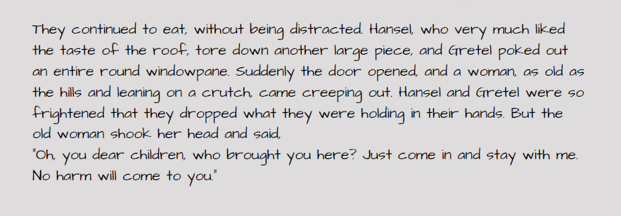
Read pages 5 and 6 or click on the sound button to hear it being read to you. The text is also attached to our blog if you want to open or print it this way.
While you are reading, jot down any tricky words you don’t know the meaning of. Then use a dictionary or the internet to look them up.
STOP:
Predict the old woman’s character. What can we tell from her speech? What impression do you get of her?

Slide 4
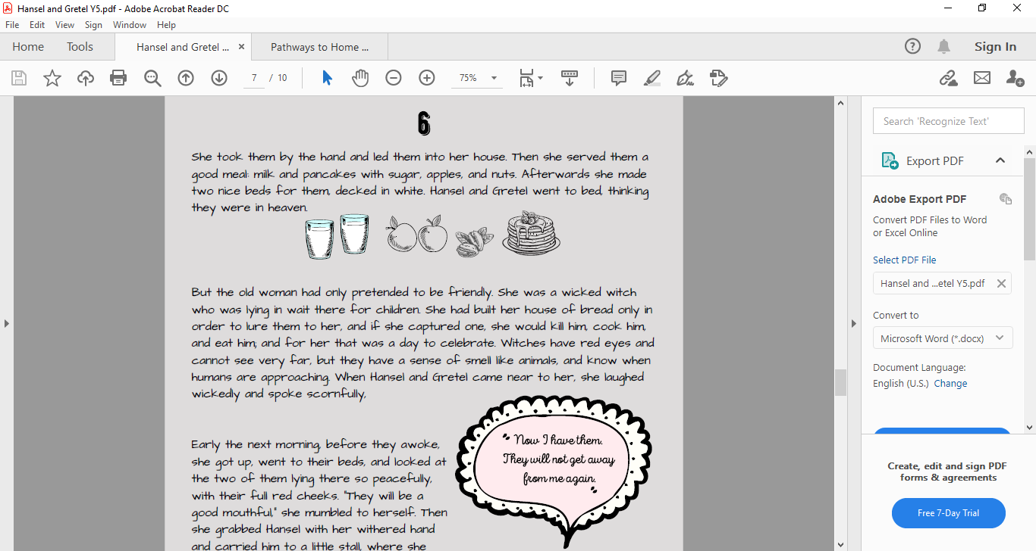
Read pages 5 and 6 or click on the sound button to hear it being read to you.
The text is also attached to our blog if you want to open or print it this way.
While you are reading, jot down any tricky words you don’t know the meaning of. Then use a dictionary or the internet to look them up.

Slide 5
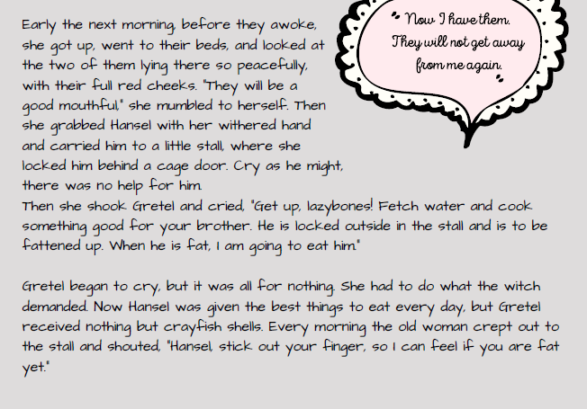
Read pages 5 and 6 or click on the sound button to hear it being read to you.
The text is also attached to our blog if you want to open or print it this way.
While you are reading, jot down any tricky words you don’t know the meaning of. Then use a dictionary or the internet to look them up.

Slide 6
Click on the sound button to hear activity 1 read to you:
Activity 1:
Summarise the two sides of the witch’s character.
Select 3 words which describe the old woman before the food pictures and three words to describe her character after the food pictures.
Before the food pictures
After the food pictures

Slide 7
Click on the sound button to hear activity 2 read to you:
Activity 2:
Complete these reading comprehension questions about pages 5 and 6. Remember to answer in full sentences.
What is the little house made from? (The little house is made from…)
Find one phrase in the text that shows you that the children were very hungry. (The phrase _______ tells me that the children were very hungry.)
What does the simile ‘as old as the hills’ tell us about the woman? How might she look? (This simile tells us that the woman is ___________________. She might look like/have _______________.)
How did the old woman put the children at ease? Find two examples in the text.
List four details about the witch from paragraph 2 on page 6.
How did Hansel and Gretel feel the next morning after they awoke?
Who would you rather be: Hansel or Gretel? Give reasons for your choice.

Slide 8
Activity 2 Answers:
Click on the sound button to hear activity 2 answers read to you:
The little house is made from bread, cake and clear sugar.
The phrase ‘They continued to eat, without being distracted’ OR “Let’s help ourselves to a good meal” tells me that the children were very hungry.
The simile ‘as old as the hills’ tells us that the woman is very old. She might look very wrinkled and hunched over because of her age.
The old woman put the children at ease by feeding them a good meal and making them a nice bed.
Choose 4 from:
  Pretended to be friendly
  She was wicked
  Made her house from bread to lure in children
  Would kill, cook and eat children she captured
  Has read eyes
  Has a sense of smell like an animal
Hansel and Gretel felt terrified because the text says that they both cried.
7. I would rather be ________________ because…

Slide 9
