Slide 1


Starlings Maths Home Learning
Wednesday 27th January

Slide 2
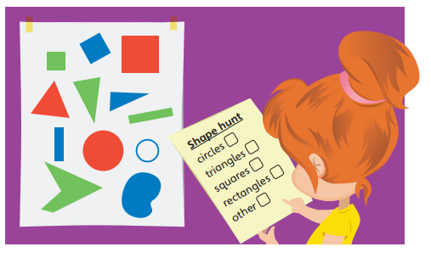
SHAPE LESSON THREE
Happy Wednesday!
So today in maths we are revising our 2D shape and checking that we understand which 2D shape it is regardless of the shapes’ colour, orientation (which way round it is) and size.
What 2D shapes can you think of? SAY circle, square, triangle, rectangle
Think of the properties of each shape – can you tell me how many sides and how many vertices (corners) each one has?
Remember that 2D shapes are flat.

Slide 3
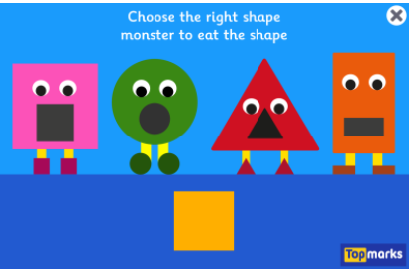
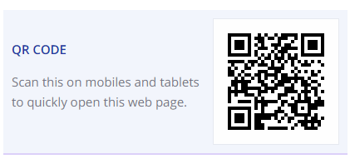
Have fun playing this game to remind you of our 2D shapes – remember it doesn’t matter what colour, what size or which way around the shape is. Follow the link or scan the QR code.
https://www.topmarks.co.uk/early-years/shape-monsters

Slide 4
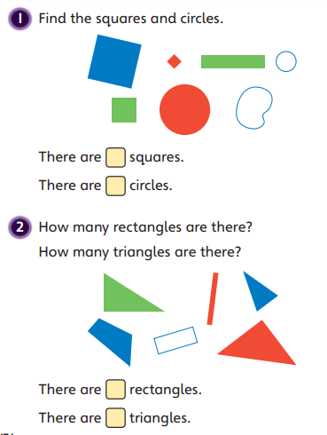
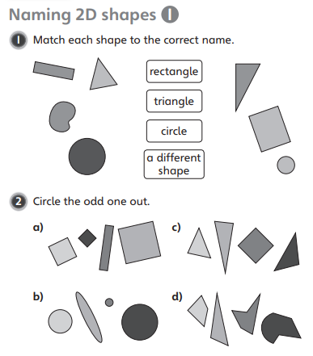

Slide 5

