Slide 1



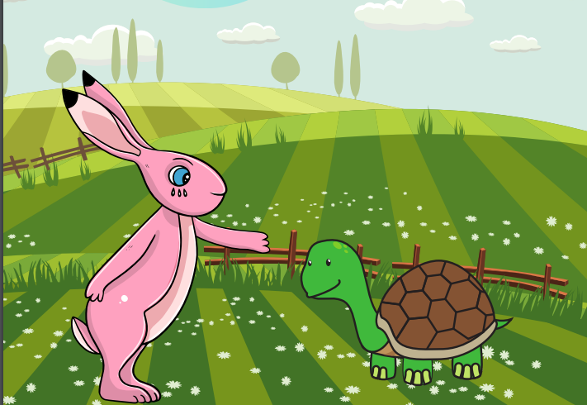
Starlings English Home Learning
Wednesday 27th January

Slide 2


Today we are going to use my version of the story to and write speech or thought bubbles to show character’s thoughts and feelings.
You will:
Find exclamation marks in my story.
Understand why I have used exclamation marks.
Write your own thought and speech bubbles using exclamation marks.

Slide 3
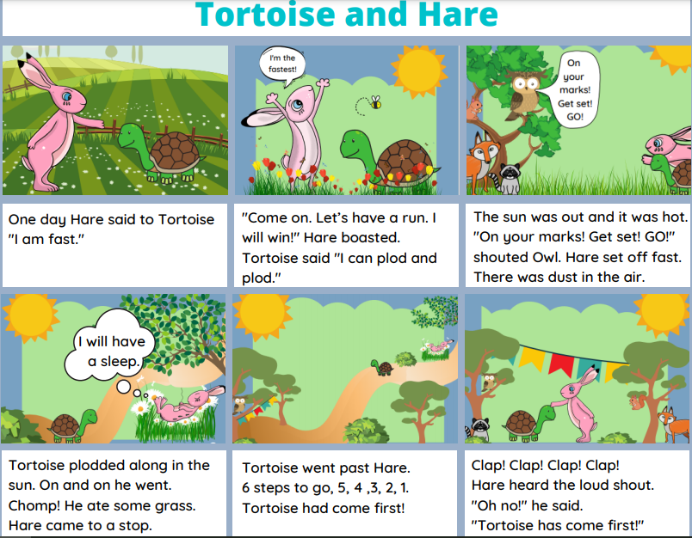
Have a look at my version of the story and find my speech or thought bubbles.
What punctuation can you see?
Can you read them out loud – did the punctuation mark change how you said it?

Slide 4
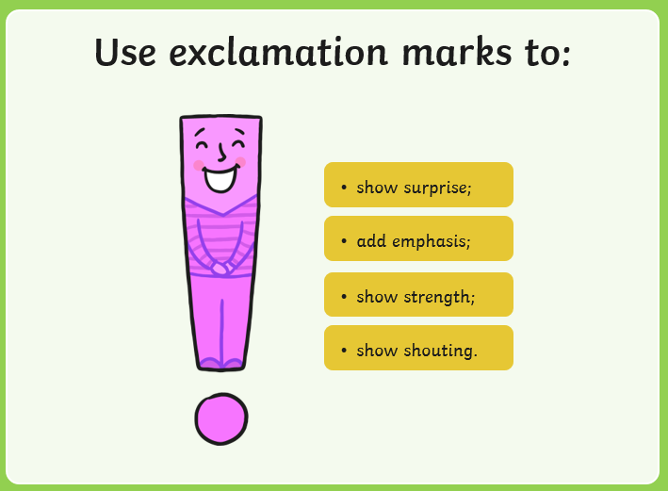

Slide 5
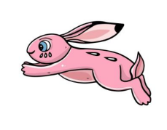

I am going to win!
Slow and steady wins the race.

Slide 6
Can you write some of your speech and thought bubbles for Hare and Tortoise? Can you try and use an exclamation mark

Slide 7


Red group – Please have a look at the separate RWI PowerPoint for set 1. We have added some special friends work for you.
Green group you need to look out for set 2 videos on the link below:
https://www.youtube.com/channel/UCo7fbLgY2oA_cFCIg9GdxtQ
We would like you to watch 4 videos: set 2 speed sounds, set 2 spelling, red words 1, and read and hold a sentence 1
Pink, yellow and blue groups you need to look out for set 3 videos on the link below.
https://www.youtube.com/channel/UCo7fbLgY2oA_cFCIg9GdxtQ
We would like you to watch 4 videos: set 3 speed sounds, set 3 spelling, red words 2 and read and hold a sentence 2

Slide 8

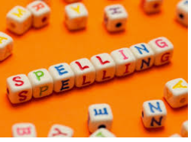



Words of the day!
do fast fastest
Can you write the word do 5 times in different colours ?
Can you write the word fast 5 times inside a squiggle?
Can you write the word fastest 5 times as tall as you can?

