Slide 1


Mathematics
Date: 27.01.21
Week 4 – Lesson 3
Calculating Perimeter 2

Slide 2
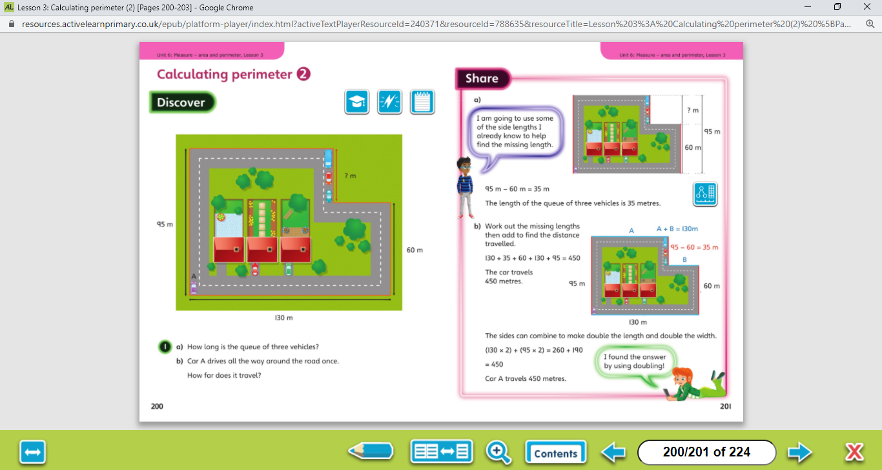

The perimeter is the distance all the way around the outside of a 2D shape. To work out the perimeter, add up the lengths of all the sides.
Let’s work together!
Look at the picture clue. What can you see?
Have a look at the questions.
Click on the sound button below to hear the questions read to you. We will also talk through the questions together like we do in school.
We will go through the possible methods and answers on the next slide.

Slide 3
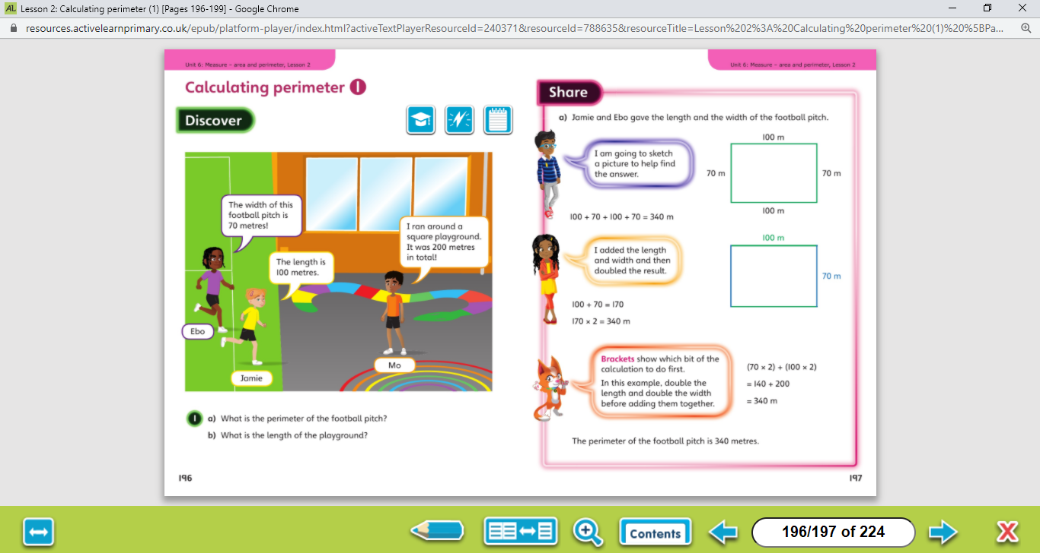
The perimeter is the distance all the way around the outside of a 2D shape. To work out the perimeter, add up the lengths of all the sides.
Let’s work together!
Click on the sound button below to hear the answers and possible methods for question A.
Click on the sound button below to hear the answers and possible methods for question B.

Slide 4
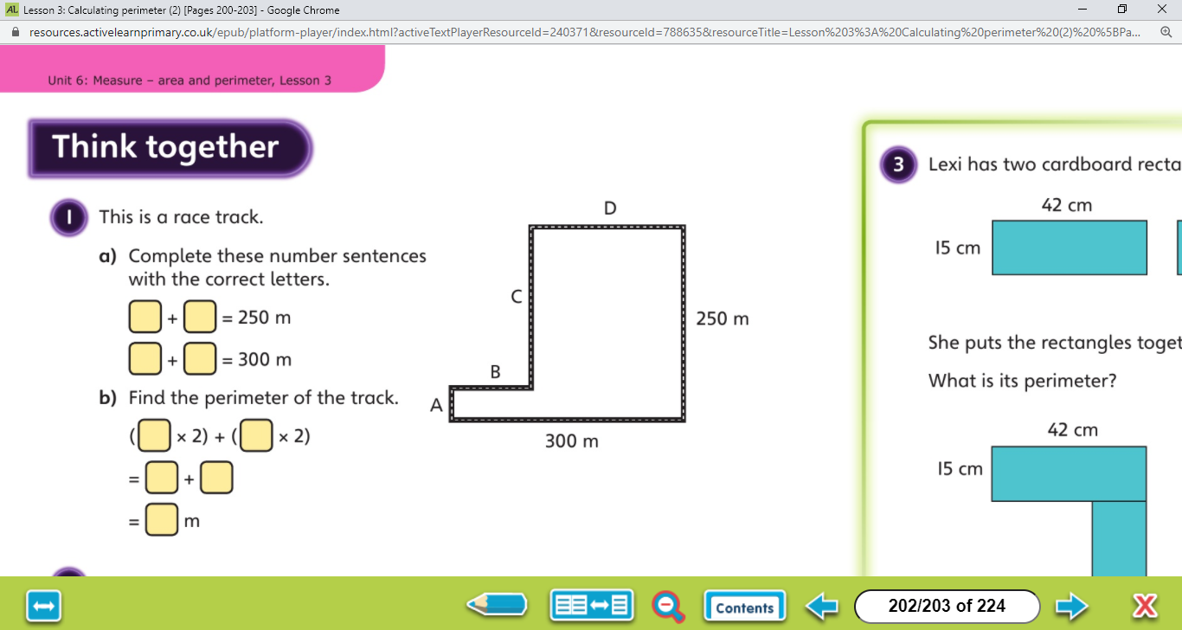
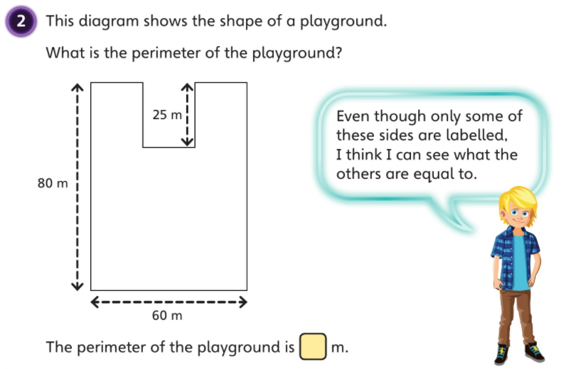
The perimeter is the distance all the way around the outside of a 2D shape. To work out the perimeter, add up the lengths of all the sides.
Let’s work together!
Click on the sound button below to hear the question read to you. We will work together to reach the answer.
Click on the sound button below to hear the answers.

Slide 5
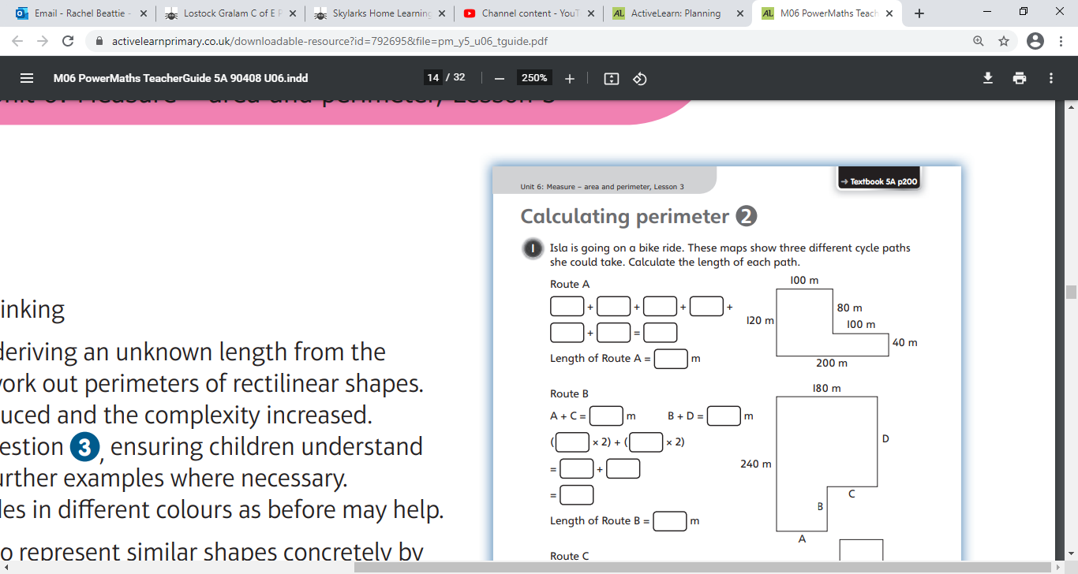
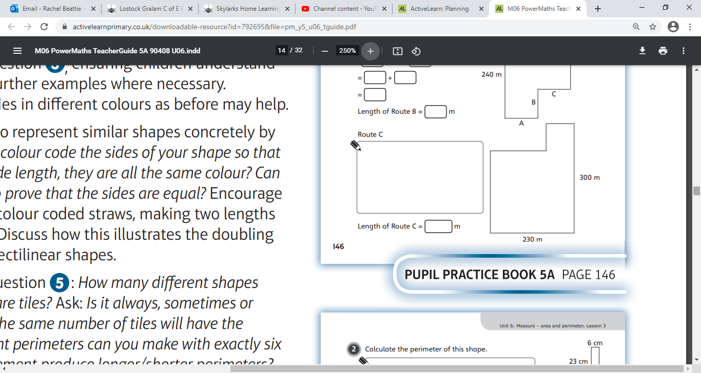
Your Turn…
The perimeter is the distance all the way around the outside of a 2D shape. To work out the perimeter, add up the lengths of all the sides.
Have a go at these questions independently. Click on the button below if you would like the questions read to you.
We will go through the answers for questions 1, 2 and 3 after completing all of the questions.

Slide 6
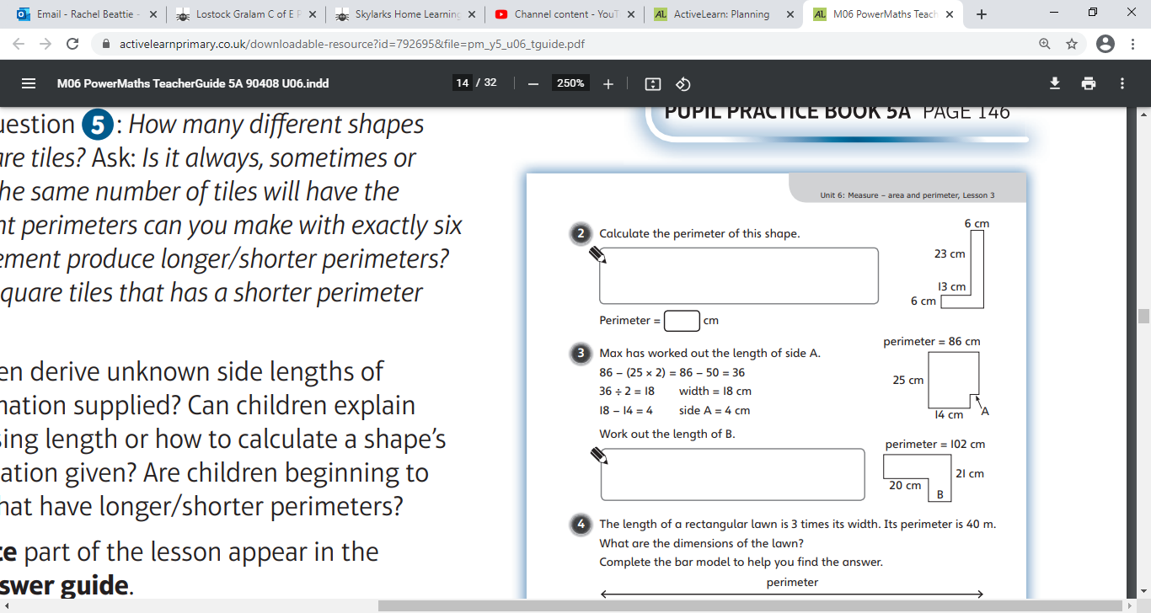
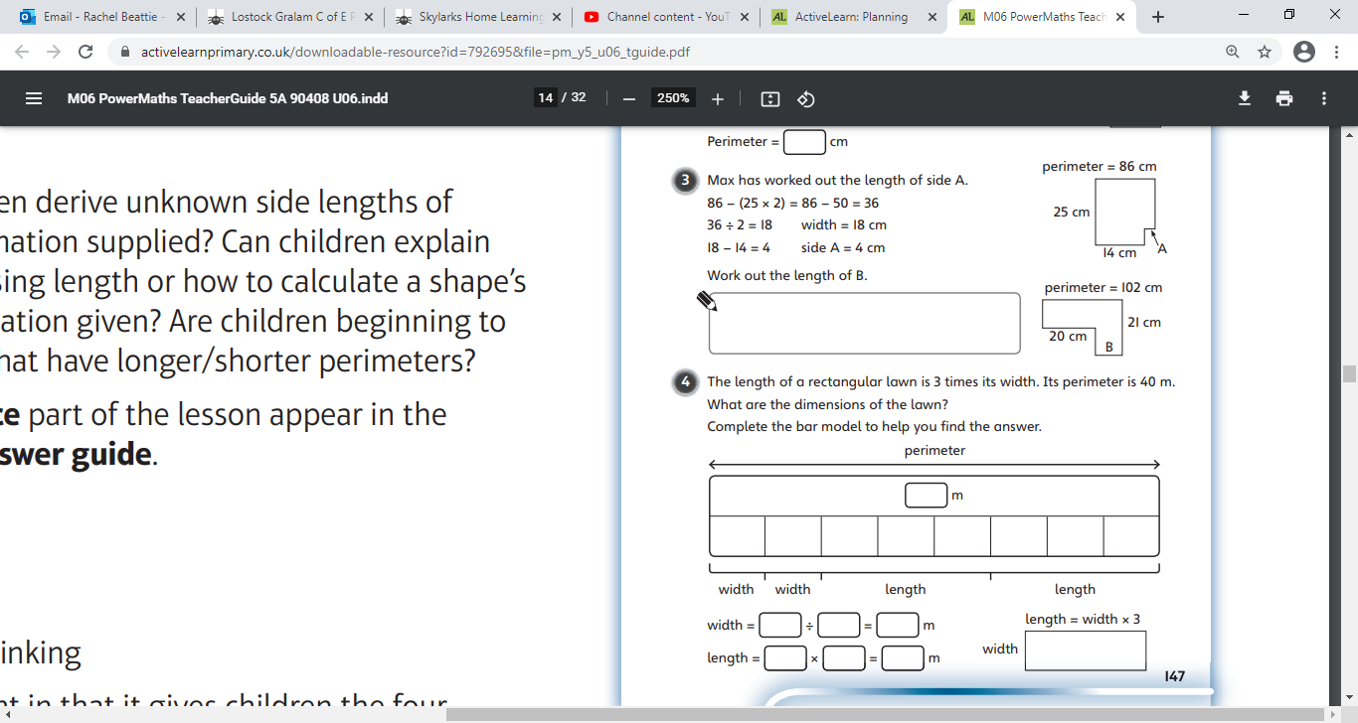
Your Turn…
The perimeter is the distance all the way around the outside of a 2D shape. To work out the perimeter, add up the lengths of all the sides.
Have a go at these questions independently. Click on the button below if you would like the questions read to you.
We will go through the answers for questions 1, 2 and 3 after completing all of the questions.

Slide 7
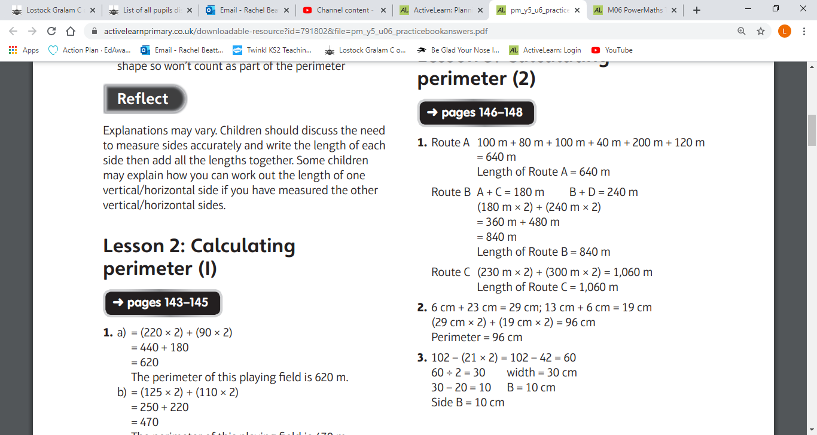
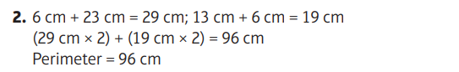
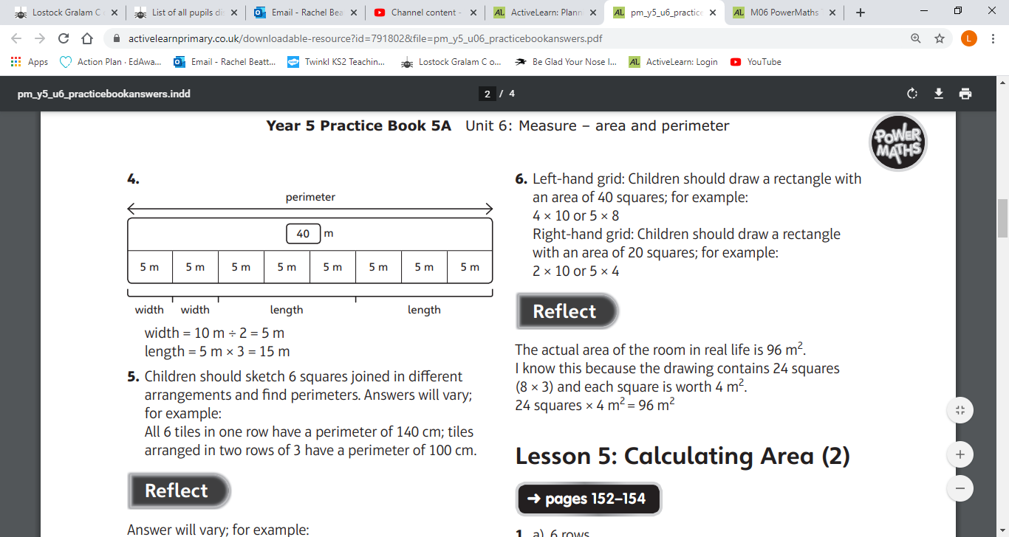
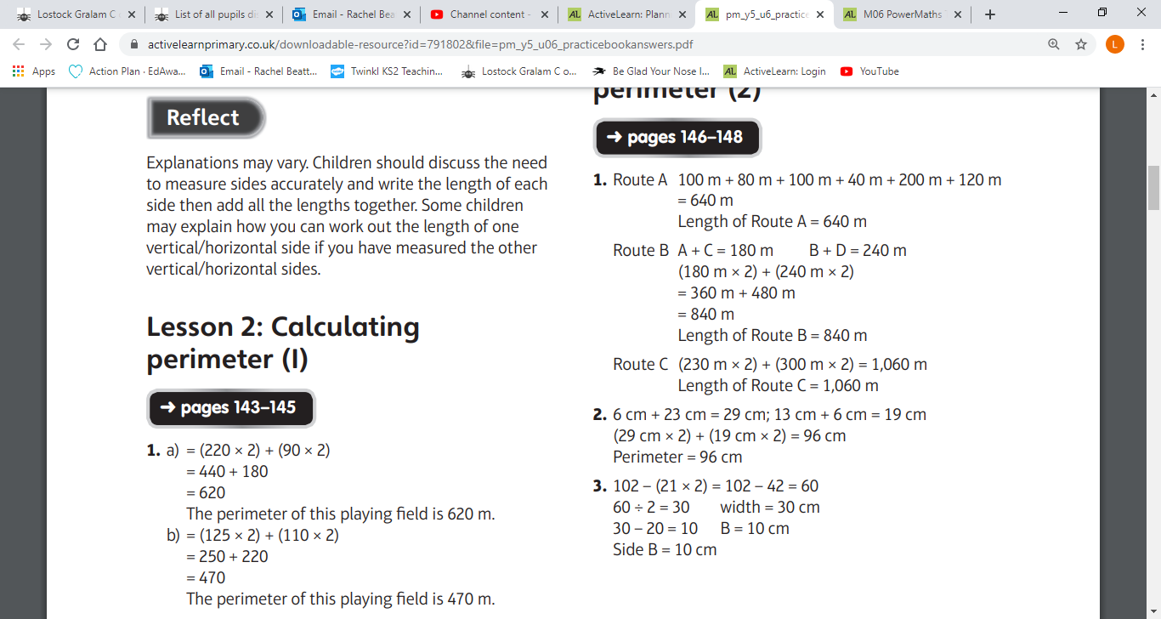
Your Turn…
Questions 1-3 Answers:
Click on the sound button to hear the answers being read to you.

Slide 8
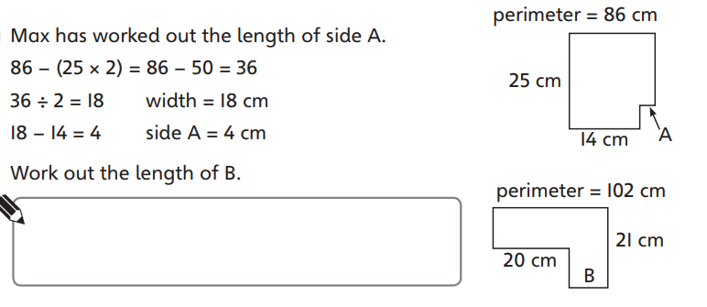
Challenge Time!
Only try this question if you are feeling confident ☺
Your Turn…
Click on the button below if you would like the question read to you.
Click on the button below to hear the answer.

