Slide 1


English
Date: 27.01.21
Week 4 – Lesson 3
Hansel and Gretel

Slide 2

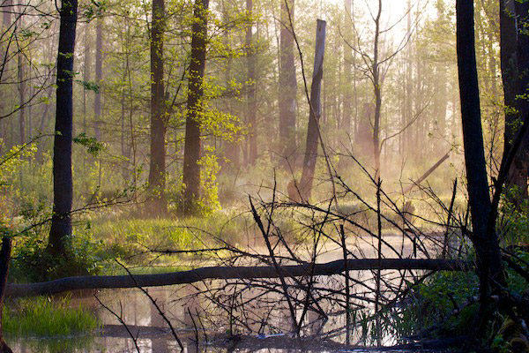
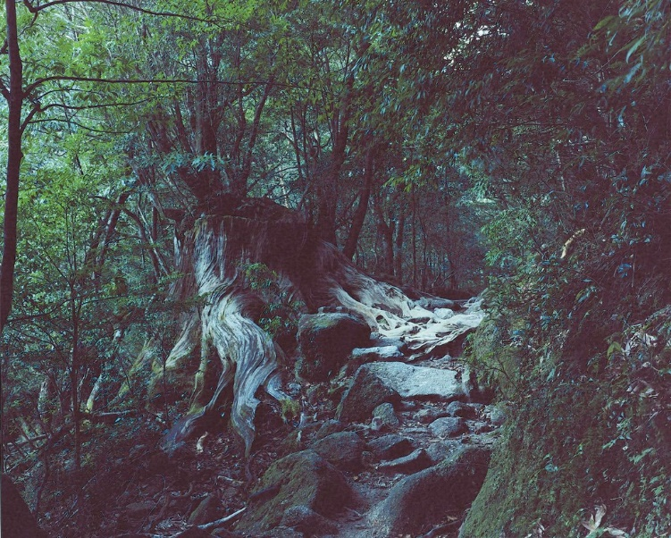
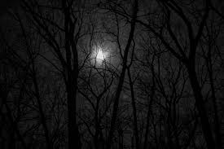
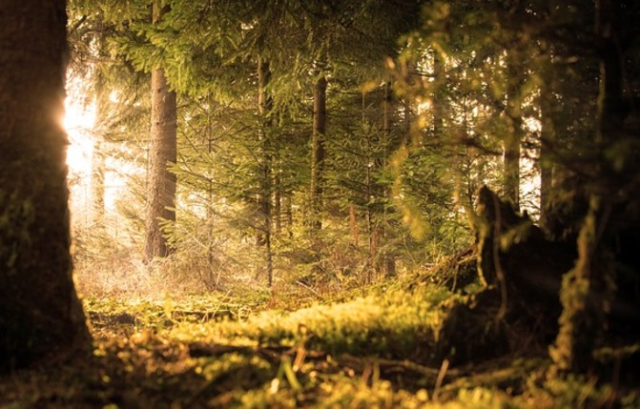

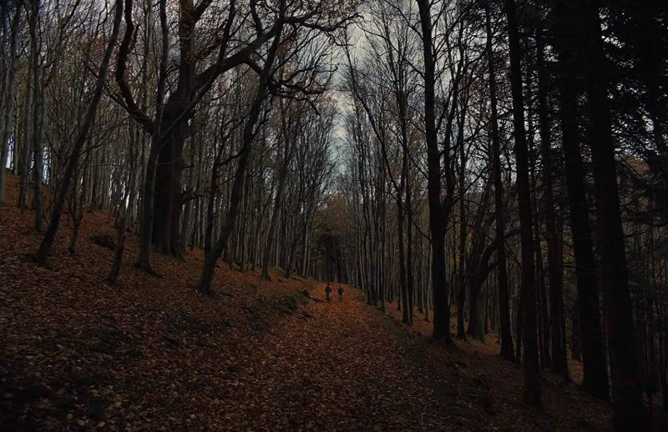
Look at the pictures below:
What can you see? What impression do you get from these images?

Slide 3
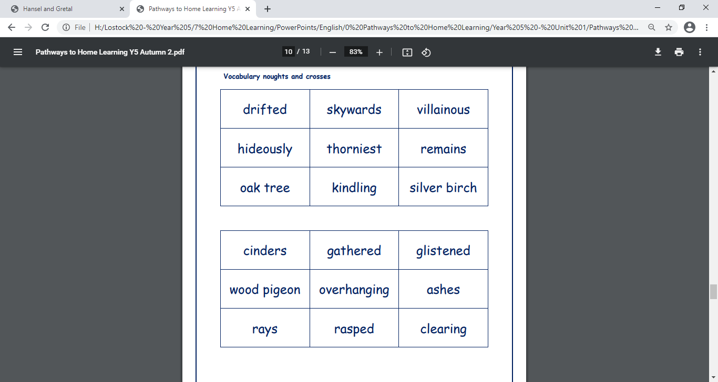



Click on the sound button to hear activity 1 read to you.
Activity 1:
Use some of the vocabulary from yesterday (above) to create noun phrases about the forest pictures you have just looked at.
For example:
villainous branches
thorniest bushes
bright sun beams
sky high oak trees
Remember: Noun phrases create extra detail and description about a noun.
Here is video and further explanation of noun phrases: https://www.bbc.co.uk/bitesize/articles/zmqh2v4#:~:text=A%20noun%20phrase%20is%20a,word%20that%20describes%20a%20noun

Slide 4
Activity 2:
Click on the sound button to hear activity 2 read to you:
Write a setting description based on the pictures using the noun phrases you have just written (between 5 and 10 sentences) – WAGOLL on the next slide.
Think about fronted adverbials you could use to start each sentence differently.
For example:
After the full moon had come up,
Through a small gap in the trees,
Because it was dark at night,
Deeper and deeper into the forest,
Noun Phrases:
villainous branches
thorniest bushes
bright sun beams
sky high oak trees

Slide 5
Think about:
What did you see?
What could you hear?
How did you feel?
Noun Phrases:
villainous branches
thorniest bushes
bright sun beams
sky high oak trees
Fronted Adverbials:
After the full moon had come up,
Through a small gap in the trees,
Because it was dark at night,
Deeper and deeper into the forest,
WAGOLL
Click on the sound button to hear the WAGOLL read to you:
After the full moon had come up, a misty haze began to form under the canopy of villainous trees. The sky high oak trees towered over the mist. Curling around the thick tree trunks, were constricting vines and layers of green moss. Dangling down from the layers of moss, vast, bold leaves flickered like flames in the growing bluster of wind. Through a small gap in the flickering leaves, something strange emerged…

Slide 6
