Slide 1



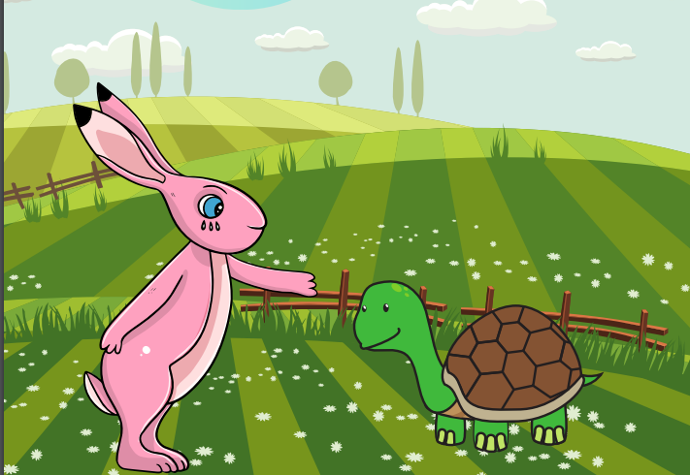
Starlings English Home Learning
Tuesday 26th January

Slide 2


Today we are going to write sentences to describe the characters in the story.
You will:
Use adjectives to describe characters.
Use our inference skills (putting together what is on the page with what you know already).
Write your own sentences to describe the characters.

Slide 3
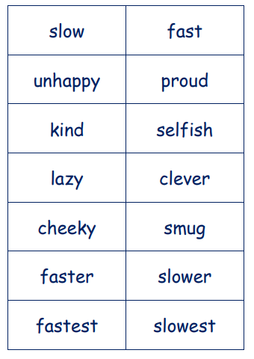
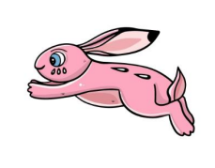
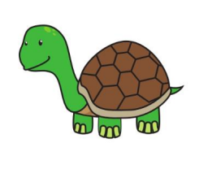

I want you to have a think about our characters from the story. Can you describe them?
Use some of these words to describe Hare and Tortoise.
You could cut the words out and stick them next to the character or you could just say them out loud.
Can you tell me what type of words these are?

Slide 4
Now I’d like you to use some of the describing words to write a description of your character. You can choose Hare or Tortoise. See if you can extend your sentences using and. Look at my example:
Hare is faster than Tortoise and thought he would win the race. He thought he was being clever by having a nap. He is unhappy about losing the race but Tortoise is kind and cheered him up. Tortoise and Hare became best friends and Hare never boasted again.

Slide 5


Red group – Please have a look at the separate RWI PowerPoint for set 1. We have added some special friends work for you.
Green group you need to look out for set 2 videos on the link below:
https://www.youtube.com/channel/UCo7fbLgY2oA_cFCIg9GdxtQ
We would like you to watch 4 videos: set 2 speed sounds, set 2 spelling, red words 1, and read and hold a sentence 1
Pink, yellow and blue groups you need to look out for set 3 videos on the link below.
https://www.youtube.com/channel/UCo7fbLgY2oA_cFCIg9GdxtQ
We would like you to watch 4 videos: set 3 speed sounds, set 3 spelling, red words 2 and read and hold a sentence 2

Slide 6

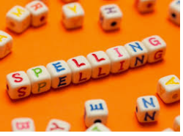



Words of the day!
nap ask asked
Can you write the word nap 5 times with your eyes closed?
Can you write the word ask 5 times with your tongue stuck out?
Can you write the word asked 5 times as tiny as you can?

