Slide 1


Starlings Maths Home Learning
Tuesday 26th January

Slide 2
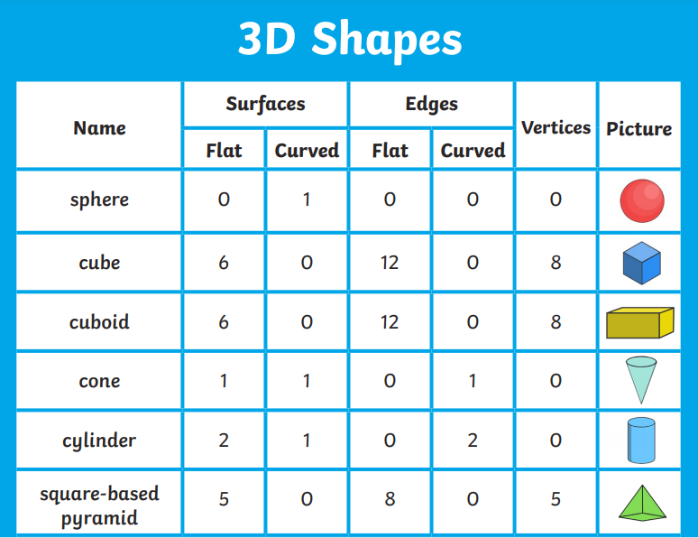
SHAPE LESSON TWO
Good Morning Starlings
Today we are looking at 3D shapes again so see if you can collect your objects together that we used yesterday.
We’re going to think of the properties the shapes have which means how many edges (sides), faces or surfaces and corners (vertices) a shape has. Remember a face is always flat.
Watch this fun video which introduces properties: https://www.youtube.com/watch?v=ZnZYK83utu0

Slide 3
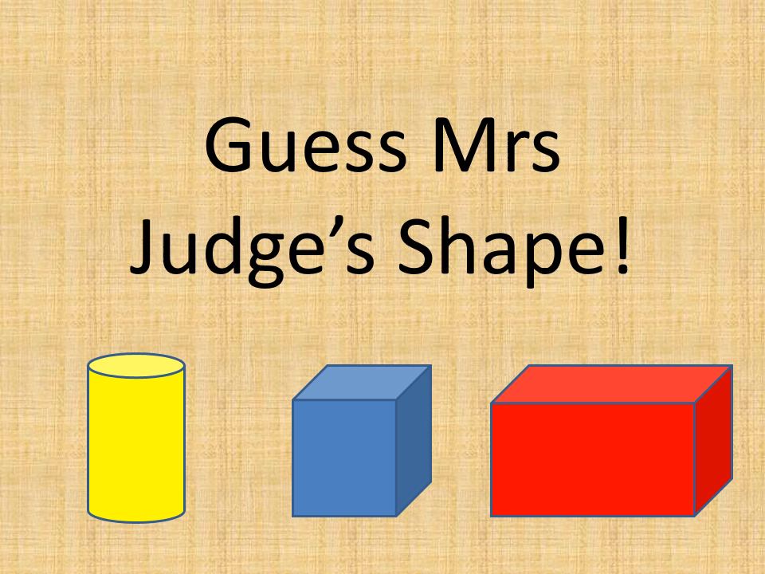
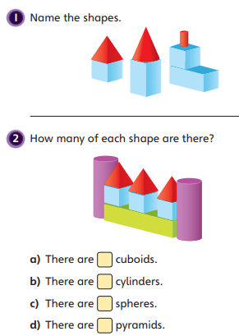
Have some fun playing my guess the 3D shape game!

Slide 4
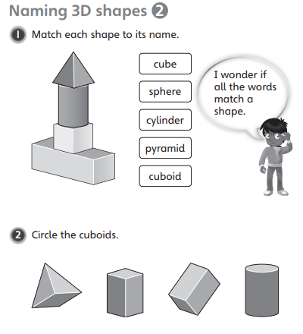
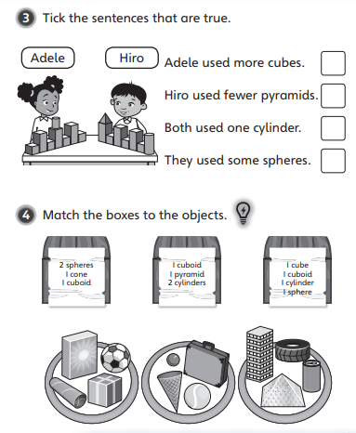

Slide 5

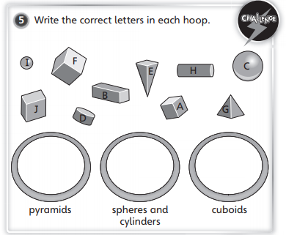
What is the
difference between a face and a curved surface?

