Slide 1






English
Tuesday 26th January 2021

Slide 2
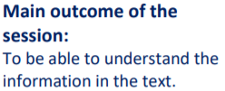
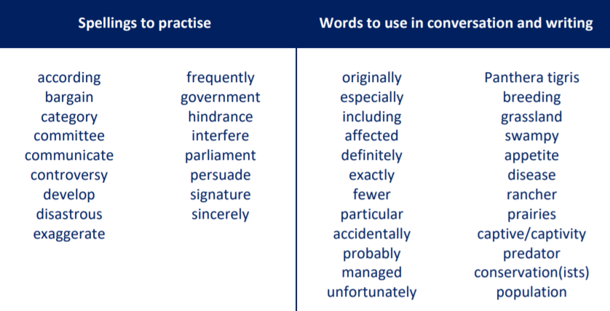
These are the spelling words that go along with this unit of work exactly like when we’re in school.

Slide 3
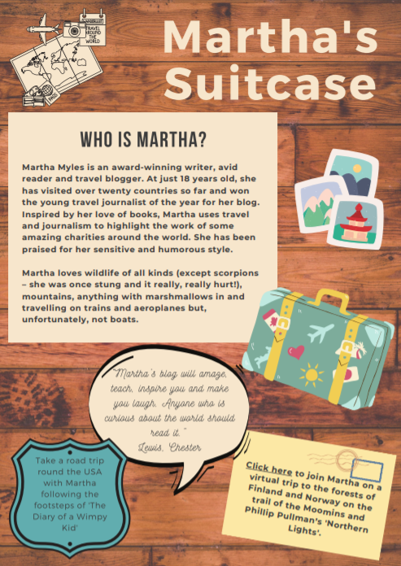
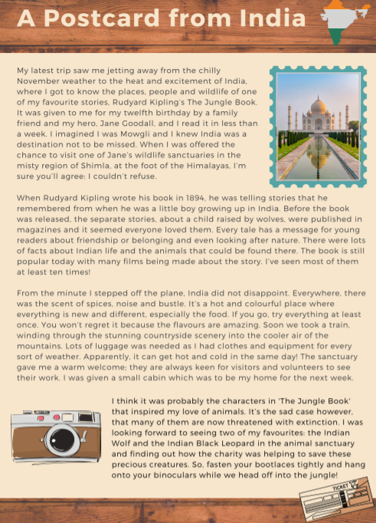
Activity 1
Re-read ‘Who is Martha?’ and ‘A postcard from India’.

Slide 4
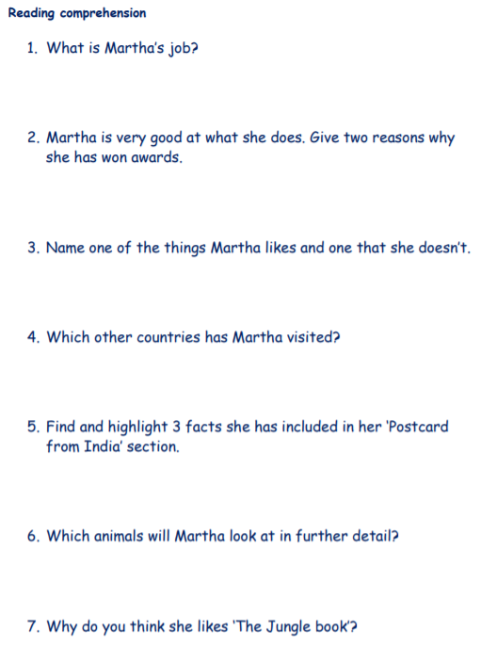
Activity 2
Have a go at the following comprehension questions.
Once you have completed them all, check your answers. You will find these on the next slide!

Slide 5
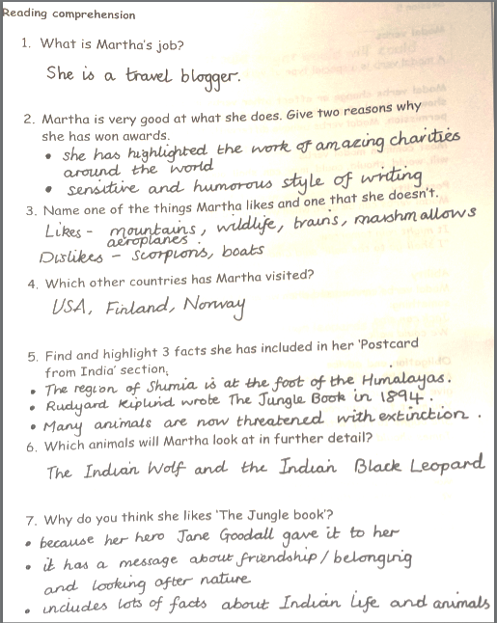
Answers
Listen here to hear me go through the answers to
Questions 1, 2, 3 and 4.
These questions focus on page 1 of the text, Martha’s Suitcase.

Slide 6
Answers
Listen here to hear me go through the answers to
Questions 5, 6 and 7.
These questions focus on page 2 of the text, A Postcard from India.

Slide 7

Here is the video link to see Mrs Whittingham read part 8 of this beautiful book.
https://youtu.be/-wjShM8I4Lg

