Slide 1


English
Date: 26.01.21
Week 4 – Lesson 2
Hansel and Gretel

Slide 2

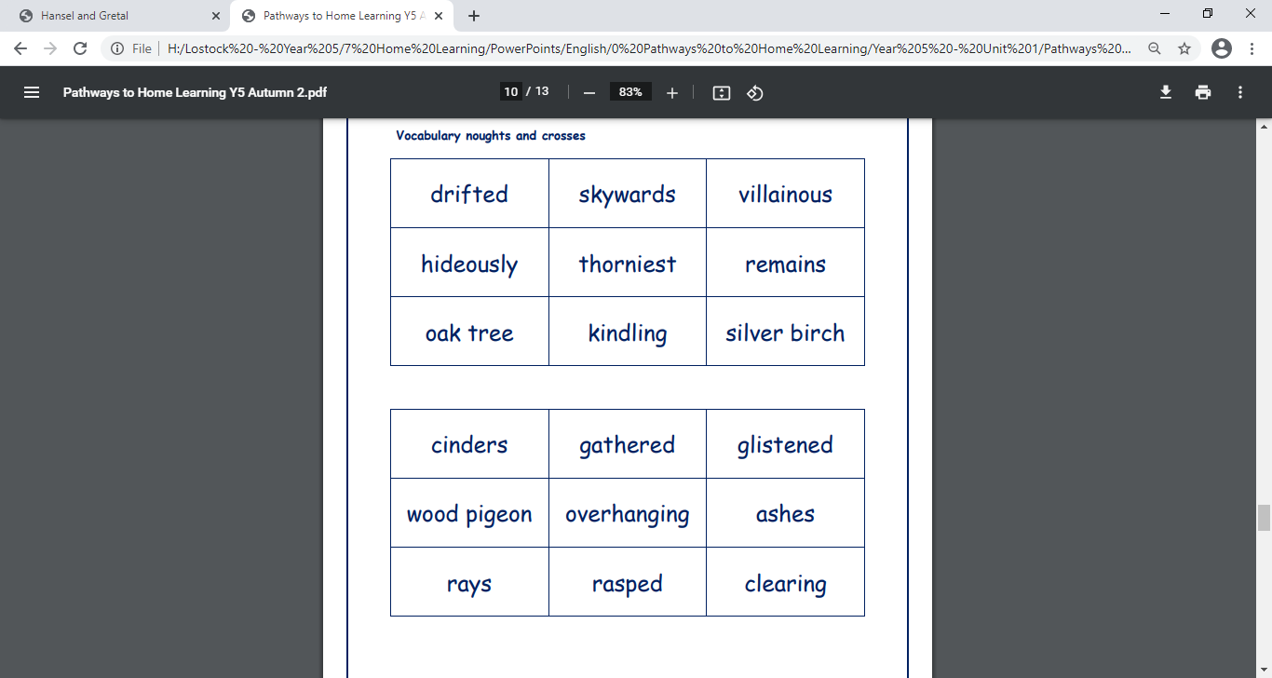
Click on the sound button to hear activity 1 read to you.
Activity 1:
Have a look at the forest vocabulary below. Do you know what each word means?
Use a dictionary or the internet to look up the definition of any unknown words.
Can you write 5 sentences using some of these words?
e.g. The sun’s rays beamed down through the gaps in the branches of the old oak tree.

Slide 3
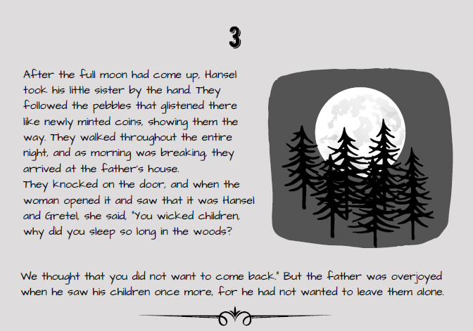
Read pages 3 and 4 of ‘Hansel and Gretel’ by Jacob and Wilhelm Grimm or click on the sound button to hear it being read to you.
The text is also attached to our blog if you want to open or print it this way.
While you are reading, listen out for descriptions of the forest.

Slide 4
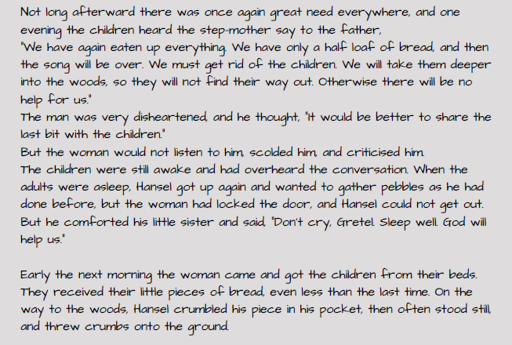
Read pages 3 and 4 of ‘Hansel and Gretel’ by Jacob and Wilhelm Grimm or click on the sound button to hear it being read to you.
The text is also attached to our blog if you want to open or print it this way.
While you are reading, listen out for descriptions of the forest.

Slide 5
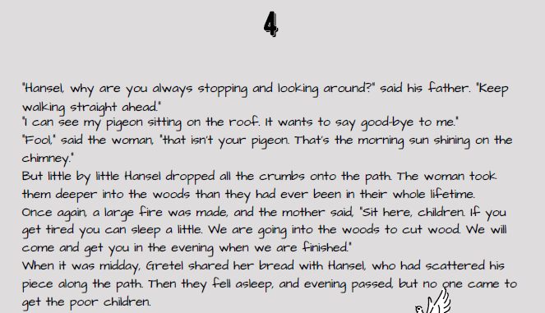
Read pages 3 and 4 of ‘Hansel and Gretel’ by Jacob and Wilhelm Grimm or click on the sound button to hear it being read to you.
The text is also attached to our blog if you want to open or print it this way.
While you are reading, listen out for descriptions of the forest.

Slide 6
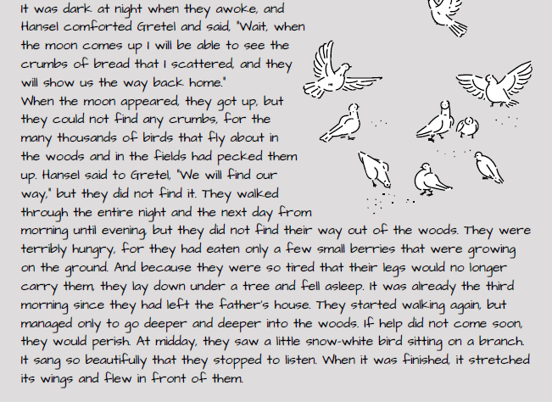
Read pages 3 and 4 of ‘Hansel and Gretel’ by Jacob and Wilhelm Grimm or click on the sound button to hear it being read to you.
The text is also attached to our blog if you want to open or print it this way.
While you are reading, listen out for descriptions of the forest.

Slide 7
Click on the sound button to hear activity 2 read to you:
Activity 2:
What words and phrases did you hear that described the forest?
What impression did you get of the forest?
How did this description make you feel?
Using the setting vocabulary from the text, draw a picture of what you think the forest looks like.
Vocabulary I picked out:
Full moon
Glistening pebbles
Large fire
Berries on ground
Snow white bird
Deeper and deeper
Dark

Slide 8
