Slide 1


Starlings Maths Home Learning
Monday 25th
January

Slide 2
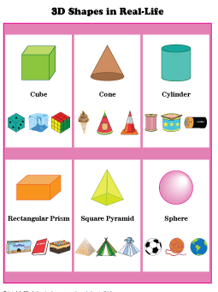
SHAPE LESSON ONE
Welcome to our fourth week of home learning! Today we are starting a new topic of shape. Can you remember any of your 2D shapes? 2D shapes are flat.
First we’re going to learn about 3D shapes which are not flat.

Slide 3

Now, when I say ‘Ready, Steady, Go!’ I need you to go and collect some 3D objects from around the house and see if can name what 3d shape it is. These are some examples but you need to see what you can find!
Sphere: marble, ball, orange
Cylinder: tin of food, can of pop, battery
Cube: box, dice, block
Cuboid: Lego piece, shoe box, domino
Cone: pencil tip, funnel, ice cream cone
Ovoid (if you have!): toy egg, rugby ball, kiwi or avocado
Pyramid (this is hard!): toy Egyptian pyramid, toy square based tent
Now have a play around with your shapes and see if you can answer my questions:
Can you work out many edges (sides) , faces or surfaces and corners (vertices) your shape has?
Does turning the shape change the shape?
Does it matter what colour or what size your shape is?
Don’t worry if you can’t find an example.
Keep your objects safe as we’ll need them again!

Slide 4
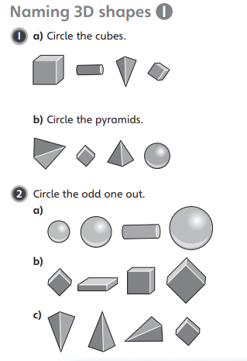
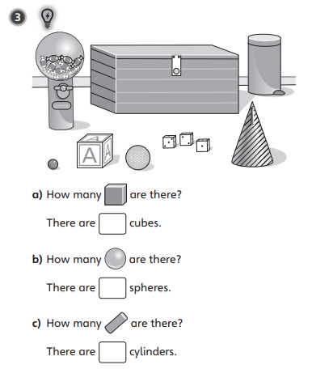

Slide 5

