Slide 1
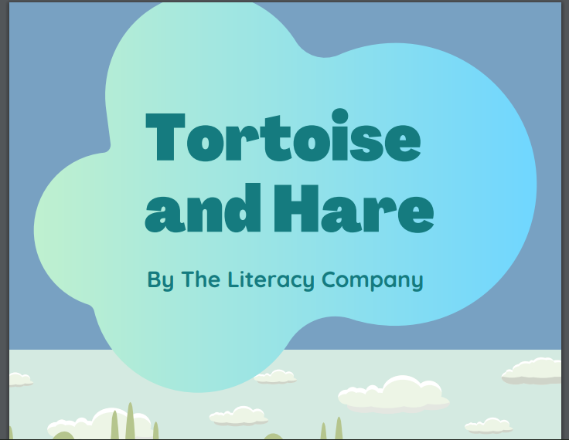

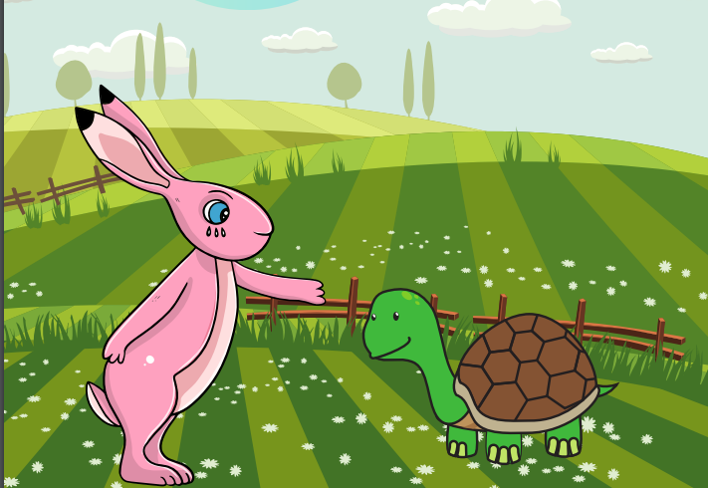
Starlings English Home Learning
Monday 25th January

Slide 2



Today we are going to use my version of the story to find punctuation and the joining word and and use the ideas to write my own sentences.
You will:
Find capital letters in my story.
Find the joining word and in my story.
Write your own sentences about the story using capital letter and extending them using the joining word and.

Slide 3
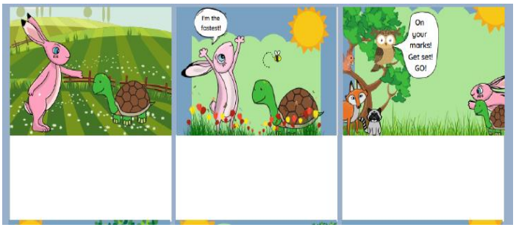
Here’s my version of the story. Can you spot where I have used capital letters? Can you tell me why? You can highlight them or just point to them?
One day Hare said to Tortoise
“I am fast.”
“Come on. Let’s have a run. I will win!” Hare boasted. Tortoise said
“I can plod and plod.”
The sun was out and it was hot. “On your marks! Get set! Go!” shouted Owl. Hare set off fast. There was dust in the air.
Now I would like you to find where I have used and. Can you tell me why? You can highlight them or just point to them?

Slide 4
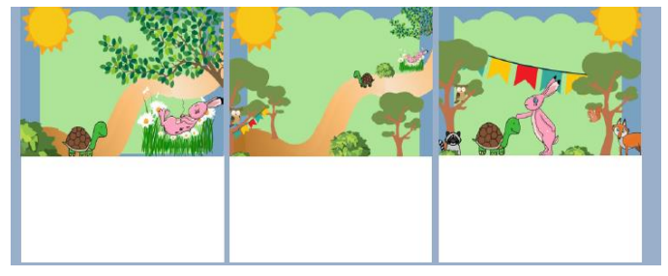
What about the next part of the story? Can you see the capital letters here?
Tortoise plodded along in the sun. On and on he went. Chomp! He ate some grass. Hare came to a stop.
Tortoise went past Hare. 6 steps, 5, 4, 3, 2, 1 and Tortoise had come first!
Clap! Clap! Clap! Clap! Hare heard the loud shout.
“Oh no!” he said.
“Tortoise has come first!”
Do the same for this part of the story – find where I have used and.

Slide 5

That’s right – I used capital letters at the start of my sentences and for the character’s names. Remember that when we use the pronoun I it always has a capital letter.
The sun was out and it was hot. “On your marks! Get set! Go!” shouted Owl. Hare set off fast. There was dust in the air.
One day Hare said to Tortoise
“I am fast.”
“Come on. Let’s have a run. I will win!” Hare boasted. Tortoise said
“I can plod and plod.”
Can you spot and name any other types of punctuation I have used?

Slide 6
Well done did you find all my ands? We use and when it is between words or when it is joining sentences (if you can replace it with a capital letter and a full stop then it is between sentences).
Tortoise plodded along in the sun. On and on he went. Chomp! He ate some grass. Hare came to a stop.
Tortoise went past Hare. 6 steps, 5, 4, 3, 2, 1 and Tortoise had come first!
Clap! Clap! Clap! Clap! Hare heard the loud shout.
“Oh no!” he said.
“Tortoise has come first!”

Slide 7
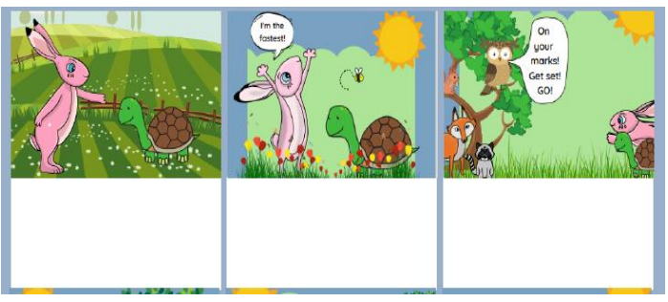
Now I would like you to try and write your own sentences about Hare and Tortoise making sure you use capital letters (especially for names) and full stops. Use the pictures to give you some ideas.
Can you extend some of your sentences (add some more information) using and?

Slide 8

Red group – Please have a look at the separate RWI PowerPoint for set 1. We have added some special friends work for you.
Green group you need to look out for set 2 videos on the link below:
https://www.youtube.com/channel/UCo7fbLgY2oA_cFCIg9GdxtQ
We would like you to watch 4 videos: set 2 speed sounds, set 2 spelling, red words 1, and read and hold a sentence 1
Pink, yellow and blue groups you need to look out for set 3 videos on the link below.
https://www.youtube.com/channel/UCo7fbLgY2oA_cFCIg9GdxtQ
We would like you to watch 4 videos: set 3 speed sounds, set 3 spelling, red words 2 and read and hold a sentence 2

Slide 9
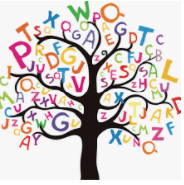
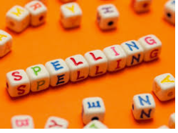



Words of the day!
once friend friends
Can you write the word once 5 times in different colours?
Can you write the word friend 5 times as tall as you can?
Can you write the word friends 5 times backwards (sdneirf)?

