Slide 1


Monday 25th January
No Outsiders Lesson

Slide 2
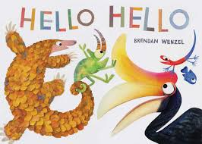

Slide 3
Are the animals in the book all the same? Or are they different?

Slide 4
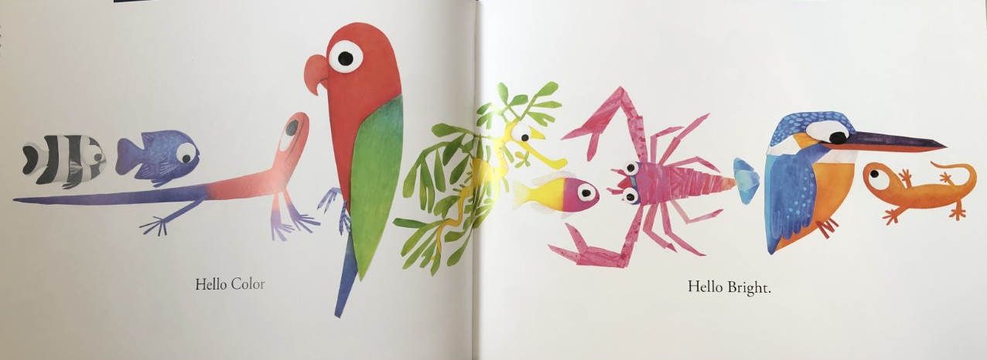

Slide 5
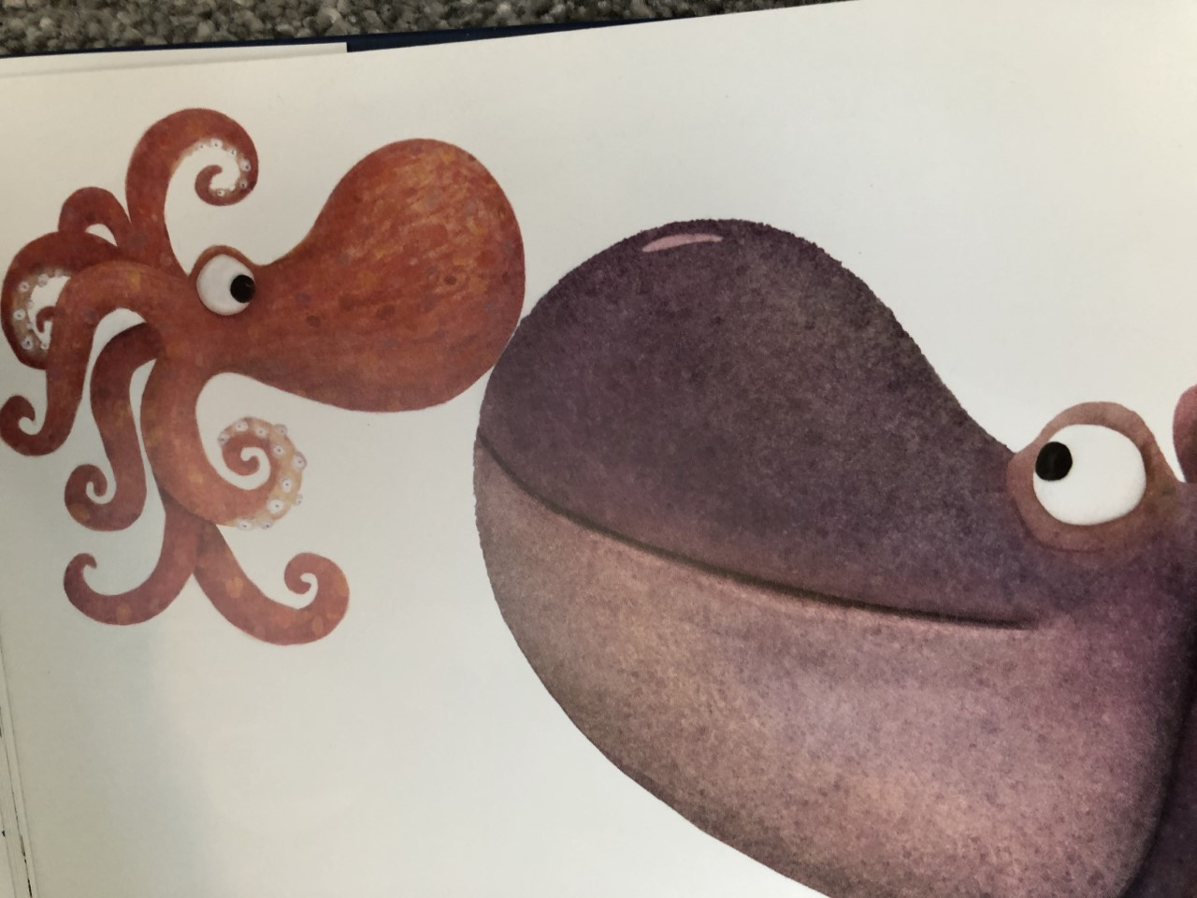
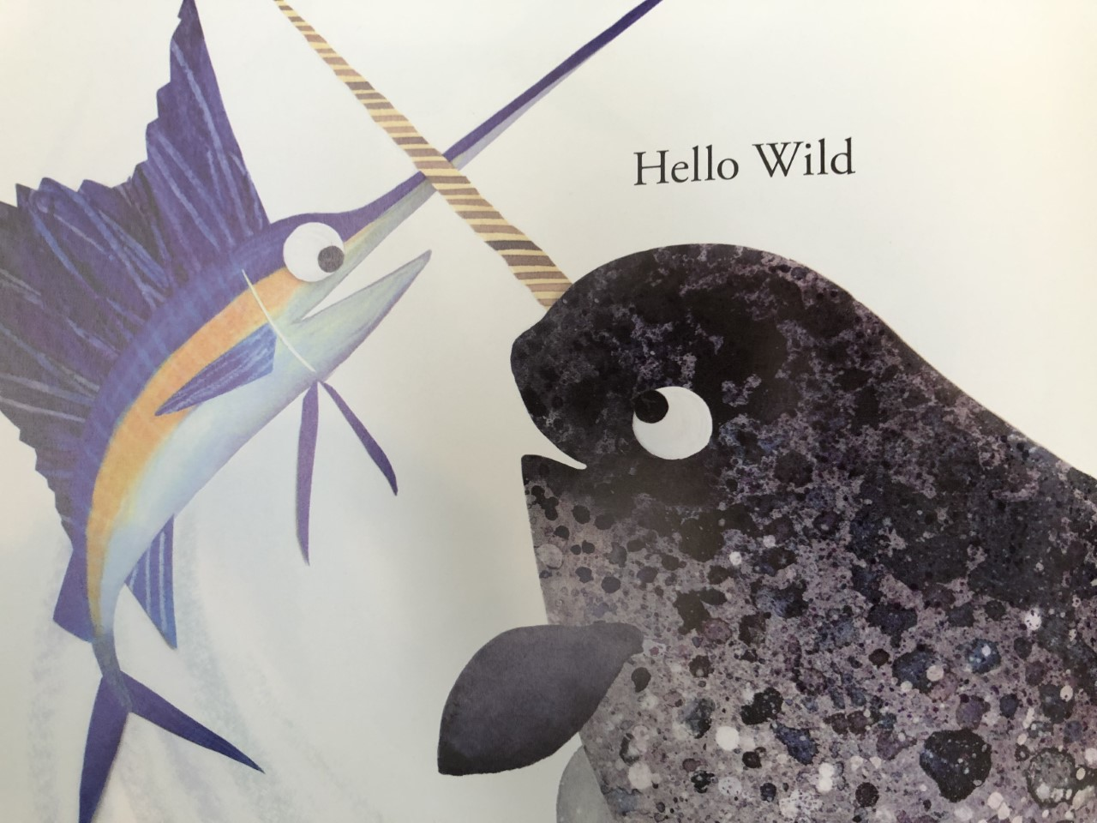
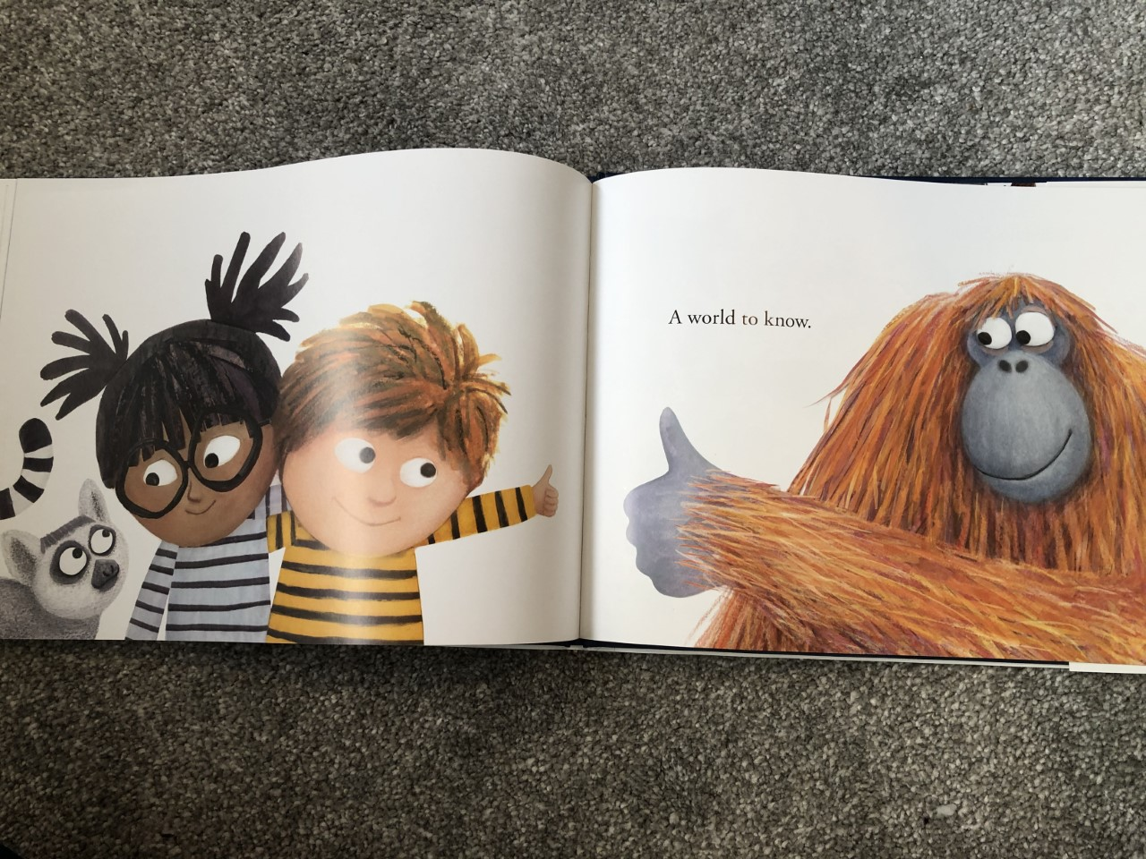

Slide 6
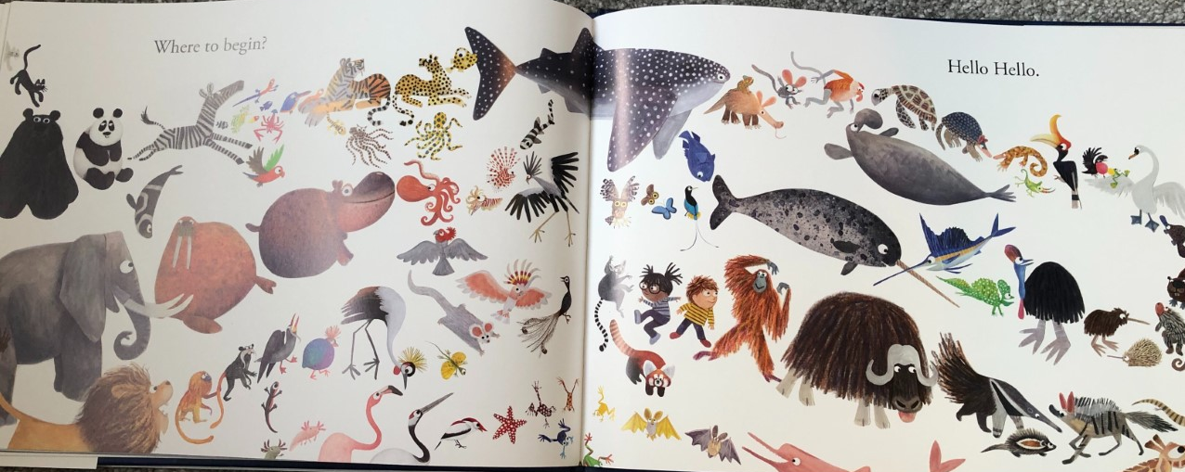

Slide 7
Ola
Hello
Good afternoon
Hi!

