Slide 1





English
Monday 25th January 2021

Slide 2
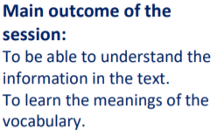

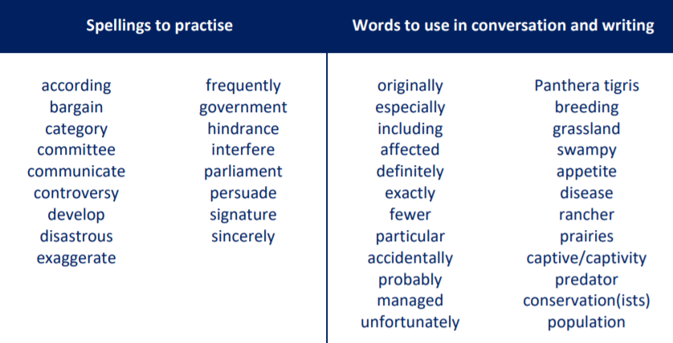
These are the spelling words that go along with this unit of work exactly like when we’re in school.

Slide 3
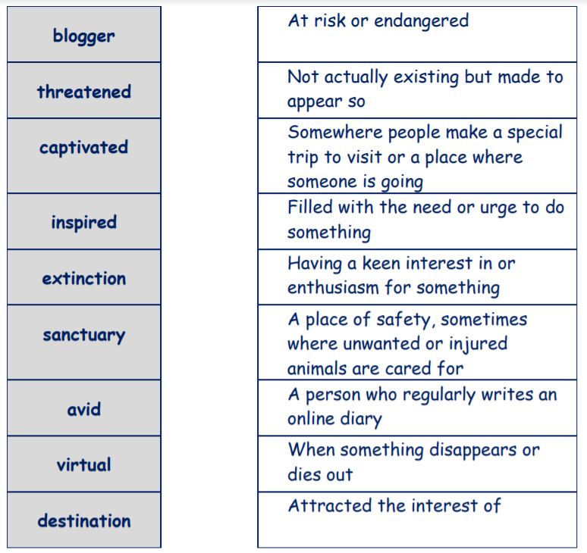
Activity 1
Have a go at matching the words to their definitions. Do the ones that you know first and then if you get stuck on words you don’t know, look them up in a dictionary or used an online dictionary such as https://www.dictionary.com/
Check your answers to the definitions – you will find them on the next slide!

Slide 4
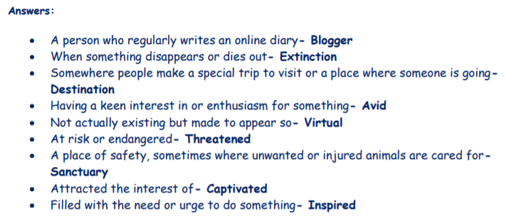

Slide 5
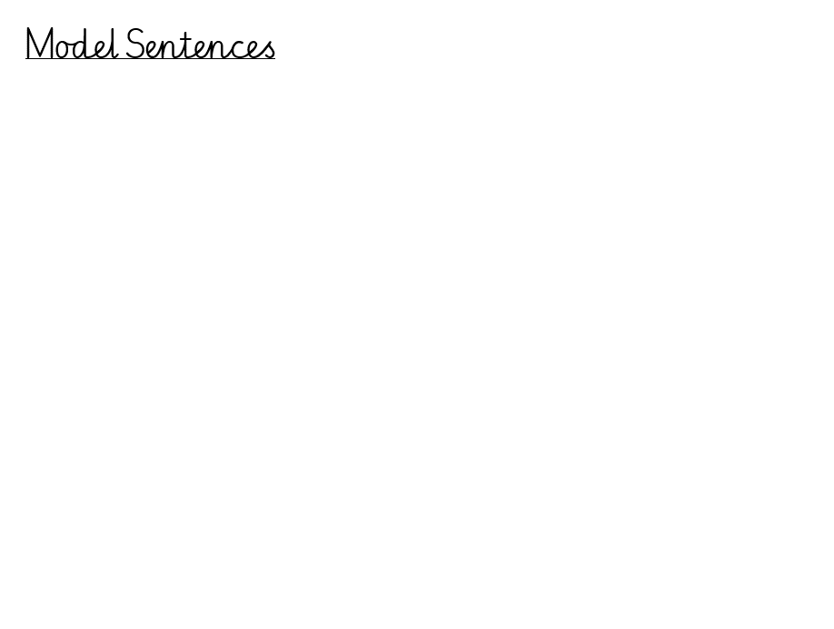
Activity 2
Write 3 sentences which include 3 of these words. You can write them about any topic.

Slide 6
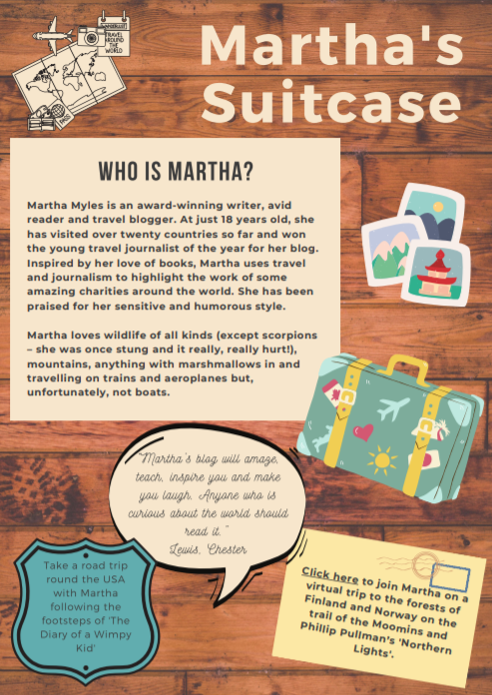
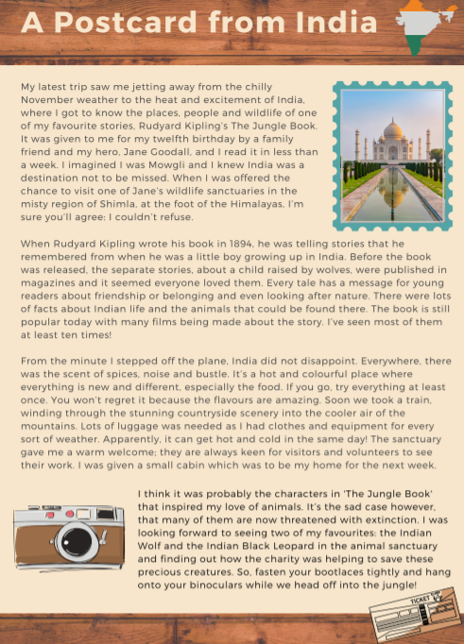
Activity 3
Read ‘Who is Martha?’ and ‘A postcard from India’.
Highlight or jot down any of the words you matched in the previous activity as you are reading the text.

